Slide 1
Guidehouse Insights on IRA Impacts in MO- C&I Perspective
Missouri Public Service Commission Virtual Workshop
May 9, 2023
Notes:
Insert image into placeholder
Font size can be adjusted to fit imagery, but subtitle font size should be larger than date
Subtitle/Description should be bold and Sapphire Blue
Date and any further details should be regular weight and black

Slide 2
Key question: How will IRA rebates and tax breaks impact the C&I sector in MO?
Multiple federal organizations may drive energy efficiency improvements in Missouri through programs in the IRA targeted at the non-residential sector. These include:
DOE Office of State and Community Energy Programs
DOE for the “Advanced Industrial Facilities Deployment Program”
USEPA for the “Funding to Address Air Pollution at Schools”
GSA for “Assistance for Federal Buildings.”
Guidehouse recommends monitoring activity through these programs in the state to understand the impact on utility attribution.
If significant activity is seen across these programs in the state, then a working group could be established to determine necessary and consistent updates to the NTG analysis methodology to include questions that address the share of attribution between utility programs and IRA funding.
Notes:
Basic text content slide – text placement may be moved and font size can be adjusted to accommodate content only if necessary.
Make sure slide title is bold and without caps.
Smaller images and graphics can be featured here – for larger images, use picture slide.

Slide 3
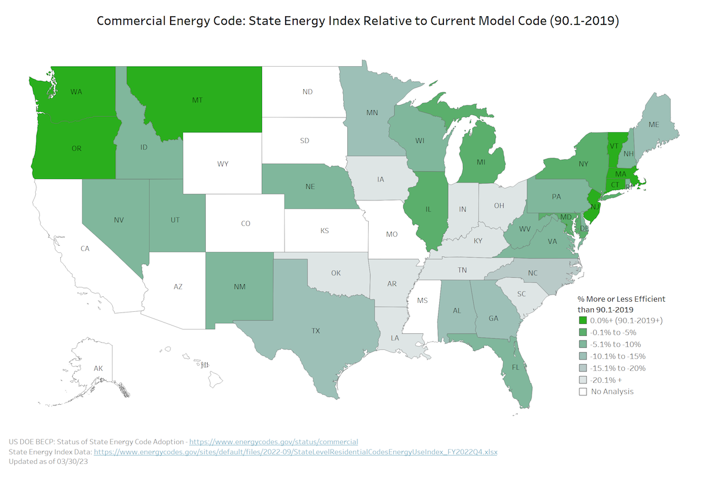
Key question: What is likely to be the biggest impact on C&I utility programs as a result of the IRA funding?
We believe that funding as part of the IRA to encourage adoption of the latest building energy codes may have the greatest impact on overall utility C&I program savings. MO does not have a statewide energy code, but some cities have moved to adopt the more recent building energy codes. If building energy code requirements were to become more stringent state-wide, opportunities for cost-effective C&I measures may decrease.
Kansas City Energy Code: In 2022, City Council approved an update to the energy code to the 2021 International Energy Conservation Code (IECC), effective July 1, 2023. In the meantime, the 2012 IECC remains in effect.

Slide 4
Key question: How were previous Federal grant/dollars considered in determining utility attribution?
We are not aware of any efforts to specifically account for Federal grant dollars in the calculation of NTG values for recent C&I program evaluations at Evergy, but do know that ARRA funding was accounted for in some states.
It could be beneficial to conduct a review of how previous attribution was handled in the era of ARRA in other states.
Also, new IRA programs targeted at non-residential customers are limited in scope and we estimate will impact a very small share of all C&I utility program activity. For example, tax credits have been available through the “179D Commercial Buildings Energy-Efficiency Tax Deduction” since January 2006 and we have continued to see NTG values greater than 80% across most program evaluation years.
Guidehouse is well-versed in incorporating multiple requirements for EM&V in our plans. It's unlikely the methods will vary significantly given IRA funding. The impact may be in the need for data tracking across different organizations. DOE Office of State and Community Energy Programs will be issuing program guidance in mid-2023. Guidehouse anticipates states will need to clarify the impact, if any, on utility EM&V.
Notes:
Basic text content slide – text placement may be moved and font size can be adjusted to accommodate content only if necessary.
Make sure slide title is bold and without caps.
Smaller images and graphics can be featured here – for larger images, use picture slide.

Slide 5
Your Guides
^{Ariel Crowley} ^{Associate Director} ^{ariel.crowley@guidehouse.com} ⁽³⁰³⁾ ⁷²⁸⁻²⁴⁹²
^{Eduardo (Ed) Balbis} ^{Partner} ^{ebalbis@guidehouse.com} ⁽³⁰⁵⁾ ³⁴¹⁻⁷⁸⁴²
Notes:
Contact slide
Keep at the end of presentation
Maintain sapphire blue headline color

