Slide 2
Missouri Integrated Resource Planning:
And the search for the “preferred plan”
Geoff Marke, Economist
Missouri Office of the Public Counsel

Slide 3
The IRP Process

Slide 4
Preferred Plan?

Slide 8
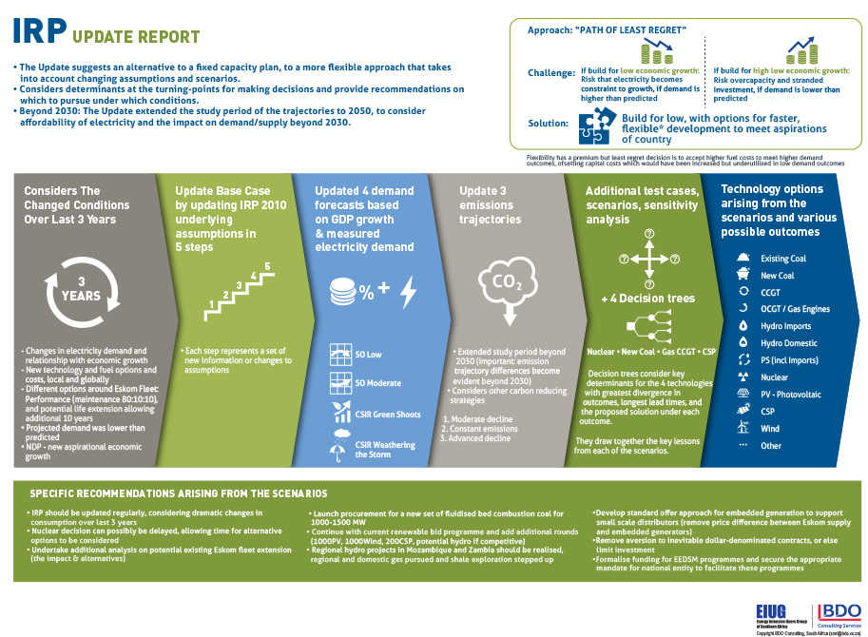

Slide 10
Missouri IRP Process
Does a good job with what it is designed to do
“Robust” Rules
Special Contemporary Topics
Annual Updates
Rinse and Repeat

Slide 11
Change?
More transparency
Expand resource modeling to a more scenario-centric modeling
Boonin, D.M. (2011) Utility Scenario Planning: “Always Acceptable” vs. the “Optimal” Solution. National Regulatory Research Institute.

Slide 12
House buying
An illustrative example of the tension between resource planning and scenario planning

Slide 13
Resource Planning
Appreciation trends
Maintenance costs
Demographics
Economic trends (rent or own)
Tax structure
Least cost three bedroom house based on present-view of the future

Slide 14
Scenario Planning
Lots of children
No children
Pets
Spouse becomes infirm
Need to house an elderly parent
Employment at home or across town
Neighbors
Rent or own

Slide 15
Pesky Variables
Legislation
Interdependence on other states
Generation change in markets
Unpredictable weather
The economy
Load Growth
Compliance Costs
Path Dependent Decisions (aka potential stranded assets)

Slide 16
Final Thoughts
Fairness and Valuation?
DOE NOPR: Baseload Valuation
PJM, New England and California
Community Choice Aggregation (“CCA”)
Demand Response: IRP? MEEIA? Other?
NY REV – “regulatory moratorium”
Regulatory resources and bandwidth?
What about costs?

Slide 17
Questions
Geoff Marke, Economist
Missouri Office of the Public Counsel
Geoff.marke@ded.mo.gov
573-751-5563

