Slide 1
Combined Heat and Power (CHP) and the Clean Power Plan
Dan York, Fellow
Meegan Kelly, Industrial Research Analyst
ACEEE
Presented to:
Missouri Statewide Collaborative
October 21, 2014

Slide 2
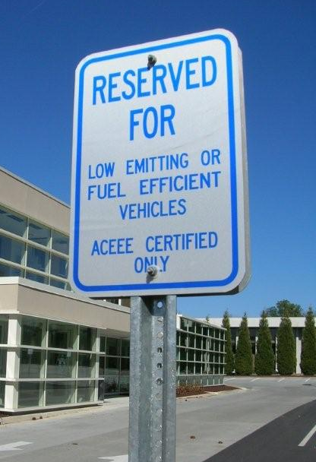
The American Council for an Energy-Efficient Economy (ACEEE)
ACEEE is a 501(c)(3) nonprofit that acts as a catalyst to advance energy efficiency policies, programs, technologies, investments, & behaviors
50 staff; headquarters in Washington, D.C.
Focus on end-use efficiency in industry, buildings, & transportation
Other research in economic analysis; behavior; energy efficiency programs; & national, state, & local policy
Funding:
Foundation Grants (52%)
Contract Work & Gov’t. Grants (20%)
Conferences & Publications (20%)
Contributions & Other (8%)
www.aceee.org/@ACEEEdc

Slide 3
Overview
CHP as a 111(d) compliance strategy
National level findings on CHP in 111(d)
What does this mean for Missouri?
State-level CHP policy considerations
Notes:
Meegan to do 1 & 2 and Dan to do 3 & 4

Slide 4
What is Combined Heat and Power?
CHP is the simultaneous production of electricity and useful thermal energy in a single integrated system.
Not a technology, but an approach to applying technologies.
Heat that is normally wasted in power generation is recovered as useful energy, making CHP highly efficient.

Slide 5
CHP as a 111(d) compliance strategy
CHP is an end-use energy efficiency measure, but EPA did not include CHP in the target
States can include any mix of strategies to achieve targets.
CHP is a low-cost compliance option that offers a LOT of flexibility for states.
State Compliance Plans
?
?
?
?
EPA
1
2
3
4

Slide 6
Proposed emissions standards in the Midwest

Slide 7
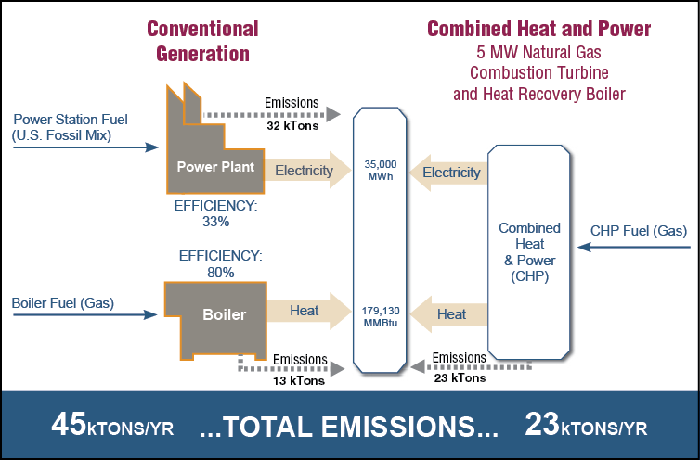
How does CHP reduce emissions?
Source: EPA CHP Partnership

Slide 8
CHP is a good emission reduction strategy for 111(d) because…
CHP provides cost-effective energy savings and emissions reductions
The technology is proven and well-established
CHP potential exists in every state

Slide 9
1. CHP is cost-effective
ECONOMIC
BENEFIT TO CUSTOMER
ECONOMIC
BENEFIT TO UTILITY
Operating savings
Hedge against cost of grid electricity
Multiple revenue streams possible
Grid reliability and resiliency
Reduced strain on T&D Low-cost emissions reductions for environmental compliance

Slide 10
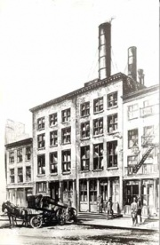
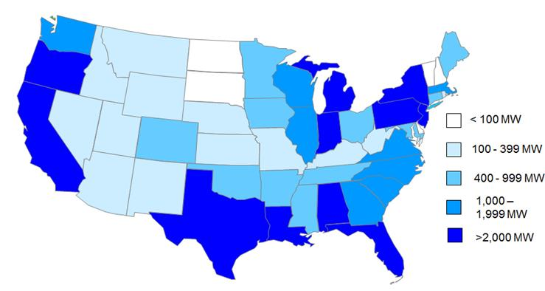
2. CHP is proven & well-established
More than 4,100 facilities
82 GW installed US capacity
12% of total electricity generated
Existing US Installed CHP Capacity
Edison Electric Light Pearl Street Plant, NYC 1882
Source: ICF International and American Gas Association (ICF CHP Installation Database, 2012)

Slide 11
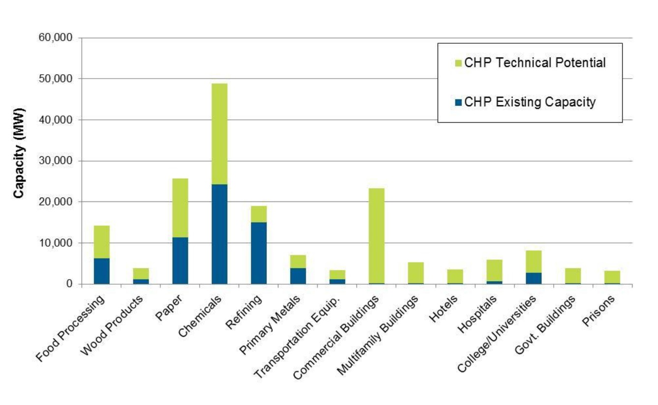
3. CHP is readily available
Recent ICF estimate of technical potential…
56 GW additional industrial CHP potential
69 GW additional commercial CHP potential
125 GW of additional capacity
Source: ICF International

Slide 12
Change is in the Air Report
What We Did
Top down policy analysis of EE potential in all 50 states
Our approach evaluated 4 common EE opportunities available to states
To find out…
Electricity savings available from proven, in-practice technologies and policies
Cost, economic impact, jobs and pollution

Slide 13
Energy savings potential from CHP in 2030
 | Annual electricity savings (MWh) | Cumulative electricity savings (MWh) | Avoided capacity (GW) | Percent avoided electricity consumption relative to 2012
Energy savings target | 692,200,000 | 5,470,500,000 | 185 | 18.8%
Building codes | 155,400,000 | 1,100,100,000 | 41 | 4.2%
Combined heat and power | 68,300,000 | 564,500,000 | 18 | 1.9%
Equipment standards | 9,400,000 | 112,100,000 | 3 | 0.3%
National total for all four policies | 925,400,000 | 7,247,200,000 | 247 | 25.1%
Source: Hayes, S. et al. 2014. Change Is in the Air: How States Can Harness Energy Efficiency to Strengthen the Economy and Reduce Pollution. Washington, D.C.: American Council for an Energy-Efficient Economy. http://aceee.org/research-report/e1401

Slide 14
Missouri Energy Savings by Policy in 2030
Policy | Annual energy savings (MWh) | Cumulative energy savings (MWh)
Energy savings target | 14,392,000 | 111,299,000
Building codes | 2,801,000 | 18,955,000
Combined heat and power | 179,000 | 1,519,000
Equipment standards | 183,000 | 2,177,000
Source: Hayes, S. et al. 2014. Change Is in the Air: How States Can Harness Energy Efficiency to Strengthen the Economy and Reduce Pollution. Washington, D.C.: American Council for an Energy-Efficient Economy. http://aceee.org/research-report/e1401

Slide 15
Missouri Carbon Emissions Reductions (from all 4 policies)
Estimated emissions impacts of efficiency policies in Missouri (tons) Pollutant
 | 2020 | 2030
SO2 | 6,000 | 23,000
NOx | 4,000 | 14,000
CO2 | 4,000,000 | 15,000,000
Source: Hayes, S. et al. 2014. Change Is in the Air: How States Can Harness Energy Efficiency to Strengthen the Economy and Reduce Pollution. Washington, D.C.: American Council for an Energy-Efficient Economy. http://aceee.org/research-report/e1401

Slide 16
How far can energy efficiency go in the Midwest?
* Percent of total goal met with energy efficiency

Slide 17
So what does this mean for Missouri?
Including energy efficiency and CHP will result in the lowest compliance costs
CHP can increase competitiveness and provide a revenue stream for Missouri manufacturers
Now is the time to begin planning and to consider policies that support CHP

Slide 18
Expanding CHP in Missouri: ACEEE policy recommendations (as per State Scorecard)
Interconnection Standards
Model: Interconnection standards in place based on NARUC guidelines; applicable to small and large systems, all types of fuels
Existing in MO: has a standard, capacity limit of 100 kW and only for renewable systems
CHP in Clean Energy Standards
Model: EERS and RPS in place; CHP eligible
Existing in MO: No EERS; RPS in place but does not recognize CHP

Slide 19
Financing Assistance
Model: Available specifically for CHP, apply to all forms/fuels, and offer at least $1 million/project
Existing in MO: Energy Loan Program provides low-interest loans to hospitals, schools, etc. for EE projects; CHP is eligible
Financial Incentives for CHP
Model: Provide incentives or grants for CHP
Existing in MO: No incentives or grants for CHP
Revenue Streams
Model: Net metering/feed-in tariffs applicable to CHP based on fossil fuel (natural gas) and renewable fuel
Existing in MO: Net metering in place for distributed generation, but only systems 100 kW or less and only renewable-fueled systems

Slide 20
Output-based Emissions Regulations
Model: Rule in place for granting permits for major air pollutants based on output based emissions
Existing in MO: No output-based regulations
Additional Supportive Policies for Advancing CHP
Dedicated CHP-focused technical assistance
Utility rate structures actively designed to encourage CHP investment
Requirement that public/critical facilities consider CHP for new construction or major upgrades

Slide 21
Leading state CHP policies:
Connecticut: Strong CHP policy environment including tiered interconnection standards, incentives and financing, etc. 10 new CHP systems installed in 2013.
Texas: In 2013, HB 2049 amended the state utility code to make it simpler for CHP operators to sell excess power, and make investment in CHP more attractive.
New Jersey: After Hurricane Sandy, the state has prioritized CHP for protecting against future extreme weather events critical facilities that need power and
Notes:
ACEEE’s State Scorecard provides examples of best practices.
Connecticut -- Ranked #2 in the CHP section of the 2013 State Scorecard (MA is #1)
The state has pursued a variety of policies to encourage CHP development:
including establishing interconnection standards (for CHP, there are 3 tiers based on system size, which allows fast-tracking for smaller, less complex systems → lowers costs
instituting incentive and financing programs,
and including CHP as an eligible resource within the state's RPS and EERS.
The Department of Energy and Environmental Protection (DEEP) is also developing the CHP Pilot Program to promote large CHP systems by limiting the demand charge electric companies impose on them.
Ten new CHP systems came online in Connecticut in 2013, which is a good indicator of the healthy policy landscape here.
Texas
-- HB 3268 directed the states’ Commission on Environmental Quality to develop a streamlined permitting process for CHP systems, which they established as a rule in July 2012.
-- New process should reduce permitting time from 1+ years to 4-6 weeks and be less financially burdensome.
-- Permits requires the use of output-based emissions calculations, which explicitly recognize the efficiency benefits of CHP.
-- Emerging issue: Texas is one of several states where savings from CHP can count towards meeting state EERS goals

Slide 22
Good in-state CHP installation:
Location: University of Missouri
Size: 66 MW CHP Plant
Fuel: coal, natural gas, biomass, tire derived fuel, fuel oil.
Efficiency: 76%
Savings: Requires 38 percent less fuel and reduces CO2 emissions 107,000 tons per year
Recipient of EPA ENERGY STAR CHP award in 2010
Source: EPA, http://www.epa.gov/chp/documents/past_award_winners.pdf; University of Missouri Sustainability Office
Notes:
Universities make energy investments because they are smart long-term projects that they know will benefit them and their students in the long run.
Many manufacturers and potential CHP users are overly focused on short-term gain, and when we talk 111d, we need to be talking long term, in terms of what our energy supply will look like in 10, 20 years.
Universities and hospitals are benefitting from this long-term thinking and more MO businesses can catch on.
The University of Missouri has been producing energy for its Columbia campus using various forms of combined heat and power since 1892.
417 South Fifth Street Columbia, MO 65211

Slide 23
Missouri CHP Installations
City | Organization Name | Facility Name | Capacity (kw) | Fuel Type
Butler | City of Butler | Butler | 13,100 | OIL
Cape Girardeau | Southeast Missouri State University | Southeast Missouri State University | 6,250 | COAL
Columbia | University Of Missouri | University Of Missouri Power Plant | 83,500 | COAL
Florissant | Service Merchandise Company, Inc | Service Merchandise Company, Inc | 60 | NG
Hannibal | Overland Energy Corporation | Clemmons Hotel | 150 | NG
Jefferson City | Jefferson City Sanitary Landfill | Jefferson City Correction Center | 3,200 | BIOMASS
Kansas City | Veolia Energy | Veolia Energy Kansas City | 5,000 | BIOMASS
Kansas City | Trigen Energy Corp | Trigen-Kansas City Energy Corporation | 6,000 | COAL
Kansas City | Bolling GSA office | Bolling GSA office | 100 | WAST
Laddonia | POET Biorefining - Laddonia | POET Biorefining - Missouri Ethanol | 10,700 | NG
Lewistown | Lewistown School District | Lewistown School District | 60 | NG
Louisiana | Missouri Chemical | Hercules, Inc. | 15,000 | COAL
Macon | Northeast Missouri Grain LLC / City of Macon | Northeast Missouri Grain | 10,000 | NG
Mountain View | Smith Flooring, Inc. | Smith Flooring, Inc. | 500 | WOOD
Neosho | La-Z-Boy Chair Company, Inc. | La-Z-Boy Chair Company | 750 | WOOD
North Kansas City | Archer Daniels Midland Company | North Kansas City | 4,000 | NG
St Louis | Southwestern Bell Telephone Co | Southwestern Bell Telephone | 6,000 | OIL
St. Louis | Anheuser-Busch | Anheuser-Busch | 26,100 | COAL
St. Louis | Missouri State Hospital | Missouri State Hospital | 5,000 | COAL
St. Louis | Veolia Energy | Ashley Plant | 36,450 | NG
St. Louis | Nooney Management | Laclede Gas Building | 4,300 | NG
Number of CHP sites: 21
Installed capacity: 236,220 kW
Largest site: University of Missouri Power Plant
One new installation in 2013
Source: ICF CHP Database

Slide 24
Technical Potential for CHP in Missouri
Size of Facility | 50-1000 kW (MW) | 1-5 MW (MW) | 5-20 MW (MW) | 20-50 MW (MW) | 50-100 MW (MW) | Total (MW)
Industrial | 224 | 362 | 276 | 233 | 51 | 1,147
Commercial | 779 | 333 | 180 | 117 | 0 | 1408
Total | 1,003 | 695 | 456 | 350 | 51 | 2,555
Source: ICF International and American Gas Association
Existing MO installed CHP capacity: 236 MW (21 installations)
MO technical potential for CHP: 2,555 MW
Notes:
If MO implements some of these policies that encourage CHP, it can begin to tap into all of this technical potential for CHP that exists in MO.
ICF conducted the most recent CHP potential study in 2013 for the American Gas Association and found about 2.5 GW of technical potential.
(The potential for CHP ACEEE reported in its study, remember, was just a subset of the economic potential, so much smaller).
There are many states like MO with zero or very few installations, with very poor policies in place.
Even in places with strong manufacturing bases, impending coal shut-downs, etc., the potential to do CHP has not been taken advantage of.
Good policies would really be impactful, because there is a lot of technical potential that hasn’t been taken advantage of over many years.
Within the new air quality policy and regulatory framework, the right policies in place at the state level could really help boost the CHP markets in these states.

Slide 25
Regulatory Actions to Encourage CHP Ownership by Utilities
Develop a method to calculate energy savings from CHP that recognizes system benefits
Set the groundwork for calculating avoided emissions for 111(d) compliance
Give CHP equal value in resource planning
Address state-specific regulatory barriers to greater utility ownership of CHP
Expand the project deployment time limit in energy efficiency programs

Slide 26
Utility Actions to Encourage CHP
Plan to include CHP
Conduct feasibility assessments
Include CHP in resource planning
Pilot CHP projects
Experiment with ability to dispatch
Measure and monitor all system benefits
Screen and approve developers
Identify best customers & locations

Slide 27
Resources
Change is in the Air Report: http://aceee.org/research-report/e1401
ACEEE’s 111(d) web page: http://aceee.org/topics/section-111d-clean-air-act (includes our 50-state report)
NASEO/ACEEE joint hub on 111(d) for states: http://111d.naseo.org/
ACEEE State Scorecard: http://database.aceee.org/
Policies and Resources for CHP Deployment: http://aceee.org/sector/state-policy/toolkit/chp

Slide 28
Thank you!
Dan York, Fellow
dwyork@aceee.org
608-243-1123
Meegan Kelly, Research Analyst
mkelly@aceee.org
202-507-4008

