Slide 1

IRA Home Energy Rebates

Slide 2
Today’s Discussion
What is SCEP?
What are the IRA Home Rebate Programs?
Timeline and Next steps
Key Issues and Discussion

Slide 3



Slide 4

Office of State and Community Energy Programs (SCEP)
Created to implement nearly $16 billion in programs
Bipartisan Infrastructure Law (BIL) Inflation Reduction Act (IRA)
Notes:
SCEP works to –
Accelerate high-impact, self-sustaining clean energy projects that improve people’s lives
Aid state & local governments, tribes, community-based organizations, & others in deployment
Center the needs of low-income households and Disadvantaged Communities (DACs)

Slide 5


Programs Coming Out of SCEP
$3.5B for
Weatherization Assistance Program
$260M for Building Efficiency Workforce Training
$750M for
State Energy Program & Revolving Loan Fund
$500M for
Energy Efficiency & Renewable Energy in Public Schools
$100M for
Energy
Future
Grants
$50M for Energy Efficiency for Non-Profits
$550M for
Energy Efficiency & Conservation Block Grants
$1B for
Energy Codes Technical Assistance
$8.8B for Home Energy Rebates

Slide 6

Home Energy Rebate Provisions
These Funds Are Not Yet Available.
Home Energy Rebates
$8.8 Billion
September 30, 2031
State Energy Offices & Indian Tribes
Home Efficiency Rebates
(HOMES)
$4.3 Billion
Whole-home retrofits
Home Electrification and Appliance Rebates
(HEAR)
$4.5 Billion
Efficient Electric Installations
Low-moderate income qualified

Slide 7

Home Efficiency Rebates
The Fine Print
Modeled
Measured
Calibrated to historical energy use
Consistent with BPI 2400
Minimum 20% Energy Savings
“Pay for Performance”
Minimum 15% Energy Savings
Home or portfolio of homes
Electrification
Income verification at point of sale
Energy Star minimum
Rebates up to $8,000
$14,000 Cap

Slide 8
Cross Provision Details
The Fine Print
Single Family and Multi Family
Payments double for Low and moderate Income
Low Income – less than 80% Area Median Income
Moderate Income – 80-105% Area Median Income
Prohibition on Combining Rebates
DOE Data Sharing Guidelines

Slide 9
Estimated DOE Guidance Rollout
Admin Funds
Issued
RFI
Issued
Program Requirements Released
State Program Development (and rollout?)
RFI Responses
Received
Jan
Feb
Mar
Apr
May
June
July
Aug
Sept
Oct
Nov
Dec

Slide 10
Hot Topics
Equitable Program Design
Eligible Technologies
Data Access and Sharing
Estimating & Measuring Energy Savings
Existing Program Integration
Income Verification
Tools and Resources

Slide 11

Let’s Talk

Slide 12
A Deeper Dive
Income Verification
  DOE centralized tool?
  How to efficiently verify income for 80-150%?
Self attestation
  Benefits and Risks?
Program integration
  How are states/utilities/implementers coordinating?
  What are keys successful integration?
  How do we create a positive customer experience?
Modeled Programs
  BPI2400 compliant?
  How can we achieve higher program realization rates?
  What homes achieves 20% savings?
Measured Programs
  What programs exist?
  What are lessons learned to program design?
Opportunities and Risks
  What should DOE know from stakeholders?

Slide 13
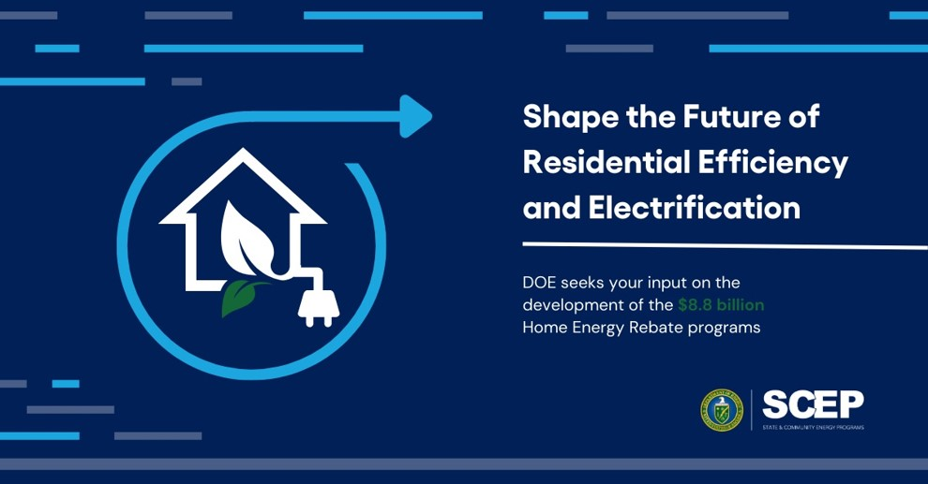
Stay Connected
Stay up to date by visiting our Home Energy Rebate Website: https://www.energy.gov/scep/home-energy-rebate-program.
Contact us at IRAHomeRebates@hq.doe.gov
Danielle.walker@hq.doe.gov

