Slide 1
Poverty in Missouri
2015
Notes:
Add new logo

Slide 2




The National Community Action Network
A network of over 1,000 Community Action Agencies
Region VII
(Missouri, Iowa, Kansas, & Nebraska)
National Partners
The Missouri Association for
Community Action

Slide 3
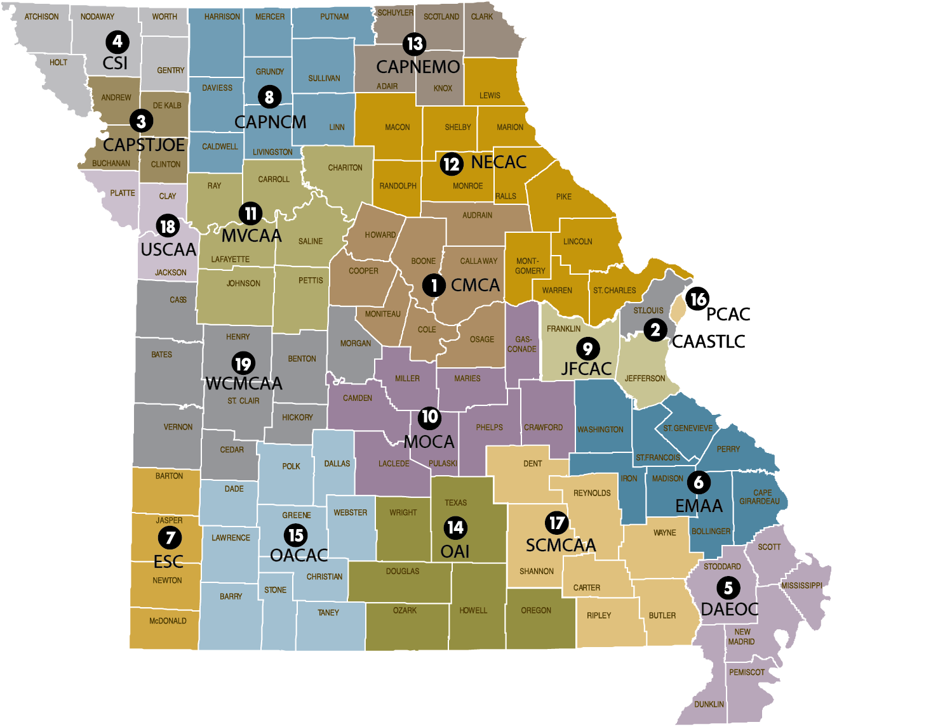
Missouri’s Community Action Network
About 3,000 employees work in these 19 agencies serving the poor and their communities.
For every dollar of Community Services Block Grant funding Missouri received…$14.04 was leveraged from federal, state, local, and private sources.
The Community Action Network provided services to 225,569 low income individuals in FFY 2013.
19 Community Action Agencies, 36 associate & business members and 1,300 individual members statewide!
Notes:
19 Agencies
Every County in Missouri and the City of St. Louis
3,000 Staff

Slide 4
General Role of Community Action Agencies
State Association
Local Community Action Agency
Advocacy
Education
Poverty Simulations
Training/Technical Assistance
Direct Services
Emergency/Crisis Intervention
Community Needs Assessment
Community Engagement
Most importantly, Community Action Agencies are mandated by the Community Services Block Grant to act as catalysts in the community for the express purpose of impacting the causes and conditions of poverty.
Notes:
The state association office handles the things you see on this slide. Advocacy, Education, Training and Technical Assistance.
In contrast, the 19 local Community Action Agencies in Missouri and those that exist in the other states provide a variety of services to individuals, children and families who are living in poverty. The best part of how Community Action works? It’s local. Services provided by agencies will vary by agency since they are determined based upon local needs assessments.
For example, in the Community of Spanish Lake in north St. Louis there was a “food desert”. Families had to travel miles away to get to a grocery store and the only local food options were convenience stores and fast food outlets. The Community Action Agency of St. Louis County developed a Community Supported Agriculture project which started as a community garden and now makes it possible for individuals in this community to access high quality fresh produce. This is just one example of hundreds of local projects that communities have developed to mitigate the effects of poverty.

Slide 5
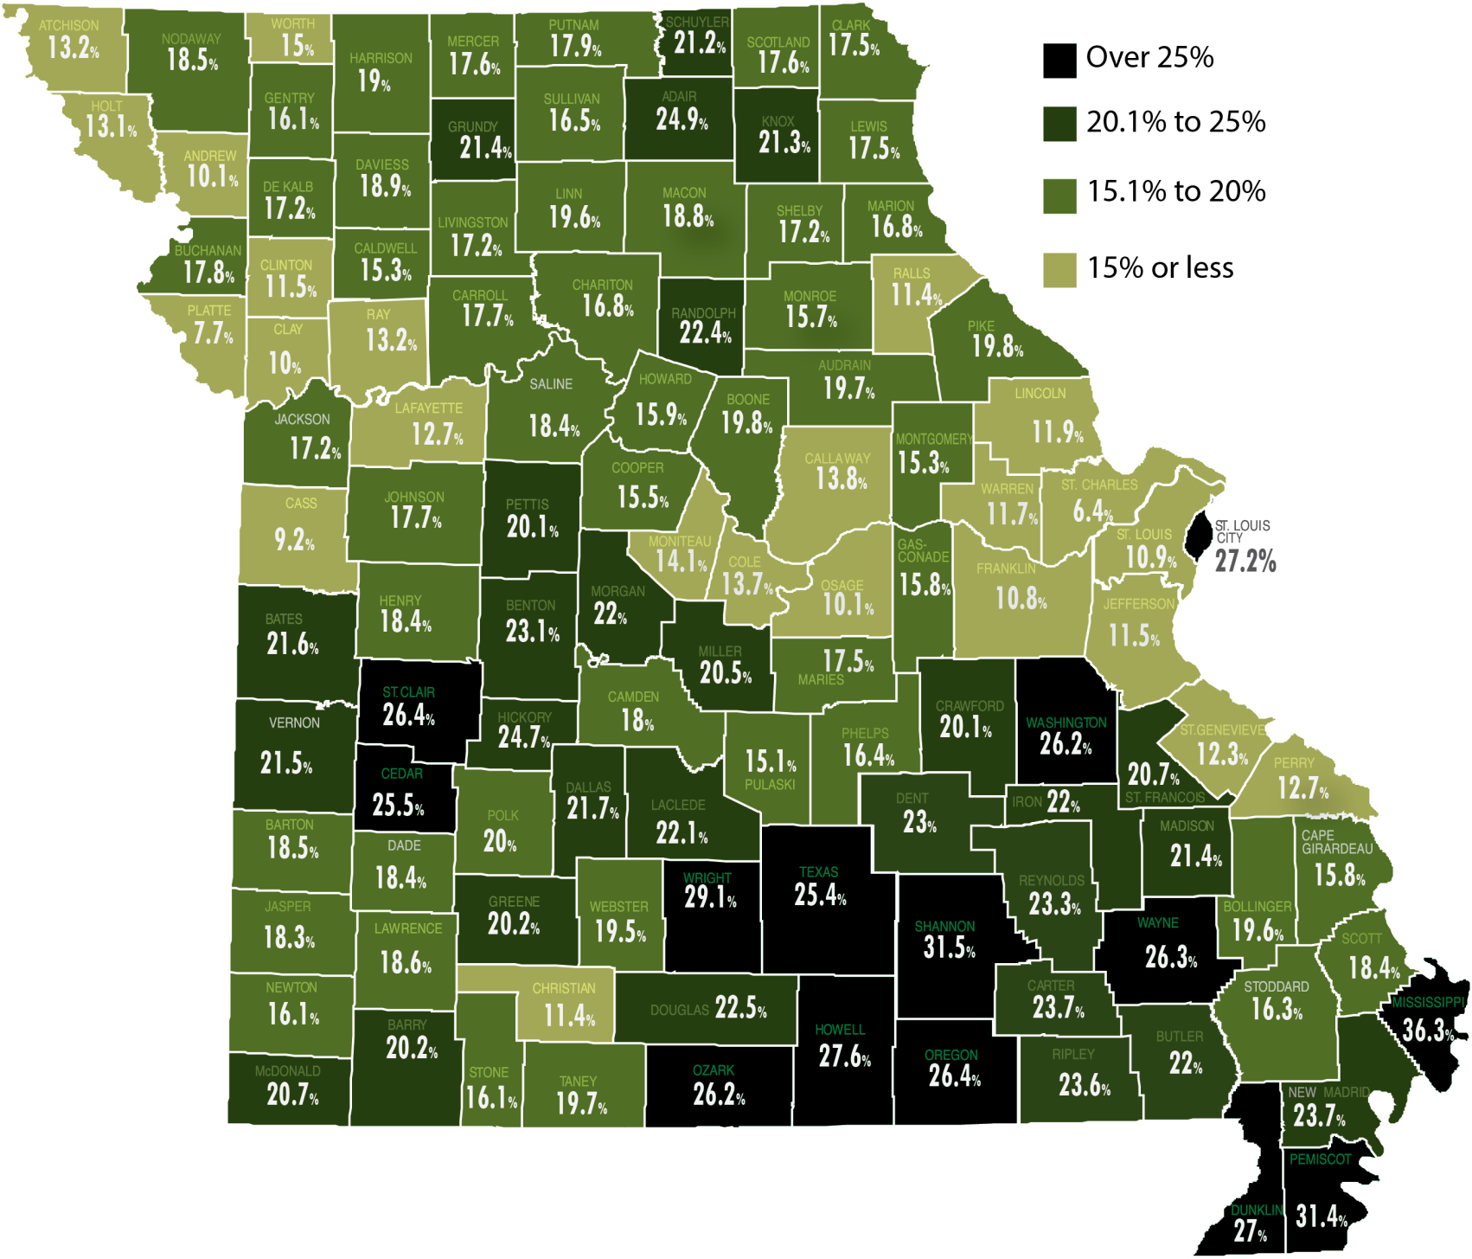
Missouri Poverty Rates
Vision
A state where all
people and communities
thrive
Mission
To advocate for
low-income Missourians
and strengthen the
Community Action Network
2014 Small Area Income & Poverty Estimates – US Census
Notes:
So, how is poverty defined in the United States today? Poverty is defined by income. Anyone living below the federal poverty rate of around $11,000 for an individual and $23,550 for a family of four, is defined as living in poverty. However, there are some problems with this measure. First of all, it was developed in 1963 by Mollie Orshansky. The basis of her idea was to use the cost of a nutritionally adequate diet as the basis for a cost-of-living estimate and to calculate a cost of living for families of different sizes and composition. In the 1960s, food made up approximately 1/3 of a family’s budget. Today, we spend approximately 6%. In contrast, other household expenses such as health care, child care and energy costs have risen considerably.
Arkansas 19.8
Illinois 14.7
Iowa 12.7
Kansas 14
Louisiana 19.9
Missouri 16.2
Nebraska 13
Oklahoma 17.2
Texas 17.9

Slide 6
Food
Family & Economic Security
Housing & Energy
Health
Education
5 Key Elements of Poverty
Thriving
Families
Notes:
When thinking of poverty, we focus on five elements of poverty:
Food, Family & Economic Security, Housing & Energy, Health, and Education. As you saw in the film, poverty is not just one issue, there are multiple barriers that keep people in poverty.

Slide 7


Housing &
Energy
10,237 Missourians are homeless
1 out of every 7 households pays more than 30% of income on housing expenses
In Missouri, in order to afford the Fair Market Rent set by Housing and Urban Development (HUD) on a 2 bedroom apartment - a person must earn at least $14.31 per hour working full time
24%
Is the percentage families earning between $10-$30K spend on energy after taxes.
Families making over $50K spend only 9% on average.
Notes:
^{Energy}
On average, low-income households spend 14% of their annual income just on energy costs, whereas middle and higher income families usually pay only 3-6%. This means low-income families often cut back on other necessities, such as prescription medication and food, in order to pay their energy bills. The higher consumption often results from housing stock that lacks insulation or other efficiency measures, and older appliances in the home.
^{Housing}
Housing is considered affordable if it equals 30% of a family’s income. Between housing and energy (assuming the housing is “affordable”) low income families face a housing and energy cost of 44% of their annual income just for those two expenses. Across the 9 states highlighted in this presentation, over 3.4 million are paying more than 30% on housing.
Substandard housing is yet another barrier that low income families face and one that drastically affects a family’s quality of life. (Substandard housing refers to any housing that does not meet the local minimum health and safety requirements.) One out of every three people living in severely substandard housing is a child.
Recently, the National Low Income Housing Coalition released a report called “Healthy Homes”, which found that substandard housing contributes significantly to the health issues faced by many low income children. Studies show that children who have secure, affordable housing are far more likely to stay in school and succeed socially, and their parents are far more likely to keep their jobs and maintain a family income

Slide 8
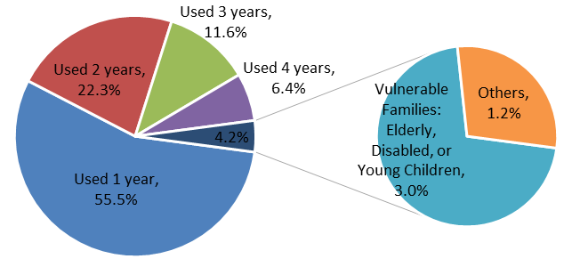
MO Energy Crisis Intervention Program Five-Year recipient data

Slide 9
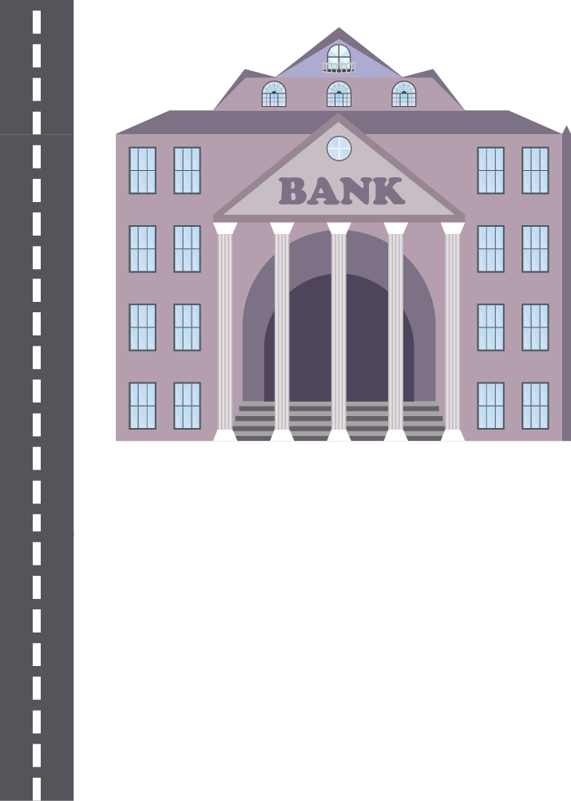
Family & Economic Security
29.5%
Although over 908,628 people in the state are below the federal poverty line...only 89,033 adults and children receive Temporary Assistance for Needy Families (TANF).
The 2015 federal poverty rate is $11,670 for an individual or $24,250 for a family of 4.
Almost a third of all jobs in Missouri are considered “low wage” meaning that they pay less than 100% of the federal poverty line
Notes:
In the United States, we have an unconscious bias toward what we could call the deserving and the undeserving poor. Kathleen Geier wrote in the blog “Political Animal” - You don’t become poor because you’re a terrible person or a defective human being. People are poor because of the way our economy and our society is arranged. As Mark Rank has written, “American poverty is largely the result of structural, rather than individual, failings. There simply are not enough viable opportunities for all Americans.” For example, compared to other rich nations, the U.S. has what is by far the highest proportion of its workers in low-wage jobs. Yet as hard as they work, those workers have found it impossible to work themselves out of poverty. An excellent book that demonstrates how hard living is when working at low wage jobs is “Nickeled and Dimed, On NOT getting by in America” by Barbara Ehrenreich.
Percentage of Jobs that are “Low- Wage” and percentage of low income families that work.
Arkansas 31.9 41.8
Illinois 19 30.4
Iowa 23.6 28.8
Kansas 23 32
Louisiana 31.4 36.3
Missouri 25.1 32.7
Nebraska 25.1 31.1
Oklahoma 31.9 37.4
Texas 27.8 38.3

Slide 10
Poverty Impacts
Families
ENTIRE
COMMUNITIES
Individuals
Overall Health
  Obesity
  Heart Disease / Hypertension
  Osteoporosis
  Diabetes
Life Expectancy
Brain Development
  Social and Educational Skills in Children
Notes:
According to a 2011 report from the U.S. Senate Committee on Health, Education, Labor & Pensions: Is Poverty A Death Sentence? The Human Cost of Socioeconomic Disparities, rates of poor or fair health are seven times higher among children of low-income families than their higher earning counterparts.
This report also states the lowest-earning and least-educated individuals often suffer from the worst health; meanwhile, those in the highest income group live, on average, six and a half years longer than people living in poverty. When a family moves out of poverty and closer to self-sufficiency, their health improves. With adequate health insurance, people live longer lives, are diagnosed and treated sooner, and have healthier children.

Slide 11

Thank you.
For more information visit us on the web
www.CommunityAction.org

