Slide 1
Measured Program Models:
Bridging the Gap Between
M&V and Implementation
Carmen Best
carmen@recurve.com
Ted Thomas
ted.thomas@energizestrategies.com
Missouri - May 9, 2023

Slide 2
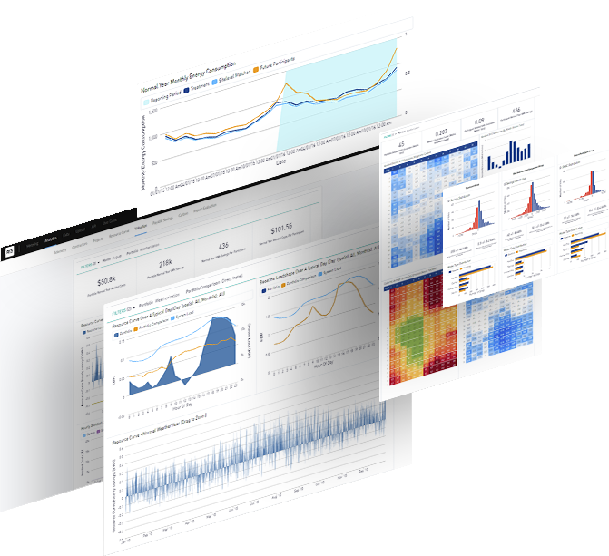
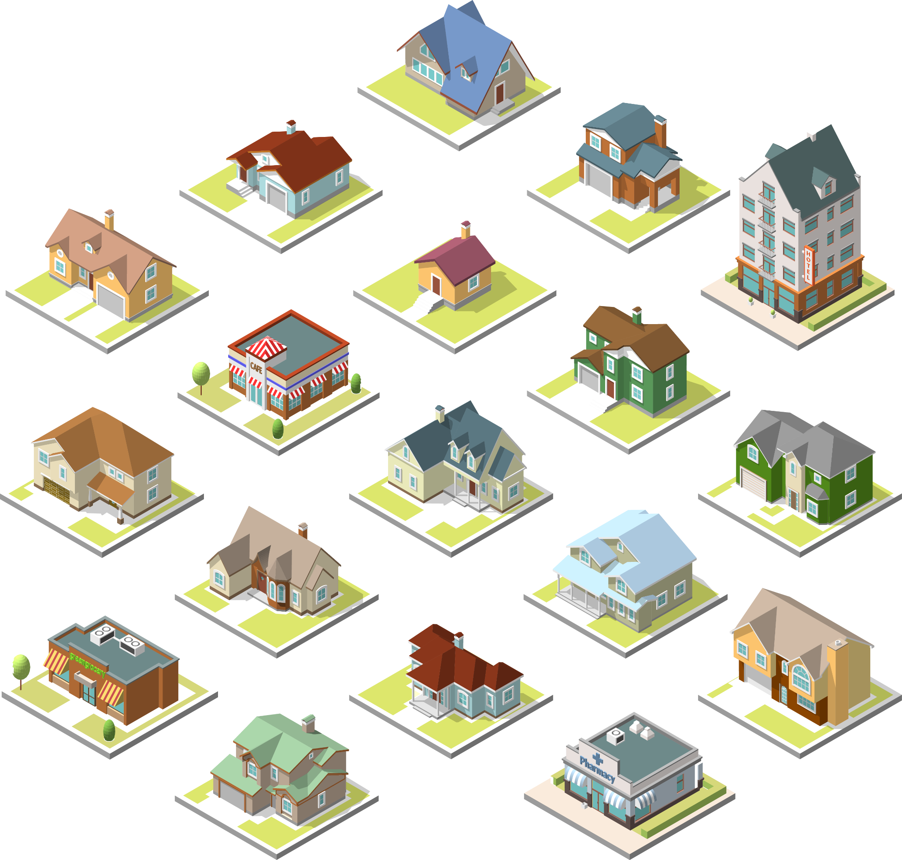
What Does Recurve Do?
Recurve is a SaaS and Transaction Platform
1.
Demand Flexibility
Analytics Platform
2.
Market for Virtual Power Plants
200,000 kWh
5,000 therms
$148,000
550,000 kWh
7,000 therms
$457,000
325,000 kWh
4,000 therms
$240,000
Agg
Agg
Agg
Agg
Agg
Agg
© Recurve Analytics Inc. 2021 | Privileged and Confidential
Notes:
We have two key components - we do analytics to support programs and markets; and we also can deploy our own market-driven virtual power plant.

Slide 3
Recurve Customers
Recurve is a SaaS and Transaction Platform
© Recurve Analytics Inc. 2021 | Privileged and Confidential
Notes:
We are operating across the country with utilities, other load serving entities, state agencies and in partnership with our implementation and evaluation buddies in the demand side management world.

Slide 4
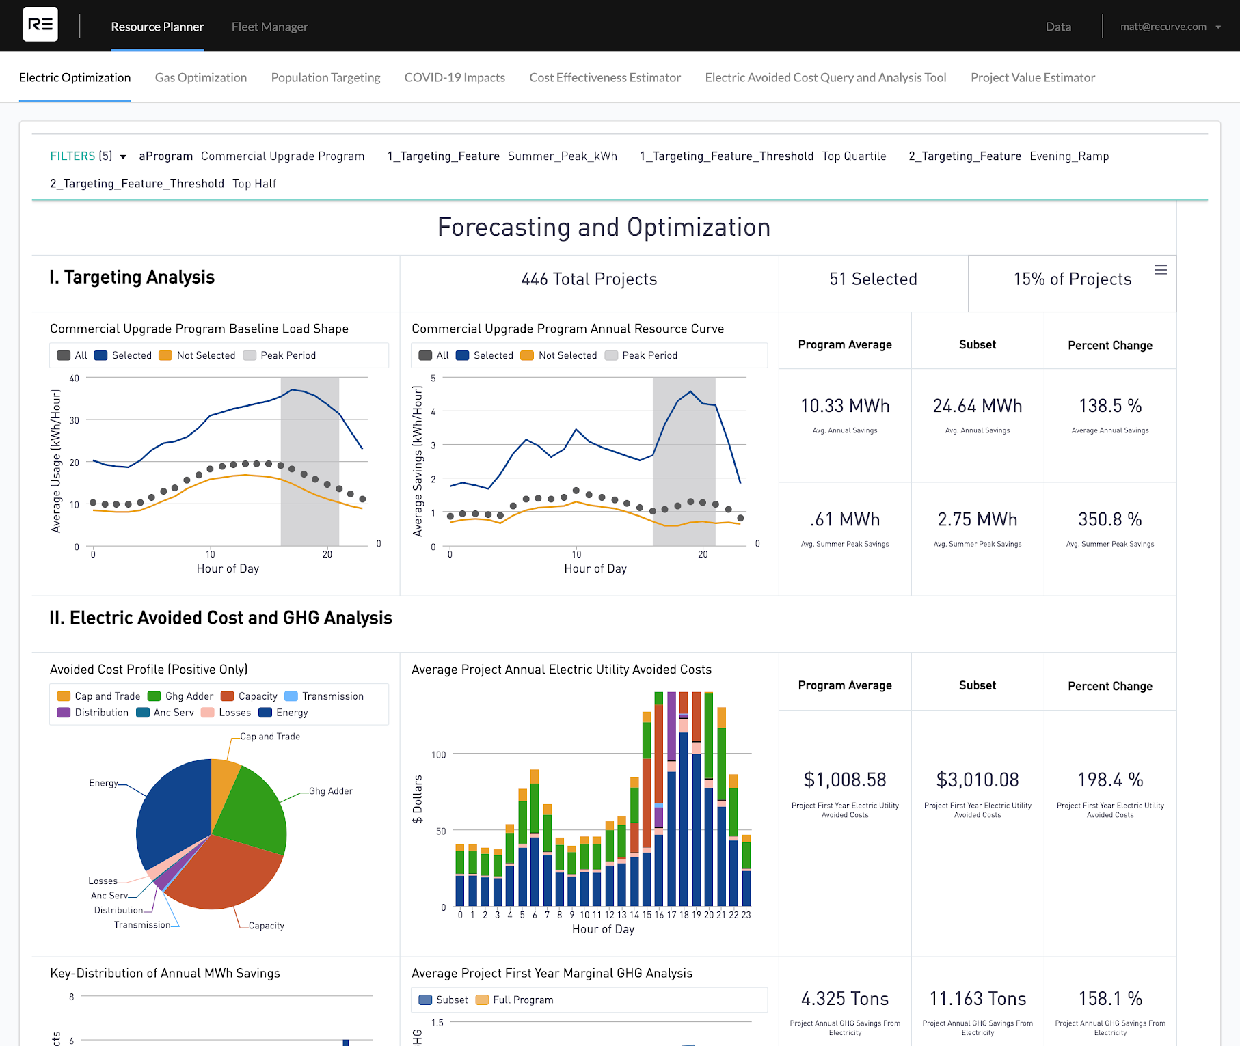
Optimize Demand-Side Investments
Targeting the top performing 15% of projects lead to:
2.5x energy savings
4.5x peak reduction
3x grid value
2.5x GHG savings
15% of Projects
Link to ComEd report
4
© Recurve Analytics Inc. 2021 | Privileged and Confidential
Notes:
The Basic Story = when you target you can get to more valuable impacts.

Slide 5
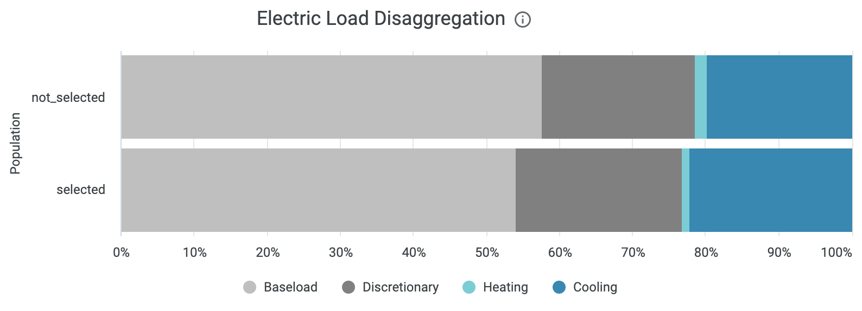
Targeting Increases kWh and Peak Savings
TOP 50% OF CUSTOMERS
Jan Feb Mar Apr May June July Aug Sept Oct Nov Dec
Month and Hourly Resource Curve (savings load shape)
Notes:
The WHO - Targeting - See where the opportunities exist - overall load disaggreation and peak impacts . . . ADD COMED STUDY REFERENCE

Slide 6
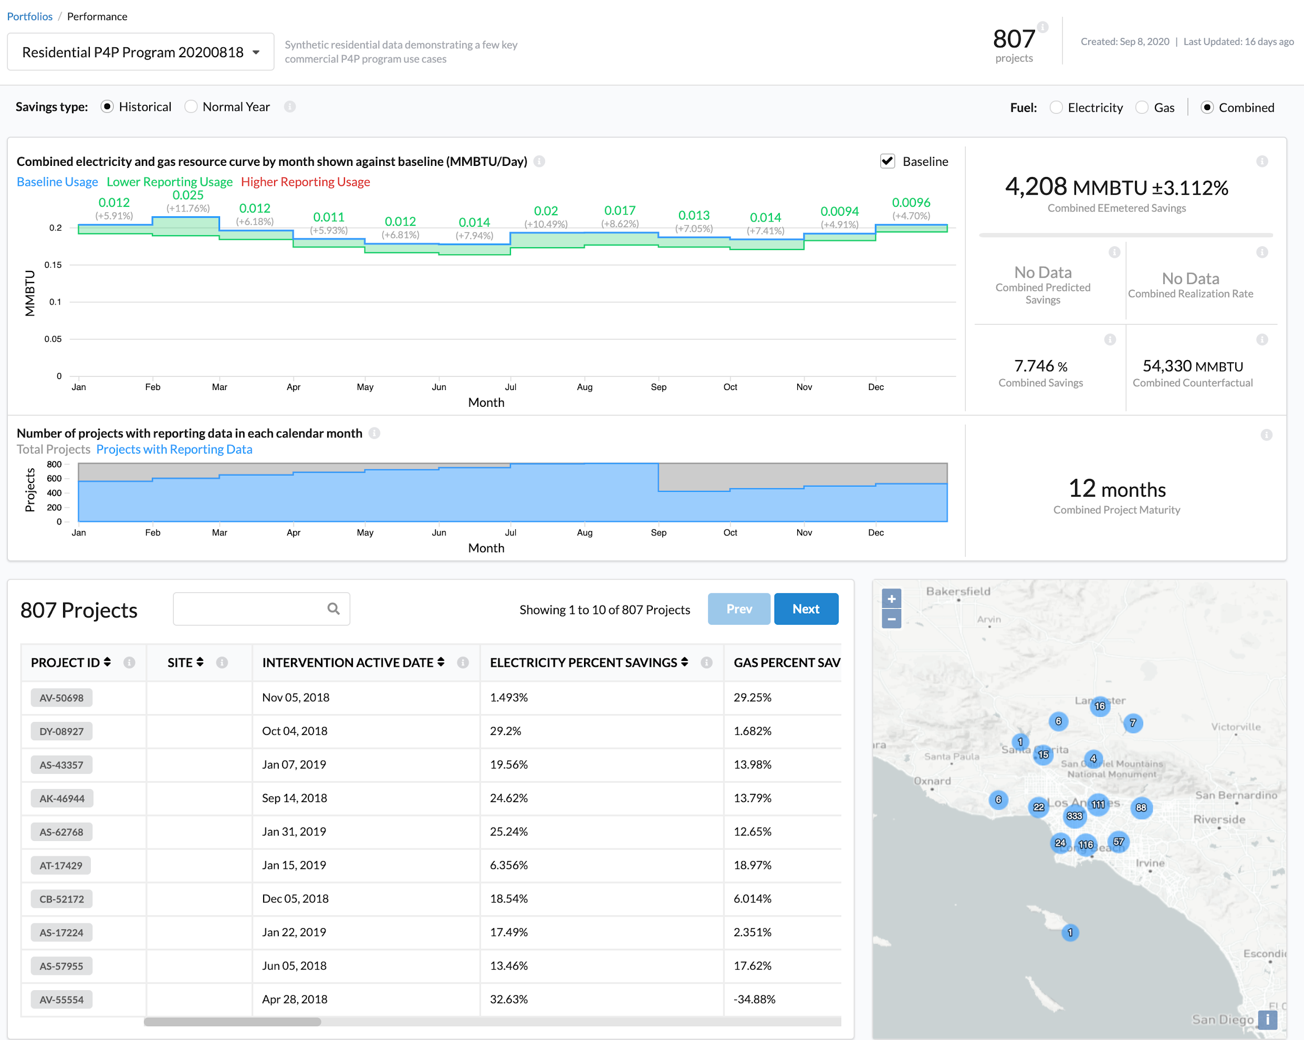
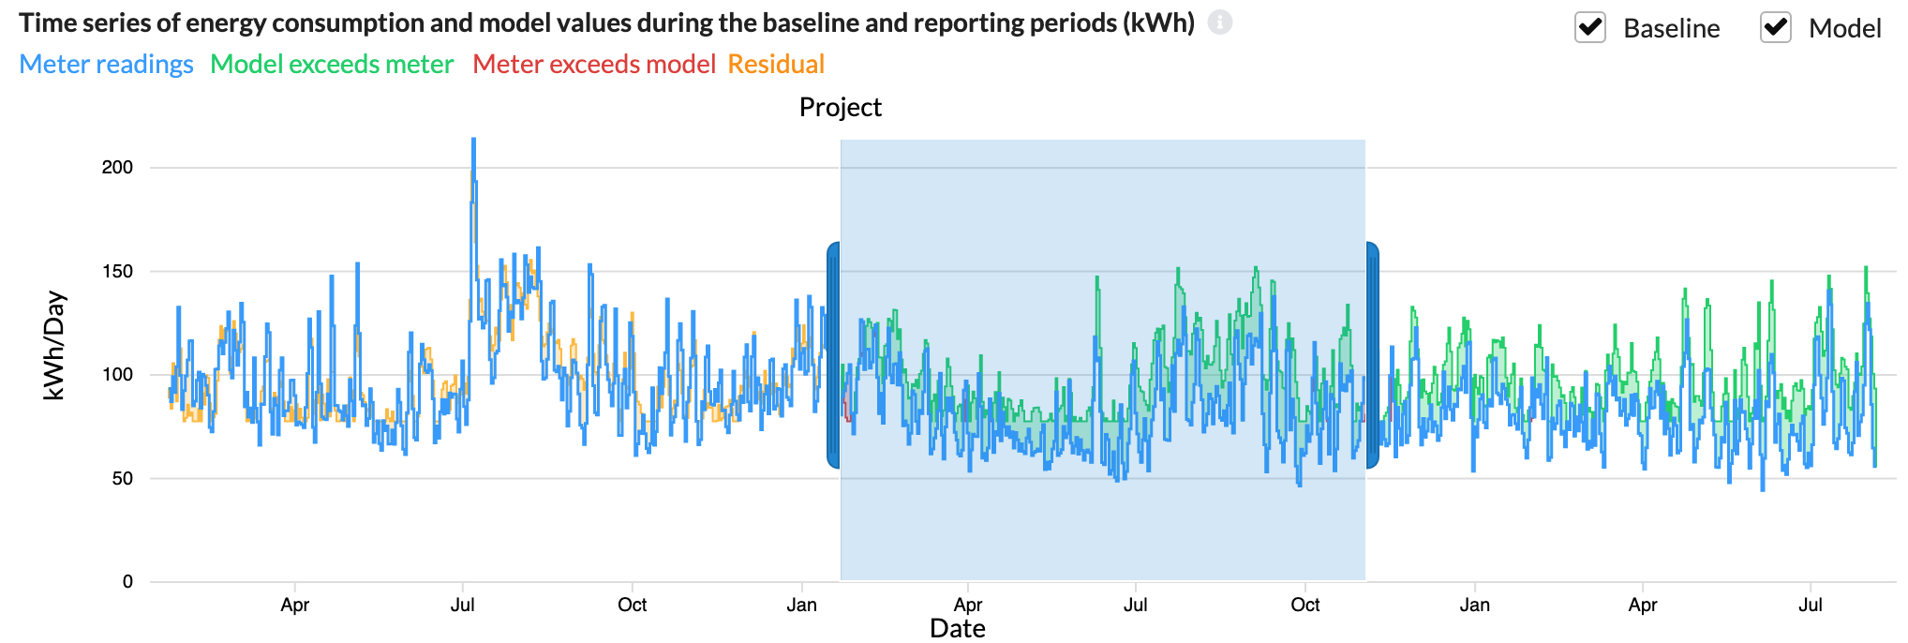
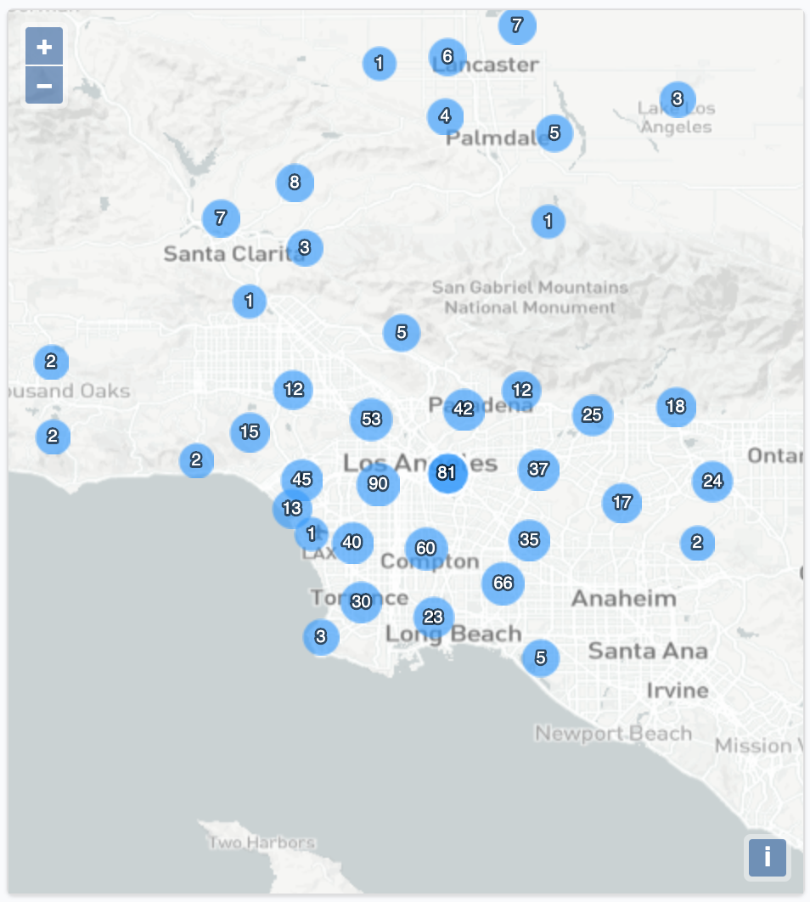
Track & Monitor Performance
Site-level metering and analytics for every project in your portfolio
Optimization
Channel management
Reporting / Audit Trail
6
© Recurve Analytics Inc. 2021 | Privileged and Confidential
Notes:
The Basic Story = when you target you can get to more valuable impacts.

Slide 7
Inflation Reduction Act
Energy Efficiency 4.3B: To Accelerate Energy Efficiency
Measured Performance pays for savings using Open-Source advanced M&V
Single and multifamily buildings with a 2x multiplier for low income
Can utilize existing programs and utilities as aggregators for rapid deployment
Stackable funding increases customer incentives and lowers ratepayer costs
Works with monthly or smart meters
Utilities can provide measurement eliminating data barriers
Low risk as taxpayer dollars pay only for measurable outcomes
Notes:
Measured Performance is the Fastest, Least Disruptive, Lowest overhead way to deploy IRA funds for Residential Flexibility. Find out how it can work for every State with existing infrastructure and minimal brain damage for all.
Measured performance in the IRA is a hidden virtual power plant, find out how, with smart meters, this part of the legislation represents a chance for energy efficiency to become a real grid resource.
Measured performance works regardless of data access. Find out how utilities and regulators across the country are already using open-source advance M&V to optimize programs, and how easily that can be adapted to take advantage of IRA funding. And existing open methods linux foundation. Not the problem!
Measured performance is great for State Energy Offices. Find out how the IRA can give regulators real performance data, and with smart meters, the ability to influence traditional EE programs to focus on system peaks, GHGs, and grid reliability.
The measured performance path in the IRA can enable States to make markets that encourage innovation in the market by allowing companies to deliver diverse solutions to customers, paid based on what is delivered with low transaction costs.

Slide 8
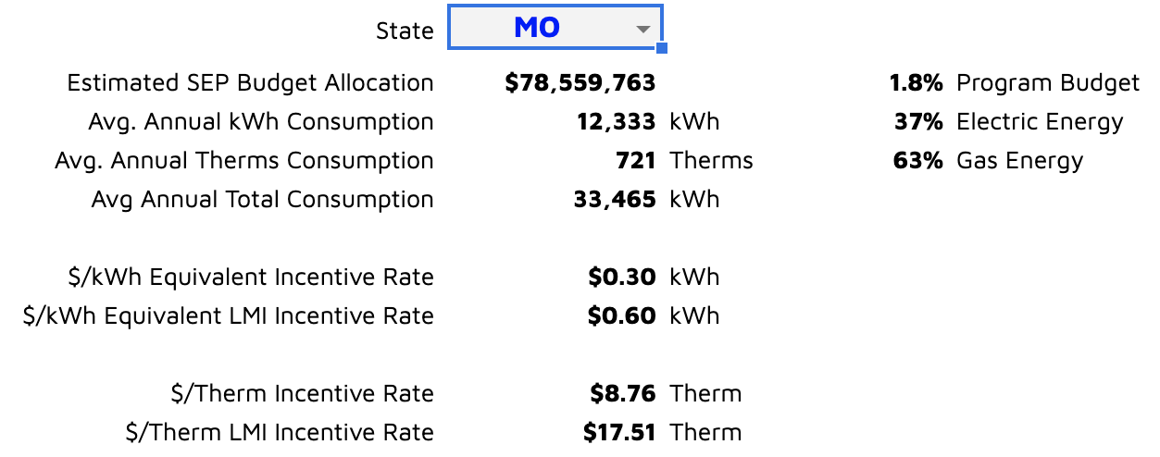
How it Works: kWh Payable Rate
Pay for Measured Savings based on Monthly Payable Rate
Incentive Rate
Incentive Rate based on 20% of energy in average home in state, divided into $2,000 or $4,000 for low income customers.
Market Rate pays upto 50% of project cost and upto 80% for low income.
Portfolios must reduce by 15%.
$2,000 or $4,000
Incentive Rate =
Link to Access Calculator
(20% * Avg. State Res Energy Usage)
Notes:
The WHAT - How do these compare with your current incentives for households or aggregators?

Slide 9
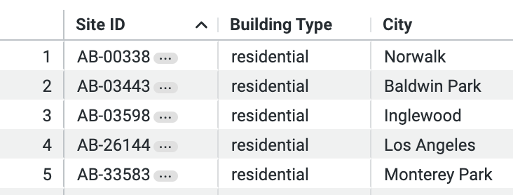
Inflation Reduction Act
Energy Efficiency 4.3B
Measured Performance
Fast, efficient, low overhead deployment.
Open source measurement at the meter
Can overlays on top of existing programs and/or can be deployed as a “market”
Values the full impact of home performance
Can enable market innovation prepare for a future of grid integration
Even if using Modeled approach, measuring outcomes provides essential feedback
Advanced Open Source M&V
Targeting
Tracking &
Monitoring
Payments &
Reporting
Recurve's RFI Responses to DOE - March 3, 2023
Notes:
Who is Recurve?

Slide 10
State Energy Office enables comprehensive upgrades
State Energy Office or Utility
Implementer / Market Manager
Aggregators
Homeowners
and Building Owners
Contract
Flexibility Purchase Agreements
Contract
Program Administrator
Open-source advanced M&V Platform
Install innovative projects to reduce energy use
Receive comfortable homes buildings and lower utility bills
HOMES Rebates Improve Comfort and Affordability
Notes:
Single family and MF (especially with whole building meter)
Paths after explaining who Recurve is and how we fit into IRA have options of where to take preso:
Market System → Program administration models slides; OR
Market System → How do IRA incentives work in this system; OR
Market System → Advanced M&V; OR
Market System → Customer journey

Slide 11
Open-Source M&V at the Meter
Proven accurate methods and code available publicly
OpenEEmeter: open-source code implementation of hourly, daily and monthly methods to quantify changes energy consumption
GRIDmeter: code and methods for automated stratified and matched comparison groups
FLEXvalue: hourly avoided cost calculations and cost-effectiveness tool
Notes:
The HOW -

Slide 12
Common Sense Algorithm
Recurve is a SaaS and Transaction Platform
Intervention
Avoided Energy Use
Energy
Time
Baseline
Business as Usual
Treatment
© Recurve Analytics Inc. 2021 | Privileged and Confidential
Notes:
The OpenEEmeter is an open-source python code base that operationalizes a standard pre-post modeling method. Many of you probably would recognize it as "billing analysis".
We then then project out how you would have kept using energy after the intervention, a “business as usual” case, given the actual weather of the intervention period. The delta of of BaU and metered is the impacts from your intervention (largely). [click]
For Targeting we're just looking at the front half of that model - your baseline year.

Slide 13
Valuing Demand Flexibility:
Using a Common Measurement Framework
Ted Thomas
ted.thomas@energizestrategies.com

Slide 14
System Benefits From Demand-Side Resources
© Recurve Analytics Inc. 2021 | Privileged and Confidential
Notes:
One barrier to consider right now - is the USE of hourly data in the context of optimizing efficiency.
PROBLEM: In a data poor context we've relied on technology profiles and their associated engineering calcs to get deemed savings values especially in energy efficiency - DR has done a lttle better in this respect - but they still deal with some goofy baselines;
SOLUTION: In a data rich context (identifying system value and aligning with changes in consumption) we can use every installation (and every potential installation) to understand the unique time value for shed, shift, shape from a suite of technologies and load management solutions we may not even have dreamed of yet. THERE is a value for a KW used at EVERY hour of the year;

Slide 15
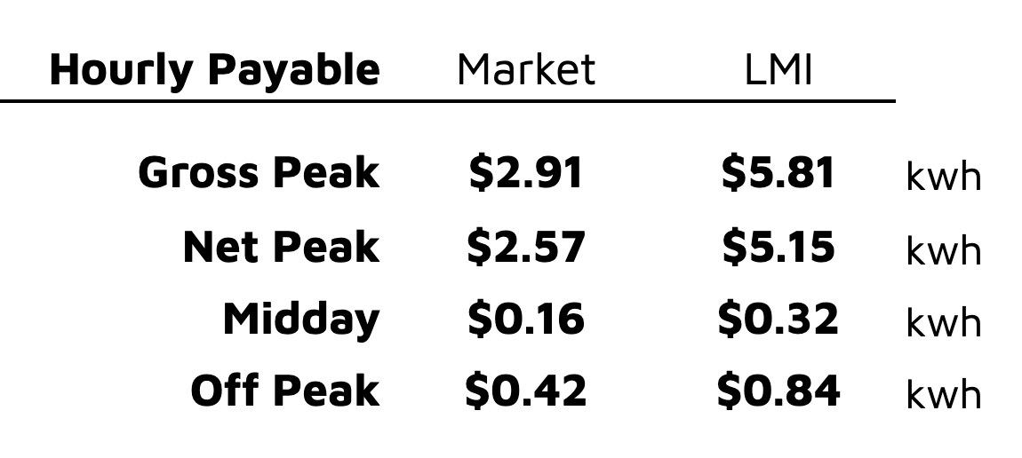
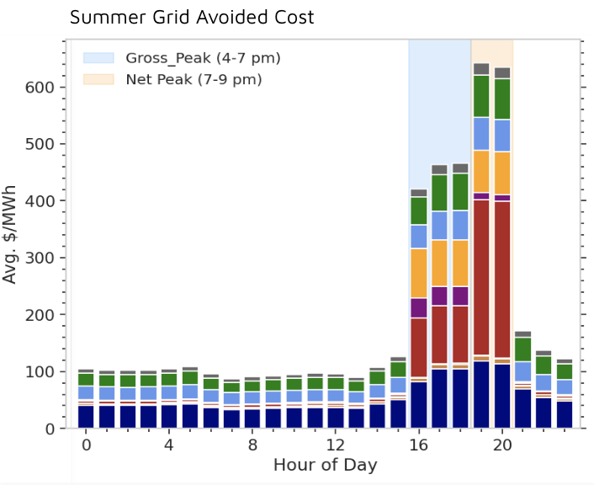
IRA Incentives + AMI Unlock Hourly Value
Transforming Incentives Based on Time, Location, or GHGs
Example: Hourly Payment Rates
Based on Avoided Cost Values
Align incentives with GHG and grid value
Encourage programs to focus on projects that drive the most grid value
Maximize savings on TOU
Enable EE to function as a grid resource
Link to IRA Landing page
Notes:
Using hourly approach . . .

Slide 16
Peak Impacts: FLEXmarket
Promote load shifting and event-based energy response
Flex Project
EE Project Savings
DR Event Savings
Long Term
Baseline
Historical Consumption
Additional Value Captured by EE Load Shape
Event Period
Baseline
Post Project Consumption
Performance
Period Consumption
Expanding Energy Efficiency Open-Source Measurement Methods to Incorporate Demand Response for Grid Stability, ACEEE Summer Study, 2022.
Notes:
When Recurve runs the flexmarket, they can separate the savings coming from efficiency/load shifting from the savings coming from demand response - by using the same hourly consumption model (OpenEEmeter)
This allows us to provide one value for scheduled load shifting, and another value for demand response events called 24 hours prior.

Slide 17
Advanced Metering Infrastructure Is Underutilized
Missed opportunities for AMI to improve energy efficiency and demand response abound
Opportunities for time-variant pricing, granular usage feedback, pay for performance and actionable intelligence are still out there.
Regulators and state agencies can encourage use of AMI by having reasonable protocols for data access and set performance standards for metered energy savings and pilots
Leveraging Advanced Metering Infrastructure to Save Energy, ACEEE Study 2020
© Recurve Analytics Inc. 2021 | Privileged and Confidential
Notes:
We need to remind people that AMI isn't the only path to do measured. But it will enhance delivery and is a great opportunity to use it.

Slide 18
IRA HOMEs - Gateway to Virtual Power Plants
Supply Demand
Supply: Energy Resources
Demand: Load Modifying Resources
Notes:
Call to action - implementation with the long view. The measured approach in particular has particular value in preparing us for the future of an integrated grid. Recurve and the many partners along the way can support us in getting there and we're already doing it in various forms around the country.
So before I dive in - I wanted to step back - everyone take a deep breath. What are we trying to do here? We're trying to optimize our energy resources.
This comes down to supply and demand - basic economics right? It's been getting a little hairy as we adapt and we're seeing some demand side resources popping up on the supply side, and that line isn't always crystal clear - except for the fact that we DO have a point of transaction (so far) with our utility service agreements (as customers)
They supply the energy that we demand. If they are going to demand that we supply energy (or not demand it) - well OK then the flow of electrons (and cash) needs to go the other way too. We are ACTIVE parts of the grid infrastructure.

