Slide 1
Distributed Energy Resources in SPP
MoPSC EW-2017-0245 Workshop
November 20, 2017

Slide 2
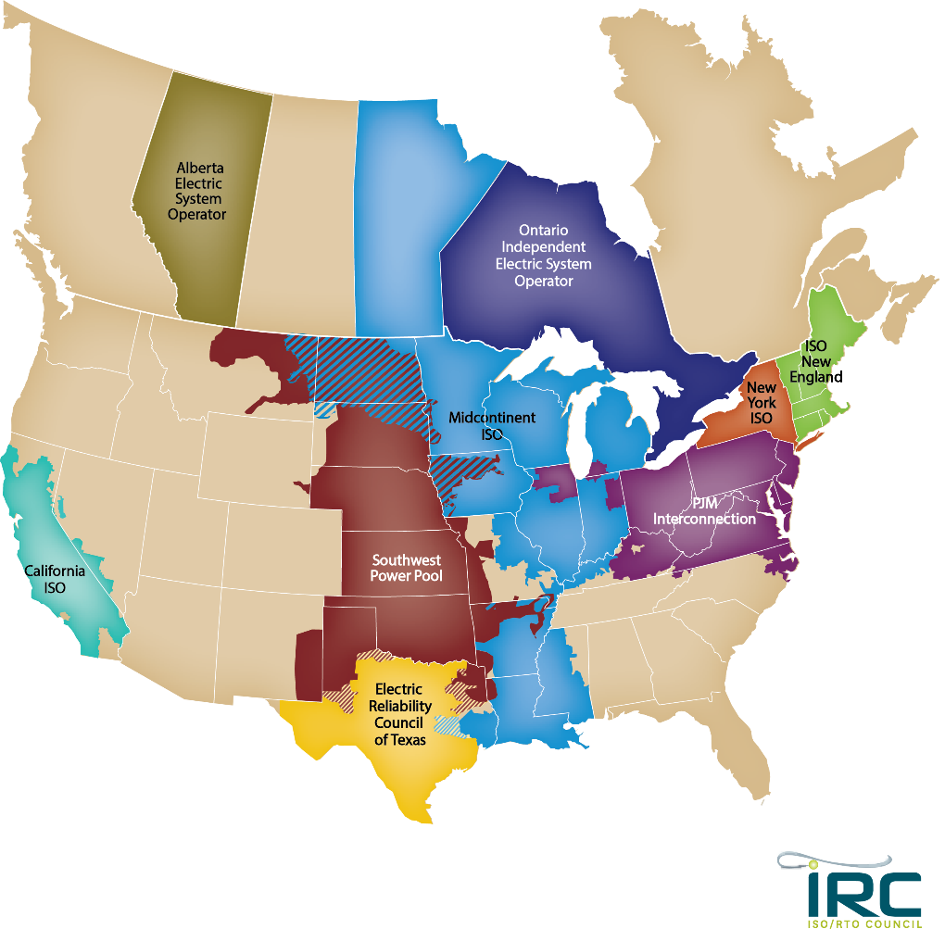
North American
Independent System Operators (ISO) and Regional Transmission Organizations (RTO)
Notes:
This map depicts the 10 other FERC-approved Independent System Operators and Regional Transmission Organizations in the United States and Canada.

Slide 3
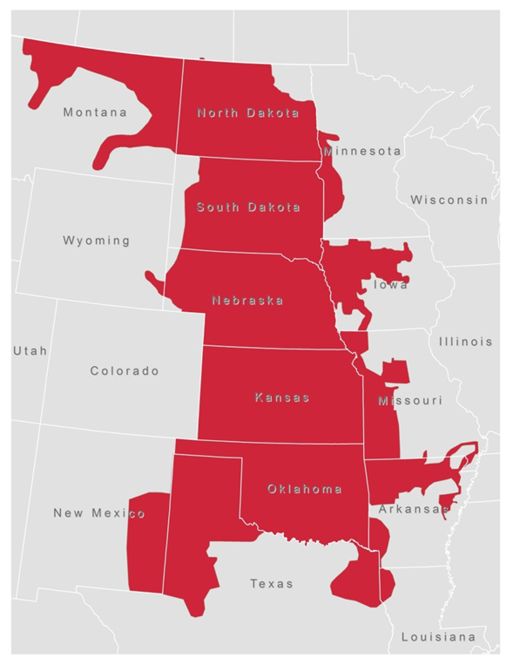
SPP Footprint

Slide 4
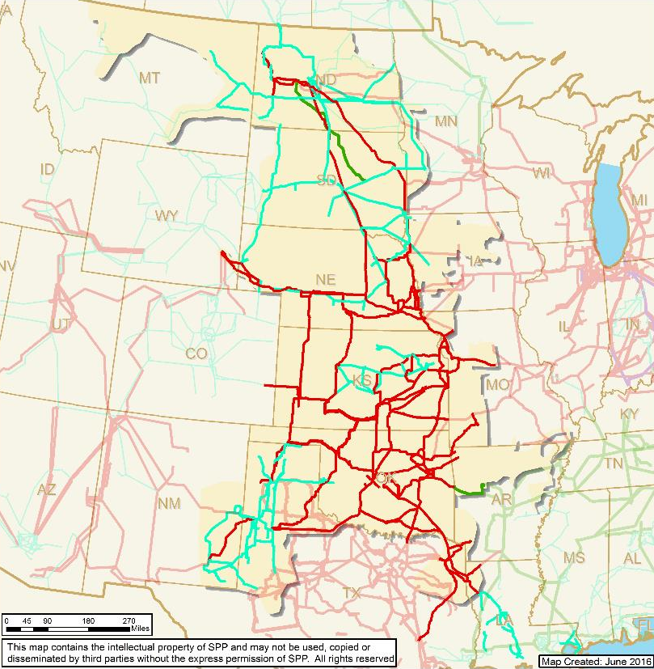
SPP Fast Facts
Miles of service territory: 546,000
Population served: 17.5M
Generating Plants: 790
Substations: 4,835
Miles of transmission:
65,755
  69 kV 16,808
  115 kV 15,512
  138 kV 9,471
  161 kV 5,596
  230 kV 7,518
  345 kV 10,758
  500kV 92

Slide 5
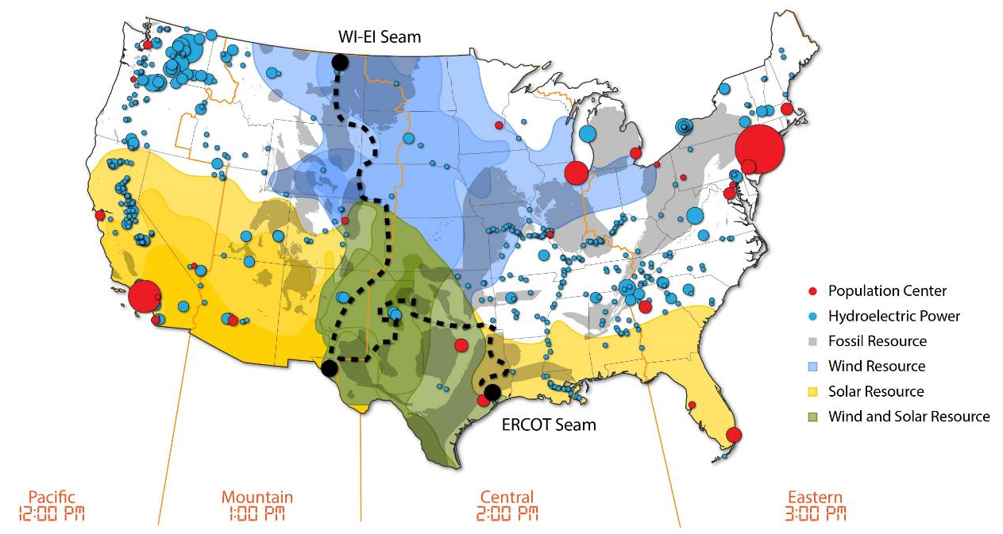
Diversity in Resources and Load Centers

Slide 6
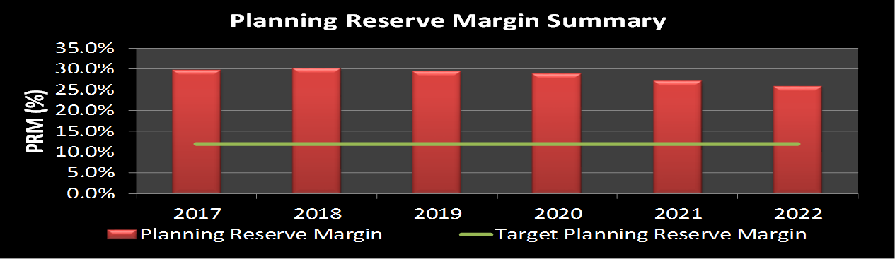
Planning Reserve Margin
The SPP Assessment Area Planning Reserve Margin (PRM) requirement for the 2017 summer is 12 percent, unless a member’s capacity mix is comprised of at least 75 percent hydro-based generation, and then the PRM is 9.89 percent, effective for the 2017 summer

Slide 7
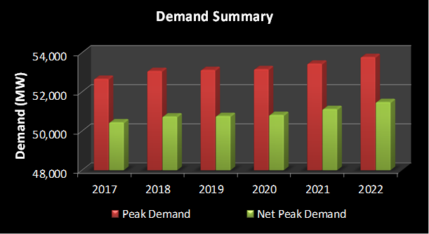
Demand
SPP Assessment Area is a summer peaking region
Peak Demand is an aggregated non‐coincident number based on member‐submitted data
Demand is based on 50/50 forecast
Annual demand growth over the 10 year assessment timeframe is ~ 1%
Net Peak Demand reflects the reduction of available Controllable and Dispatchable Demand Response
Demand | Peak Demand | Net Internal Demand
2017 | 52,403 | 51,577
2018 | 52,554 | 51,687
2019 | 53,319 | 52,422
2020 | 53,361 | 52,476
2021 | 53,643 | 52,774
2022 | 53,981 | 53,116
2023 | 54,179 | 53,311
2024 | 54,409 | 53,537
2025 | 54,729 | 53,853
2026 | 54,929 | 54,049
2027 | 55,250 | 54,365

Slide 8
Demand- Side Management
Demand Response resources are used as a load reduction unless they registered as a Designated Resource for firm transmission service
Controllable and Dispatchable Demand Response include both the available Demand Response and Distributed Generation that are load reductions
SPP Integrated Marketplace currently does not have any Demand Response registered
SPP expected peak demand impact for Demand Response is 734 MW in 2019 and 734 MW in 2027
Portion of this impact is due to Distributed Generation 164 MW in 2017 and 146 MW in 2027
There are approximately 1,500 MWs of behind-the-meter generation registered in the SPP Integrated Marketplace

Slide 9
Energy Efficiency is Big in MO
 |  | Peak | Demand |  | Demand | Response |  | Distr. | Resources |  | Energy | Efficiency
 |  | 2019 | 2027 |  | 2019 | 2027 |  | 2019 | 2027 |  | 2019 | 2027
SPP |  | 53,519 | 55,250 |  | 736 | 734 |  | 160 | 152 |  | 594 | 1,504
Missouri |  | 8,556 | 8,321 |  | 141 | 137 |  | 19 | 19 |  | 120 | 656

Slide 10
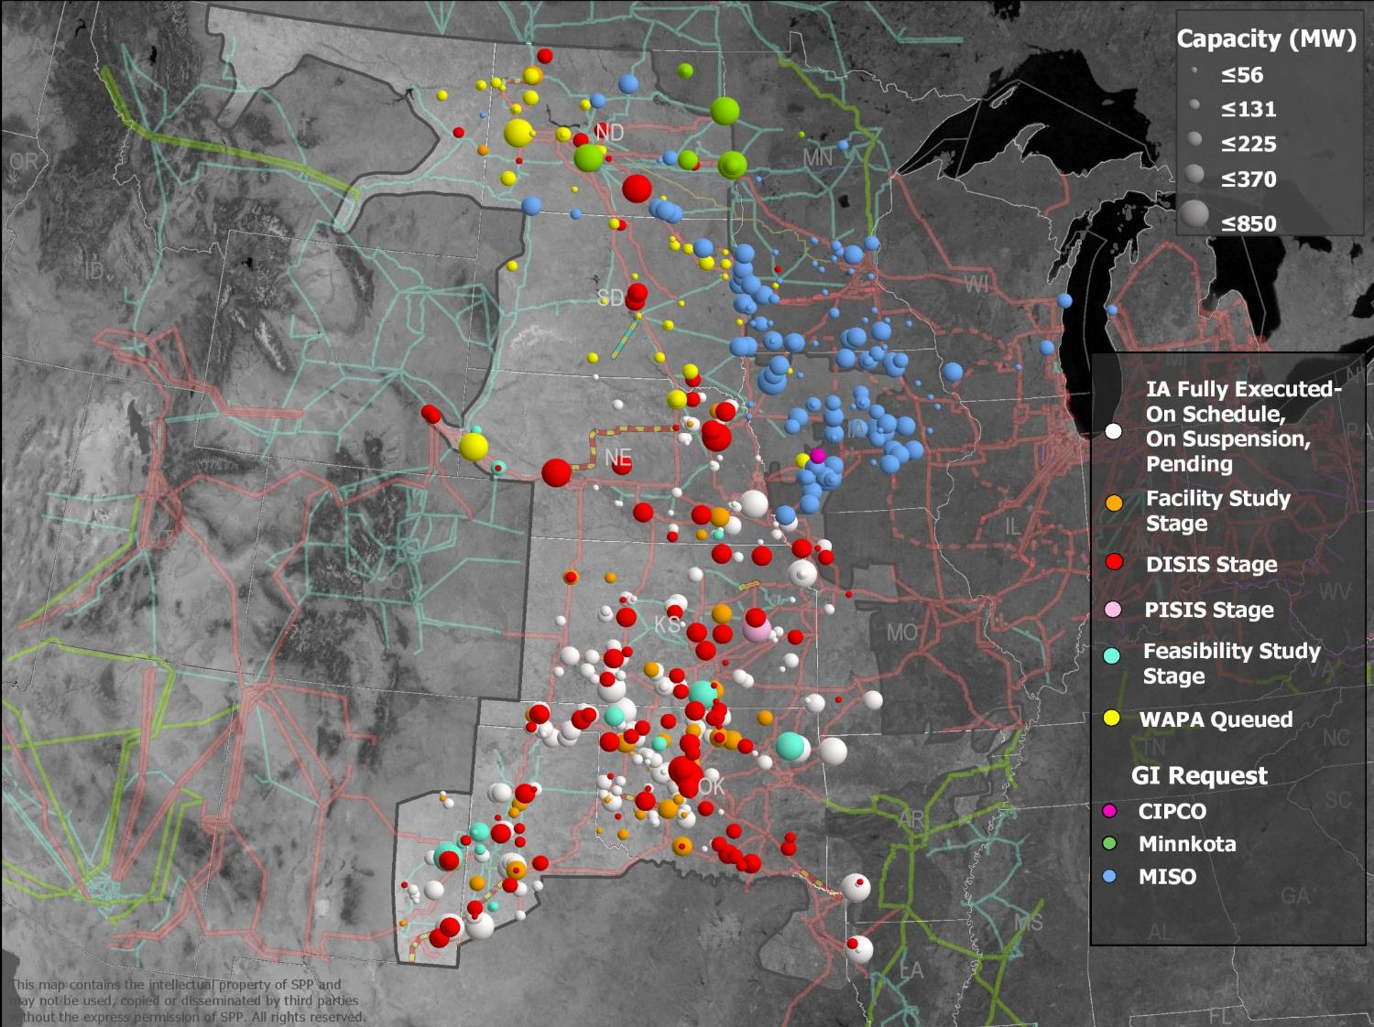

Slide 11
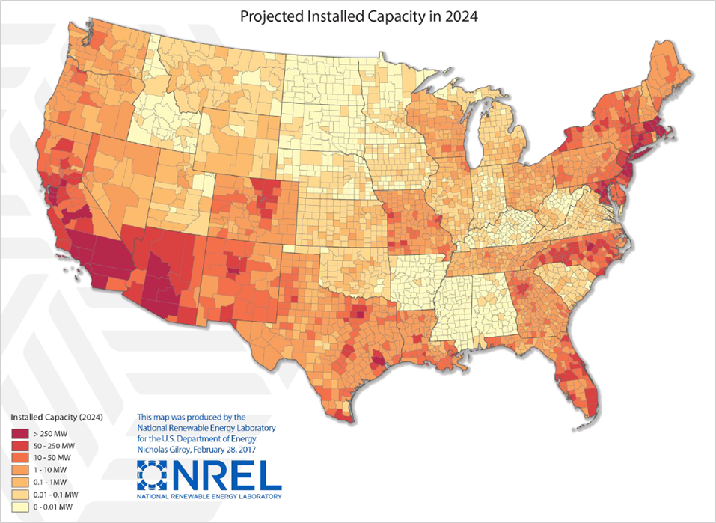
NREL Projecting More than 1.1GW Distributed PV capacity in SPP in 2024

Slide 12
Conclusions
Very limited visibility and operational control of distributed resources in SPP wholesale market
Market mechanisms in place and under development in SPP to enable participation by Distributed Energy Resources, Storage Energy Resources, Aggregated Demand Response, etc
Integrated Energy Network is blurring lines between wholesale transmission and retail distribution services

