Slide 1



2015 Statewide Collaborative
December 1, 2015
TM
Ameren Missouri and Laclede Co-delivered
Residential Direct-Install Low Income
Energy Efficiency Program
Presenters:
Cara Dolly, Manager-EE
Ameren Missouri
Jim Travis, EE Specialist
Laclede Gas

Slide 2
What is CommunitySaversTM?
EE Program available to building managers and building owners of USDA and HUD housing. Eligible housing is federally subsidized, low-income, multi-family housing with 3 dwelling units or more.
100% of tenant unit electric and natural gas energy saving upgrades paid for by the utility program depending on energy source. CFLs, electric water heater insulation, electric and gas water heater pipe wrap, programmable thermostat, high efficiency shower head, faucet aerator, replace refrigerators 2001 & earlier, window or t-t-w A/C unit replacements, central a/c tune-up.
All residents receive training and education on the upgrades and new appliances as part of program requirements.

Slide 3
100% Free to Customer
Multifamily dwelling units receive the following energy saving measures installed at no cost to occupants or property owners:
  ENERGY STAR® air conditioner
  ENERGY STAR refrigerator
  Energy efficient faucet aerators – E&G
  Energy efficient showerheads – E&G
  Water-heater insulating pipe wrap – E&G
  Programmable thermostats – E&G
  CFL light bulb installation
  Central A/C tune-ups

Slide 4
Timeline
  Ameren Missouri offered a Multifamily Income Qualified Program
2012
2013
  Ameren Missouri received program approval as part of MEEIA 2013-2015
  Ameren Missouri re-branded the program as CommunitySavers
  The program was approved by Laclede’s EE Collaborative & tariff was approved for 12/1/13-12/31/15
2010
In December 2013, Laclede contracted with Ameren Missouri’s contractor, Honeywell Smart Grid Solutions, providing a single point of delivery for both gas and electric measures.
Laclede shared Ameren Missouri’s existing CommunitySaversTM marketing assets.
The Ameren/Laclede co-delivered program enabled programmable thermostat unit costs to be shared as long as the thermostat controlled gas heat and electric AC.

Slide 5
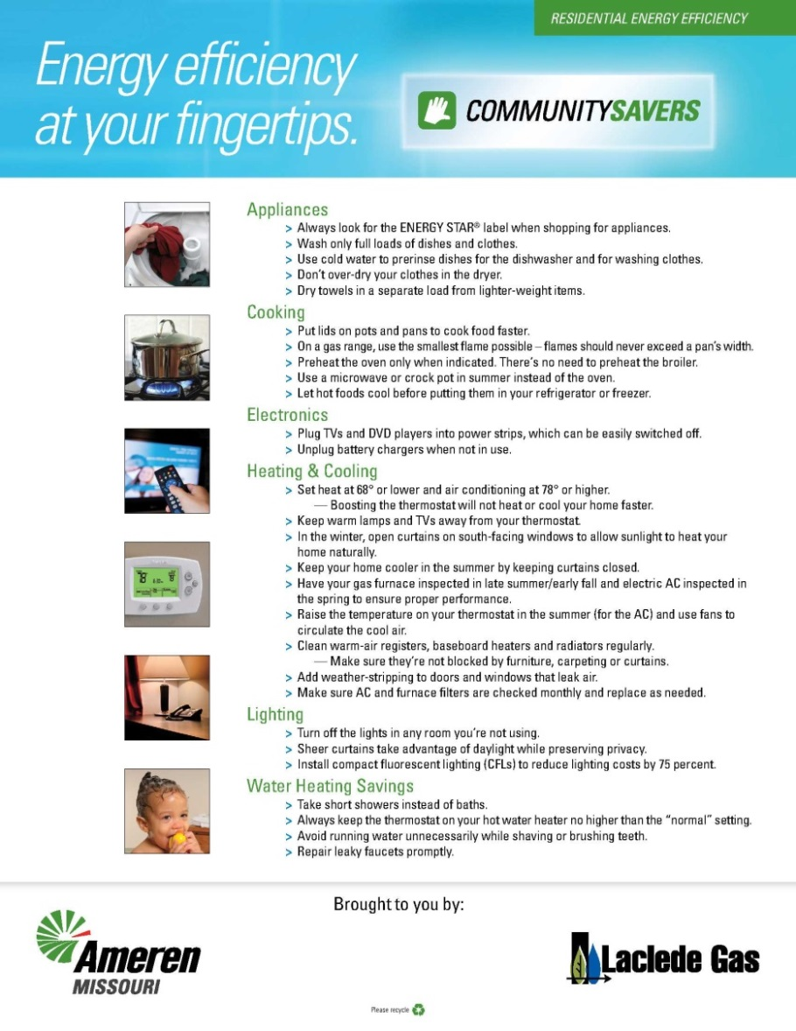
Marketing and Education
Marketing and education material was successfully co-branded using the existing CommunitySaversTM to simplify the process, lend value, and avoid customer confusion.

Slide 6
Electric & Gas Co-Delivery
CommunitySavers is saving each family hundreds of dollars over the lifespan of the new energy efficient measures.
During 2014 and through October 2015, 59% of the MF dwelling units have received both gas (6,890) and electric (11585) upgrades.
Upgrades reduce energy use and on average tenants save:
  $125.00 annually on electric bills.
  $30.00 annually on natural gas bills.

Slide 7
Program Results
 | Laclede Multifamily Goal |  |  | * Laclede Multifamily Results
Year | MF Dwelling Units | Total Measures (Units) | Deemed Savings (MCF) | MF Dwelling Units | Total Measures (Units) | Deemed Savings (MCF) | MF Dwelling Units (% of Goal)
2014 | 2,250 |  | 5,555 | 4,739 |  | 17,036
2015 | 2,050 |  | 4,445 | 2,151 |  | 6,500
Total | 4,300 | 20,438 | 10,000 | 6,890 | 44,933 | 23,536 | 160.2%
Ameren Missouri Multifamily Goal |  |  |  | ** Ameren Missouri Multifamily Results
Year | MF Dwelling Units | Total Measures | Deemed Savings (kWh) | MF Dwelling Units | Total Measures | Deemed Savings (kWh) | MF Dwelling Units (% of Goal)
2013 |  |  | 5,798,000 | 5,847 |  | 7,472,000
2014 |  |  | 4,530,000 | 6,860 |  | 6,240,000
2015 |  |  | 2,635,000 | 4,725 |  | 3,681,000
Total |  |  | 12,963,000 | 17,432 | 239,839 | 17,393,000 | 134.2%
* Results as of 10/31/15
**Results as of 9/31/15

Slide 8
Lessons Learned
Significant budget differences between utility programs.
Different EE goals. (Individual utility goals not completely aligned).
Program cycles are not the same, different drivers i.e. Rate Case vs. MEEIA.
Require different program approval processes and criteria.
Stakeholder groups are comprised of different individuals.
Separate vendor contracts, payments, lack of transparency that insures shared benefits, confidentiality.

Slide 9
Laclede Challenges
  Achieving Cost-Effective Programs
    Cost of Natural Gas
  Budget Constraints
    Allocating dollars to all programs
    Multi-family Low Income Program
      23% of total budget in 2014
      34% of total budget in 2015
  Infrastructure: Natural Gas Metering
    Who experiences the benefits?
    “Split incentive” barrier to energy efficiency
  Diverse Building Ownership and Financing Structures

Slide 10
Ameren Missouri Challenges
Work must be started and completed within a 3 year cycle, no carryover.
Other building owner funding streams do not match MEEIA 3-year cycles.
Landlord Value Proposition – potential study-focus group findings
  Landlord pays/tenant benefits
  EE is not marketable, rather invest in safety, building maintenance, landscaping
  Existing equipment is working
Missouri Low Income/Historical Tax Credit exclusion in MEEIA.
  Buildings receiving a low income/historical tax credit may not participate in electric utility EE, this impacts whole building improvements.
  Ameren Missouri made efforts to fix this, but it did not pass in 2014.
Company currently donates $1.2M electric funds and $263K gas funds annually to low income weatherization, outside of MEEIA.

Slide 11
