Slide 1

Combined Heat and Power Benefits, Examples, and Resources
Statewide MEEIA Collaborative
November 22, 2016
David Baker
Notes:
Good afternoon

Slide 2
Presentation
Intro on CHP and CHP TAPs/DOE Programs
CHP today in U.S.
Missouri – current CHP installations and technical potential
Utility mechanisms for supporting development of CHP
Snapshots of some successful CHP projects
U.S. DOE resources

Slide 3
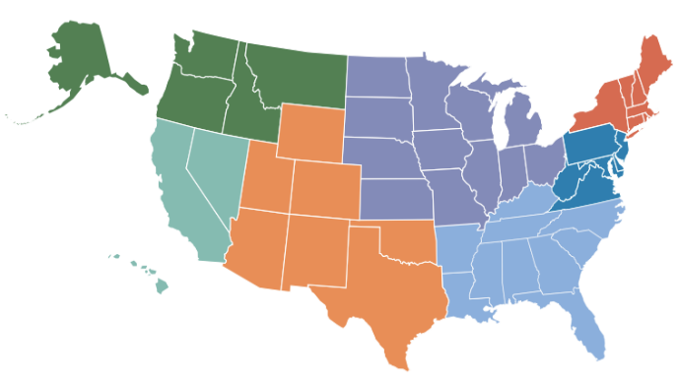
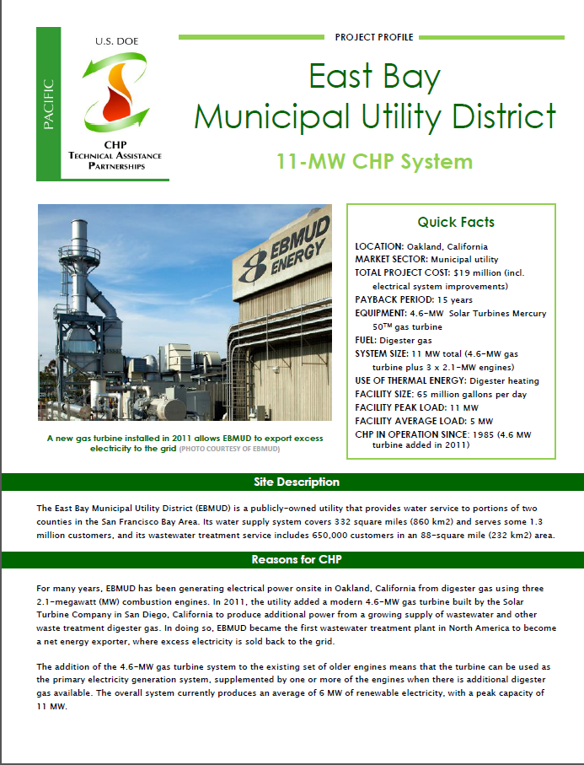
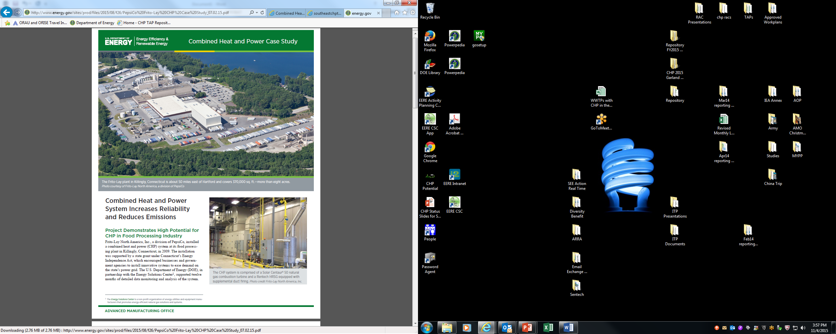
U.S. DOE CHP Deployment Program
Market Analysis and Tracking
  Supporting analyses of CHP market opportunities in diverse markets including industrial, federal, institutional, and commercial sectors.
Technical Assistance through DOE's CHP Technical Assistance Partnerships (CHP TAPs)
  Promote and assist in transforming the market for CHP, waste heat to power, and district energy with CHP throughout the U.S.
Just Launched Combined Heat and Power (CHP) for Resiliency Accelerator
  Collaborating with Partners to support consideration of CHP and other distributed generation solutions for critical infrastructure resiliency planning at the state, local, and utility levels.
  www.energy.gov/chp

Slide 4
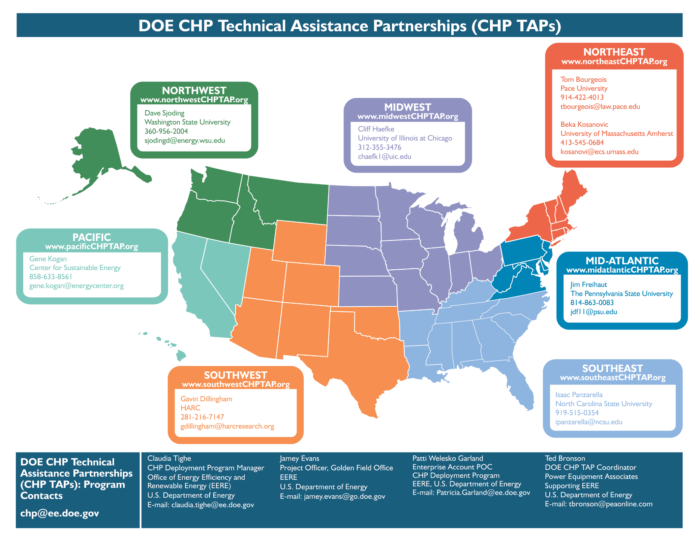
Notes:
Here is the map with the regional contacts

Slide 5
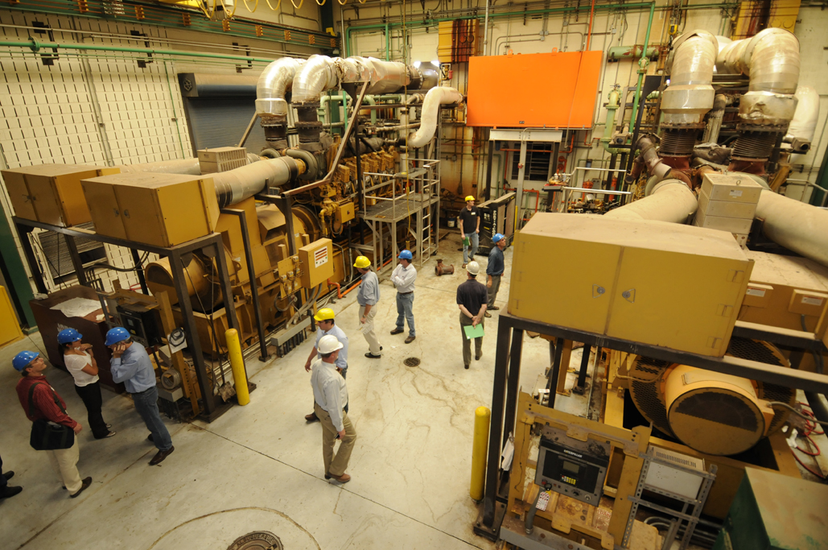
CHP Technical Assistance Partnerships
  Technical Assistance
  Providing technical assistance to end-users and stakeholders to help them consider CHP, waste heat to power, and/or district energy with CHP in their facility and to help them through the development process from initial CHP screening to installation.
  Education and Outreach
  Providing information on the energy and non-energy benefits and applications of CHP to state and local policy makers, regulators, end users, trade associations, and others.
  Market Opportunity Analysis
  Supporting analyses of CHP market opportunities in diverse markets including industrial, federal, institutional, and commercial sectors
5

Slide 6
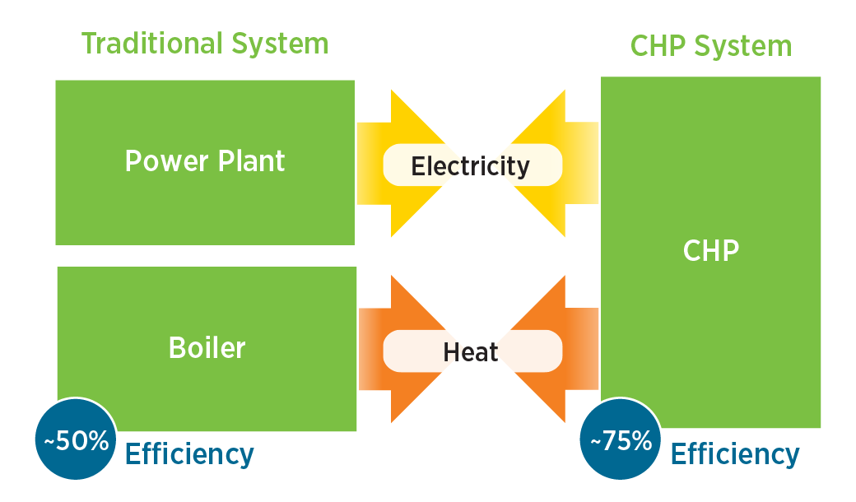
CHP: A Key Part of Our Energy Future
An integrated system
Located at or near a building / facility
Form of Distributed Generation (DG)
Provides at least a portion of the electrical load and
Uses thermal energy for:
  Space Heating / Cooling
  Process Heating / Cooling
  Dehumidification
CHP provides efficient, clean, reliable, affordable energy – today and for the future.
Source: http://www1.eere.energy.gov/manufacturing/distributedenergy/pdfs/chp_clean_energy_solution.pdf

Slide 7
CHP is significantly more efficient than Traditional Electric + Heat Generation
30 units
Power Plant
32% efficiency
(Including T&D)
94 units
CHP
75% efficiency
Fuel
Electricity
Fuel
100 units
Onsite Boiler
80% efficiency
56 units
Fuel
Heat
45 units
Total Efficiency
~ 50%
Total Efficiency
~ 75%
30 to 55% less greenhouse gas emissions
Notes:
CHP Recaptures Heat of Generation, Increasing Energy Efficiency, and Reducing GHGs

Slide 8
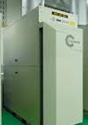
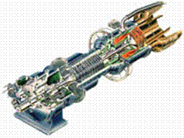
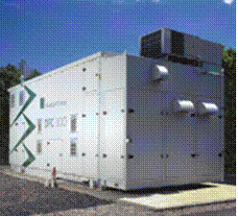

Common CHP Technologies and
Generating Capacity Ranges
Microturbines
Gas Turbines
Reciprocating Engines
Fuel Cells
50 kW
100 kW
1 MW
10 MW
20 MW

Slide 9
CHP Today in the U.S.

Slide 10
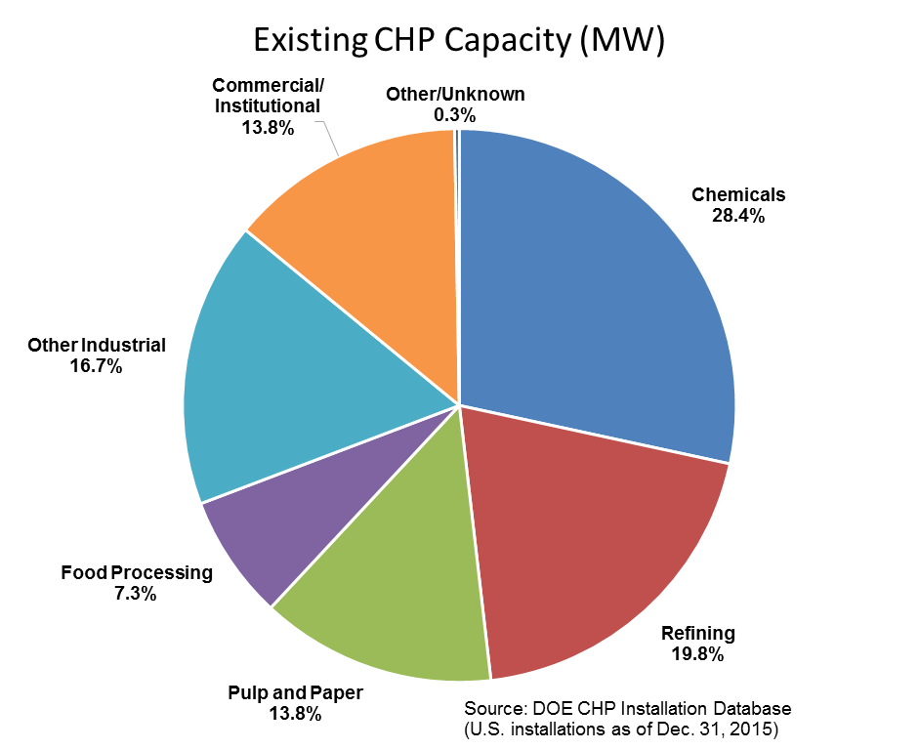
CHP Today in the United States
81 GW of installed CHP at over 4,300 industrial and commercial facilities
8% of U.S. Electric Generating Capacity; 14% of Manufacturing
Avoids more than 1.8 quadrillion Btus of fuel consumption annually
Avoids 241 million metric tons of CO₂ compared to separate production
10

Slide 11
What Are the Benefits of CHP?
CHP is more efficient than separate generation of electricity and heating/cooling
CHP can also increase energy reliability and enhance power quality
CHP contributes to business retention and economic development
Higher efficiency translates to lower operating costs
Higher efficiency reduces emissions of all pollutants
11

Slide 12

Emerging Drivers for CHP
DOE / EPA CHP Report (8/2012)
  Benefits of CHP recognized by state and federal policymakers
  Energy resiliency and critical infrastructure
  Utilities finding economic value
  Economically favorable outlook for natural gas supply and price in North America
  Opportunities created by environmental drivers
Report: http://www1.eere.energy.gov/manufacturing/distributedenergy/pdfs/chp_clean_energy_solution.pdf

Slide 13
Critical Infrastructure and Resiliency Benefits of CHP
“Critical infrastructure” refers to those assets, systems, and networks that, if incapacitated, would have a substantial negative impact on national security, national economic security, or national public health and safety.”
Patriot Act of 2001 Section 1016 (e)
Applications:
  Hospitals and healthcare centers
  Water / wastewater treatment plants
  Police, fire, and public safety
  Centers of refuge (often schools or universities)
  Military/National Security
  Food distribution facilities
  Telecom and data centers
CHP (if properly configured):
Offers the opportunity to improve Critical Infrastructure (CI) resiliency
Can continue to operate, providing uninterrupted supply of electricity and heating/cooling to the host facility
Notes:
critical infrastructure site are those that if incapacitated would have a substantial negative impact on natural or economic security or public health.
These facilities include hospitals, water and WWTP, police, fire and public safety, centers of refuge meaning schools or university, and several others.
If properly configured, CHP can provide resiliency to these facilities by providing an uninterrupted supply of electricity, heating and cooling.

Slide 14
Missouri – Current CHP Installations and Technical Potential

Slide 15
Missouri Existing CHP Installation Summary
23 CHP Sites = 236.9 MW Generating Capacity
Application | Facility | City | Capacity (KW)
Agriculture | ADM - North Kansas City | North Kansas City | 4,000
Agriculture | Agricultural Facility |  | 800
Chemicals | Missouri Chemical / Hercules, Inc. | Louisiana | 15,000
Chemicals | POET Biorefining - Laddonia | Laddonia | 13,000
Chemicals | POET Biorefining / City of Macon | Macon | 10,000
Colleges / Univ. | Southeast Missouri State Univ. | Cape Girardeau | 6,250
Colleges / Univ. | University Of Missouri | Columbia | 99,500
Communications | Southwestern Bell Telephone Co | St. Louis | 6,000
District Energy | City of Butler | Butler | 13,100
District Energy | Trigen Energy Corp | Kansas City | 6,000
District Energy | Veolia Energy - Ashley Plant | St. Louis | 15,000
District Energy | Veolia Energy KC | Kansas City | 5,000
Food Processing | Anheuser-Busch | St. Louis | 26,100
Furniture | La-Z-Boy Chair Company, Inc. | Neosho | 750
General Merch. Stores | Service Merchandise Company, Inc | Florissant | 60
Government | Bolling GSA office | Kansas City | 100
Government | Jefferson City Landfill/Corrections Center | Jefferson City | 3,200
Hospitals / Healthcare | Missouri State Hospital | St. Louis | 5,000
Hotels | Overland Energy / Clemmons Hotel | Hannibal | 150
Office Building | Nooney Mgt. / Brandonview Bldg. | St. Louis | 4,300
Schools | Lewistown School District | Lewistown | 60
Solid Waste Facilities | Columbia Light and Power/Landfill | Columbia | 3,000
Wood Products | Smith Flooring, Inc. | Mountain View | 500
Source:
www.energy.gov/chp-installs

Slide 16
Missouri CHP Technical Potential in the Industrial Sector
1,276 MW @ 1,194 sites
Source: energy.gov/chp-potential

Slide 17
Missouri CHP Technical Potential in the Commercial Sector
1,521 MW @ 5,173 sites
Source: energy.gov/chp-potential
Notes:
Other sectors with potential that may be economically viable (upper colors >1 MW) – military, data centers, some govt. buildings. Also we find WWT plants are often economic, even if less than 1 MW. DOE study focuses on potential primarily for nat. gas fired CHP. Does not address biogas opportunities like WWT.

Slide 18
Missouri Technical Potential for CHP
(all types)
Source: energy.gov/chp-potential

Slide 19
Utility Mechanisms for Supporting Development of CHP

Slide 20
Utility Mechanisms for Supporting Development of CHP
Integrated Resource Plans
Utility-Industry Partnerships
Utility-Ownership of CHP
Utility CHP Incentive Programs

Slide 21
CHP and IRPs
DOE, US EPA, RAP, ACEEE, NASEO, and Pew Charitable Trust – all highlight the important role that IRPs can play in evaluating and promoting CHP as an option for efficiently and cost-effectively meeting electric demand.
13 states require or “call out” CHP as an option to be considered in utility IRPs: Connecticut, Georgia, Iowa, Indiana, Kentucky, Nebraska, Nevada, New Mexico, Oregon, Massachusetts, Minnesota, Utah, and Washington.
“Integrated resource planning helps monetize the benefits of CHP that do not currently have a market value, such as reduced emissions and increased resiliency and efficiency, enabling planners to account for all of the technology’s advantages.” (Pew Charitable Trust)
  Sources: epa.gov/statelocalclimate/resources/action-guide.html;
  synapse-energy.com/sites/default/files/SynapseReport.2013-06.RAP_.Best-Practices-in-IRP.13-038.pdf
  aceee.org/policy-brief/utility-initiatives-integrated-resource-planning
  pewtrusts.org/en/research-and-analysis/fact-sheets/2015/03/10-reasons-states-should-include-chp-in-clean-power-plans
  naseo.org/data/sites/1/documents/publications/CHP-for-State-Energy-Officials.pdf

Slide 22
Utility IRP Examples
Best practices – the Regulatory Assistance Project (RAP) cites IRP processes conducted by Arizona and Colorado utilities and by PacificCorp, a utility that provides power across six Western states, as conducting detailed analyses of CHP and other distributed generation
Indiana utilities – Duke Energy Indiana’s 2015 IRP recommends 15 MW of CHP, while Indiana & Michigan Power’s preferred scenario includes 27 MW
Duke Energy – recently announced plans for a utility-owned and operated 21 MW CHP system at Duke University in North Carolina and is proposing three more similar projects to be developed by 2021
Alabama Power – its system includes >500 MW of company-owned and 1,500 MW of customer-owned CHP generation. Its most recent IRP makes clear the company continues to try to identify “CHP projects that are expected to bring benefits to all customers” and attributes its success in developing CHP resources to “a good working arrangement between all parties” and “an adaptive regulatory process“.
Sources: synapse-energy.com/sites/default/files/SynapseReport.2013-06.RAP_.Best-Practices-in-IRP.13-038.pdf
in.gov/iurc/files/2015_Duke_IRP_Report_Volumn_1_Public_Version.pdf
indianamichiganpower.com/global/utilities/lib/docs/info/projects/IntegratedResourcePlan/2015
energy.sc.gov/files/view/2015DECIRP.pdf
alabamapower.com/about-us/regulation/pdf/IRP.pdf

Slide 23
Examples of Utility-Industry Partnerships with CHP
Lansing Board of Water & Light (REO Town Cogeneration Plant), Lansing, MI, 100 MW boiler / steam turbine (2013)¹
City of Macon (Northeast Missouri Grain, LLC), Macon, MO, 10 MW combustion turbine (2003)²
City of Russell (U.S. Energy Partners, LLC), Russell, Kansas, 15 MW combustion turbine (2002)³
Detroit Thermal Energy (Cristal Global), Ashtabula, OH, 28 MW combustion turbine (2001)⁴
Muscatine Power & Water (Grain Processing Corp.), Muscatine, IA, 18 MW boiler / steam turbine (2000)⁵
Great River Energy (Dakota Spirit AgEnergy), Jamestown, ND, 99 MW boiler / steam turbine (2014)
Holland Board of Public Works (snow melt), Holland, MI, 145 MW gas turbines / steam turbine (2016)
1 - http://www.lansingstatejournal.com/article/20130630/BUSINESS/306300016/BWL-s-REO-Town-plant-fuels-next-generation-power?nclick_check=1
2 - http://www.midwestcleanenergy.org/profiles/ProjectProfiles/NortheastMissouriGrain.pdf
3 - http://www.midwestcleanenergy.org/profiles/ProjectProfiles/USEnergyPartners.pdf
4 - http://www.eea-inc.com/chpdata/States/OH.html
5 – http://www.eea-inc.com/chpdata/States/IA.html
6 - http://greatriverenergy.com/wp-content/uploads/2016/03/FINAL-spiritwood-fact-sheet-101615.pdf
7 - http://www.businesswire.com/news/home/20150224005932/en/Siemens-Supply-Turbines-Fuel-Efficient-Power-Plant
Notes:
These are public power organizations (mostly munis and an electric coop). We are working with quite a few municipal utilities to look at opportunities for CHP to help serve a load islands, such as an industrial/business park. CHP can directly help the public power utilities and investor-owned utilities to retain businesses and encourage economic development and business expansion.

Slide 24
Benefits of Utility Ownership of CHP
ACEEE
Can bring benefits to the utility, the facility where it is located, and to ratepayers
Utilities can size a system to meet a customer’s full thermal load (which maximizes its efficiency) and export excess power to the grid
The value of the steam sales are credited back to the revenue requirement, thus reducing the cost of this generation resource
Strategically-sited CHP can avoid or defer T&D system investments and reduce maintenance costs
Siting the CHP resource close to the load avoids transmission losses and costs (an average of 7%, greater in peak periods)
CHP can offer a cost-effective way to meet efficiency goals
CHP is a fast and flexible asset that increases reliability and resiliency and reduces emissions
CHP has fuel flexibility, including the ability to take advantage of local biomass or biogas resources
Source: aceee.org/files/pdf/white-paper/
chp-and-electric-utilities.pdf

Slide 25
Utility CHP Incentive Programs – design considerations
Minimum Efficiency
  IL, OH, NY, MD – 60%, NJ - 65%
  OH, IL >20% of total useful energy, WA >33%
Qualifying resources – renewables, natural gas
  DE, AZ – renewable only, most allow natural gas systems
Conventional CHP vs. Waste-Heat-to-Power CHP
  OH, LA - WHP in RPS, CHP as EE, others both are eligible
Program Design
  Through existing Custom Program – Ameren Illinois
  Targeted program – ComEd, Dayton Power & Light, BG&E
  Structured incentives (design, commissioning/construction, production) – IL, OH, MD
  Incentive caps - $500,000 (DP&L) to $2,000,000 (IL)
Energy Savings
  Displaced electric generation – NY, MD
  Btu savings converted to kWh – MA
  Electric and natural gas – discounted to reflect CO₂ reductions – SWEEP method, IL
Source: www4.eere.energy.gov/seeaction & DSIRE.com
Notes:
Other issues: higher incentive rate for higher efficiency systems (DP&L, IL pilot), existing systems needing upgrades to bring back online

Slide 26



Emerging Utility CHP Programs in the Midwest
Ohio – Dayton Power & Light CHP Rebates
Up to $10,000 towards CHP feasibility study
Generation incentive: $100 per kW capacity and $0.08 per kWh generated over 12 months (capped at 50% of total installed cost and capped at $500,000 per project)
https://www.dpandl.com/save-money/business-government/custom-rebates/chp-rebates/
Illinois – ComEd Smart Ideas CHP Pilot
50% of feasibility assessment cost up to $25,000
50% of interconnection fee up to $25,000
Production Incentive: $0.07 per eligible kWh based on review of 12 months of metered data and capped at $2,000,000 per project
https://www.comed.com/SiteCollectionDocuments/WaysToSave/Business/PY9_CHP_flyer_v03.pdf
Illinois – DCEO Public Sector CHP Pilot Program
Up to $2M per project (capped at 50% of project cost)
Design Incentive: $75/kW capacity
Constructive Incentive: $175/kW capacity
Production Incentive: $0.08/kWh (η ≥ 70% HHV) OR $0.06/kWh (60% ≤ η < 70% HHV) of “useful electric energy” produced (after 12 months of operation)
https://www.illinois.gov/dceo/whyillinois/TargetIndustries/Energy/Pages/CHPprogram.aspx

Slide 27
CHP Project Snapshots

Slide 28

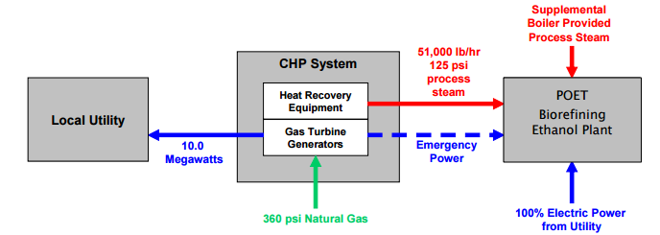
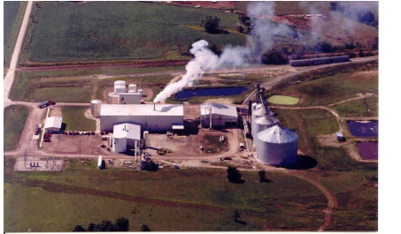
Project Snapshot:
Partnership with an Ethanol Plant
POET Biorefining & City of Macon, Missouri
Macon, MO
Application/Industry: Ethanol Plant
Capacity: 10 MW
Prime Mover: Gas Turbine
Fuel Type: Natural Gas
Thermal Use: Thermal requirements of the ethanol production process
Installation Year: 2003
Energy Savings: 15-25% reduction in natural gas steam producing costs
Highlights: The CHP system at POET provides nearly 60% of the facility's steam requirements, electric power for the plant and local grid. The plant has experienced numerous grid outages since CHP operations began in 2003 and has successfully maintained operation of the plant during these outages by switching the load totally to the CHP system, according to plant General Manager, Steve Murphy.
Source: http://www.midwestchptap.org/profiles/ProjectProfiles/POETandCityofMacon.pdf

Slide 29
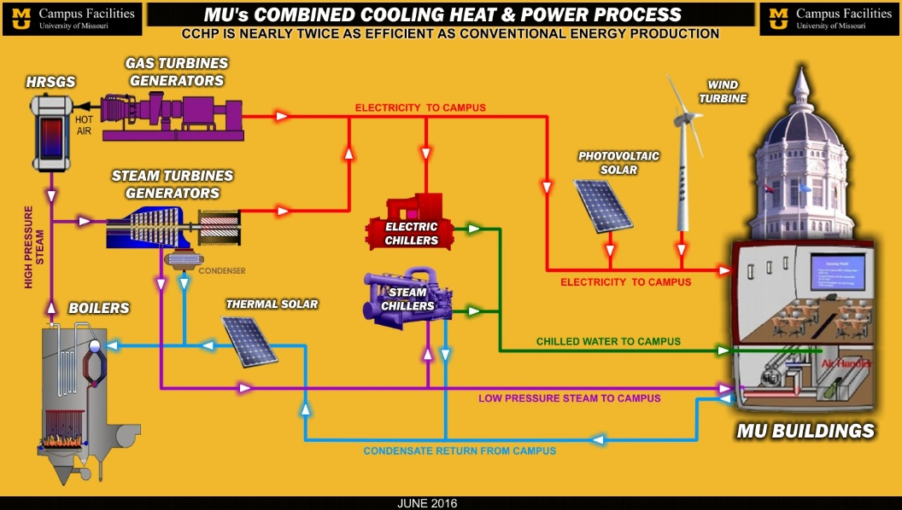
Project Snapshot:
Green University Campus
University of Missouri
Columbia, MO
Application/Industry: University Campus
Capacity: 99.5 MW
Prime Mover: Steam turbines, gas turbines
Fuel Type: Biomass
Thermal Use: Steam, heating, cooling
Installation Year: 1961
Highlights: MU has been producing energy using various forms of CHP since 1892. The plant serves a wide variety of campus buildings and facitlities, including two hospitals, a veterinary teaching hospital, a research reactor, numerous research facilities and laboratories, as well as classroom buildings, residence halls, dining facilities, athletic facilities, computer centers, and administrative buildings. The university recently replaced one of its coal-fired boilers with a 100% biomass-fired boiler integrated with the existing steam turbines, reducing coal use by 54%.
Source:
www.energy.gov/chp-installs
www.epa.gov/chp/our-partners
www.cf.missouri.edu/cf/em/eff

Slide 30

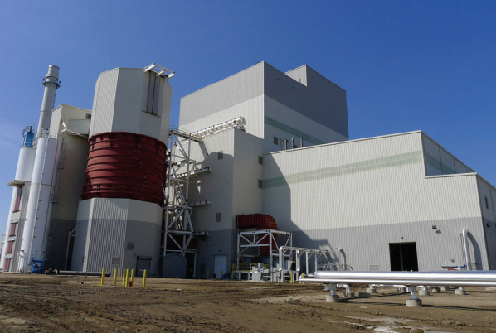
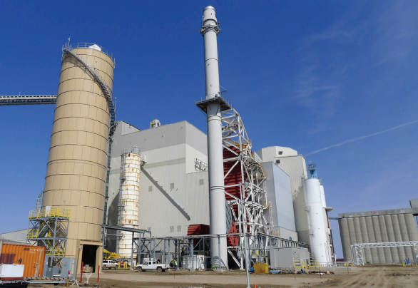
Project Snapshot:
Partnership with Industrial Facilities
Great River Energy Spiritwood Station
Jamestown, ND
Application/Industry: Utility
Capacity (MW): 99 MW
Prime Mover: Boiler/Steam Turbine
Fuel Type: DryFine Lignite Coal
Thermal Use: Steam
Installation Year: 2014
Energy Savings: Unknown
Highlights: Spiritwood Station’s cogeneration facility created 43 jobs for the local economy, including 24 direct jobs at the CHP plant. The plant provides electricity for the regional market and steam for the nearby Cargill Malt plant and the Dakota Spirit AgEnergy biorefinery.
Source: http://www.greatriverenergy.com/makingelectricity/newprojects/spiritwood_fact_sheet.pdf

Slide 31

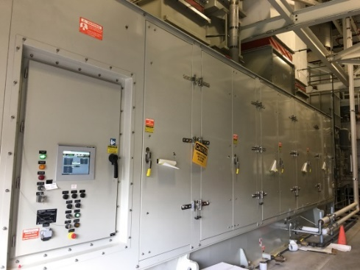
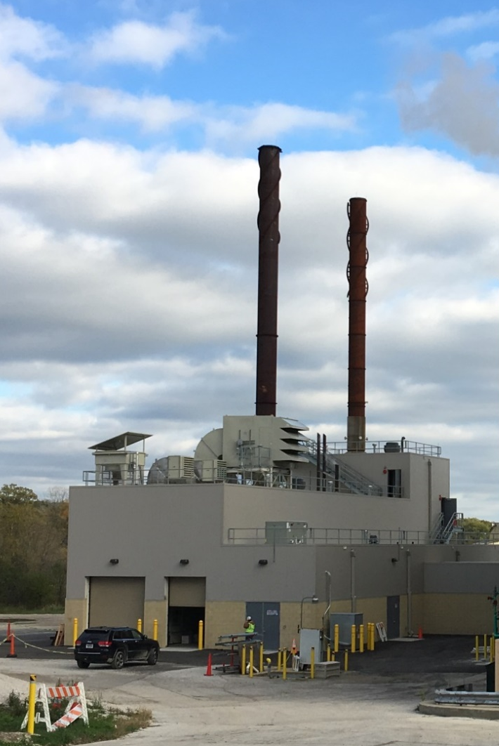
Project Snapshot:
Participating in Energy Efficiency Programs
Argonne National Laboratory
Argonne, Illinois
Application/Industry: Government Facility / National Laboratory
Capacity (MW): 6.3 MW
Prime Mover: Combustion Turbine
Fuel Type: Natural Gas
Thermal Use: Steam for Campus
Buildings
Installation Year: 2015
Highlights: Argonne National Laboratory (ANL) received energy efficiency incentives through the Illinois Department of Commerce and Economic Opportunity's (DCEO) Public Sector CHP Pilot Program. The CHP plant will help protect the lab from grid service interruptions, which is essential for Argonne as a science and engineering facility.
Source: https://www.anl.gov/sites/anl.gov/files/
Combined_Heat_and_Power_Plant_fact_sheet.pdf
Notes:
20% of electricity needs, 80% of steam needs / also used energy performance contract

Slide 32

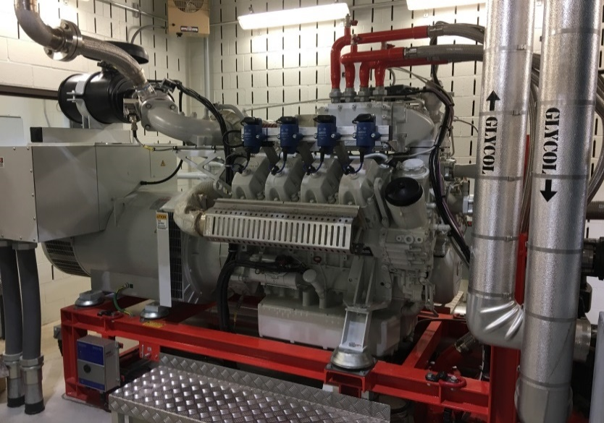
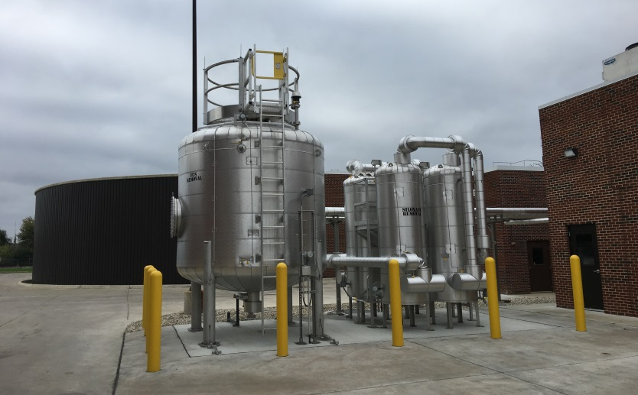
Project Snapshot:
Participating in Energy Efficiency Programs
Glenbard Wastewater Authority
Glen Ellyn, Illinois
Application/Industry: Wastewater Treatment
Capacity (MW): 750 kW (2 x 375 kW)
Prime Mover: Reciprocating Engines
Fuel Type: Biogas & Natural Gas
Thermal Use: Heating Digesters
Installation Years: 2016
Highlights: The Glenbard Wastewater Authority received energy efficiency incentives through the Illinois Department of Commerce and Economic Opportunity's (DCEO) Public Sector CHP Pilot Program, which is part of the Illinois Energy Now Public Sector Program. To boost biogas production, the Glenbard Wastewater Authority also receives food waste and fats, oils, and greases (FOG).
Source: http://www.gbww.org/wp-content/uploads/
2016/03/Glenbard-CHP-Project_Final.pdf

Slide 33
U.S. DOE Resources

Slide 34
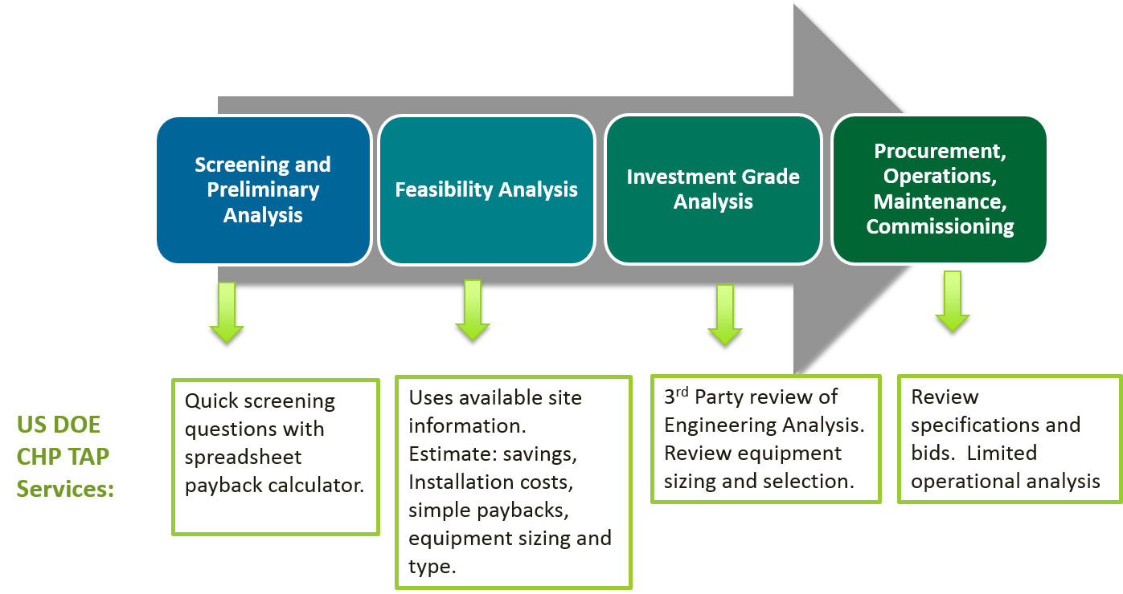
CHP TAP Project Development Technical Assistance
Notes:
Uses available site information.
Estimates savings,
Installation costs, simple paybacks, equipment sizing and type.
INTERESTED CUSTOMER
3rd Party review of engineering analysis. Review equipment sizing and choices.
SERIOUS OPPORTUNITY
Review
specifications and bids, limited operational analysis.
PROJECT IMPLEMENTATION
$$ THIS IS A PRO FORMA TYPE OF SALE $$

Slide 35
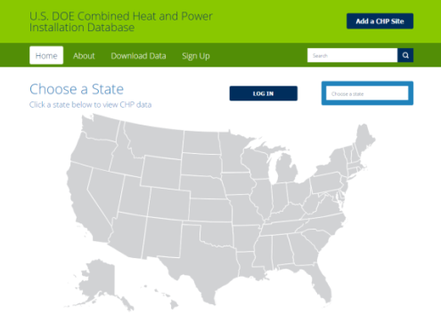

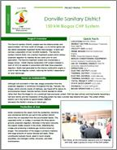
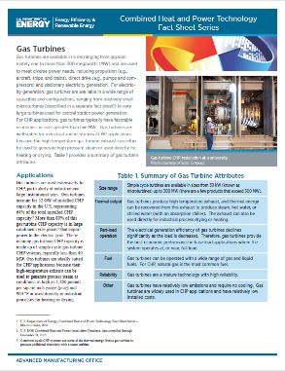
Additional CHP Project Resources
U.S. DOE CHP Installation Database
  Comprehensive data collection listing CHP installations through the country
  Data includes site location, type of prime mover, system size, fuel type, year installed
  www.energy.gov/chp-installs
U.S. DOE CHP TAP Project Profiles
  2 page fact sheets providing information and lessons learned of operating CHP systems (100+ available)
  www.energy.gov/chp-projects
U.S. DOE CHP Technology Fact Sheets
  5 fact sheets that explain the fundamentals and characteristics of the most common CHP technologies
  http://energy.gov/chp-technologies

Slide 36

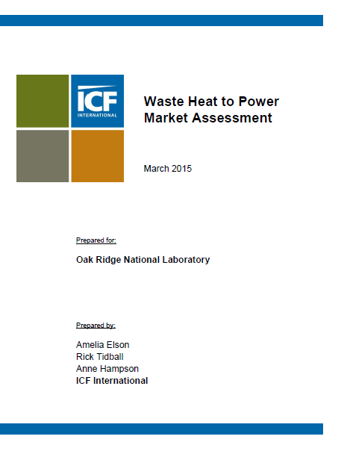
CHP Project Resources
CHP Technical Potential in the United States
Waste Heat to Power Market Assessment
http://www.energy.gov/eere/amo/downloads/new-release-us-doe-analysis-combined-heat-and-power-chp-technical-potential
http://info.ornl.gov/sites/publications/Files/Pub52953.pdf
Notes:
The “Combined Heat and Power (CHP) Technical Potential in the United States” market analysis report provides data on the technical potential in industrial facilities and commercial buildings for “topping cycle” CHP, waste heat to power CHP (WHP CHP), and district energy CHP in the U.S. The goal of the report is to provide data on the technical potential for CHP in sufficient detail for stakeholders to consider combined heat and power in strategic energy planning and energy efficiency program design. The study shows there is estimated to be more than 240GW of technical potential at over 291,000 sites within the U.S. Data are provided nationally by CHP system size range, facility type, and state. Each state’s technical potential is shown in detail on state profile pages that include break-downs by size range and facility type.

Slide 37
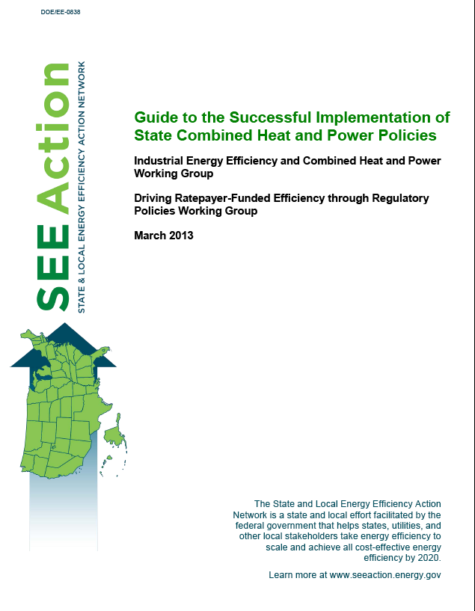
SEE Action
The Guide provides state policy makers with actionable information regarding:
Design of standby rates
Interconnection standards for CHP with no electricity export
Excess power sales
Clean energy portfolio standards
Emerging market opportunities: CHP in critical infrastructure and utility participation in CHP markets

Slide 38
Summary
CHP provides energy savings, reduced carbon footprint, resiliency benefits, economic advantages
DOE estimates 3.3 GW of CHP technical potential at Missouri industrial and commercial facilities (plus an additional 1.1 GW in export potential)
Opportunities for cost-effective CHP can be realized through utility-industry partnerships, utility ownership, and/or utility incentive programs
Please contact the U.S. DOE Midwest CHP TAP for technical assistance and take advantage of other DOE resources
Missouri’s participation in U.S. DOE’s CHP for Resiliency Accelerator offers additional opportunities to consider CHP for improving the resiliency of Missouri critical infrastructure and businesses

Slide 39
Next Steps…contact the CHP TAP
For complimentary CHP screenings (or other technical assistance) for you or your customers
For additional information about CHP program designs and considerations, DOE resources
If you are interested in any of our education activities (we would be happy to talk to your large accounts managers or provide a webinar for your large accounts)
If you have corrections, additions, deletions to the DOE CHP installation database
If you would like to help put together some additional project profiles for successful Missouri CHP projects

Slide 40

Thank You
David Baker
Senior Research Specialist
(312) 996-2615
dsbaker@uic.edu
Cliff Haefke
Director
(312) 355-3476
chaefk1@uic.edu
Energy Resources Center
University of Illinois at Chicago
www.MidwestCHPTAP.org
40

