Slide 1

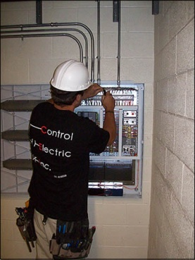


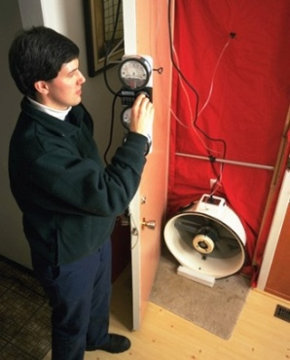
Introduction to Technical Reference Manuals for Energy Efficiency Programs
Presented by: Steven Schiller, P.E.
Schiller Consulting, Inc.
steve@schiller.com
Month date, year

Slide 2
Topics
Context/Background on EE EM&V
Introduction to TRMs
Why use TRMs
TRM examples
How To Set Up and Use TRMs
EM&V and TRM Resources
Intent is for informal presentation and discussion

Slide 3
Sources
Several of the slides and/or presentation points in this presentation were kindly provided by other people. These particularly include:
  Erin Carroll, VEIC, ecarroll@veic.org
  Tom Eckman, Northwest Power Planning Council, teckman@nwcouncil.org
  Sami Khawaja, Cadmus, Sami.Khawaja@cadmusgroup.com
  Elizabeth Titus, TRM Manager, NEEP, EM&V Forum, etitus@neep.org

Slide 4

Context and Background on EE EM&V

Slide 5
Why Evaluate?
Document impacts: Document the energy savings of projects and programs in order to determine how well they have met their goals; e.g., has there been a good use of the invested money and time? Provide PROOF of the effectiveness of energy management.
Resource Planning: Support energy resource planning by understanding the historical and future resource contributions of energy efficiency as compared to other energy resources. Provide data to support efficiency as a reliable resource.
Understand why the effects occurred: Identify ways to improve current and future projects and programs as well as select future projects. “You can’t manage what you don’t measure” and “Things that are measured tend to improve”.

Slide 6
Evaluation Types
Evaluation Type | Description | Example Uses
Impact Evaluation | Quantifies direct and indirect changes associated with the subject program(s) | Determines the amount of energy and demand saved
Process Evaluation | Indicates how the procedures associated with program design and implementation are performing from both the administrator’s and the participants’ perspectives | Identifies how program designs and processes can be improved
Market Effects Evaluation | Analyzes how the overall supply chain and market for energy efficiency products have been affected by the program. Market baselines. | Characterizes changes that have occurred in efficiency markets and whether they are attributable to and sustainable with or without the program
Cost-Effectiveness Evaluation | Quantifies the costs of program implementation and compares them with program benefits | Determines whether an energy efficiency program is a cost-effective investment compared with other programs and energy supply resources

Slide 7
EM&V Definitions
Evaluation - The performance of studies and activities aimed at determining the effects of a program or portfolio
Measurement and Verification - Data collection, monitoring, and analysis associated with the calculation of gross energy and demand savings from individual sites or projects. M&V can be a subset of program evaluation.
EM&V - The term “evaluation, measurement, and verification” is frequently seen in efficiency evaluation literature. EM&V is a catchall acronym for determining both program and project impacts.

Slide 8
Impact Evaluation Results
Gross Savings - The change in energy consumption and/or demand that results directly from program-promoted actions taken by program participants regardless of why they participated
Net Savings - Refers to the portion of gross savings that is attributable to a particular program. Attributing changes to one cause (i.e., a particular program) or another can be quite complex
Non-Energy Benefits (NEBs) - Identifiable non-energy impacts associated with program implementation (e.g., avoided emissions and environmental benefits, productivity improvements, jobs created and local economic development, reduced utility customer disconnects, higher comfort and convenience)

Slide 9
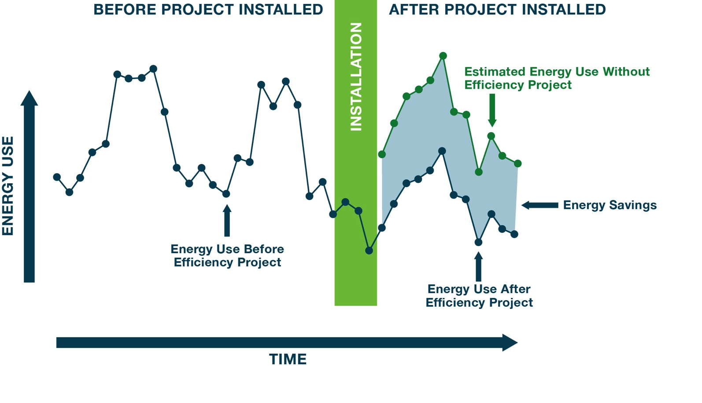
Savings Cannot Be Measured -
They Are Estimated
Graph of Energy Consumption Before, During And After Project Is Installed
Notes:
Measure Energy
Adjust energy in baseline period to conditions of the reporting period

Slide 10
The Big Issues of EM&V
How good is good enough?
As compared to what?
Fundamental issue of EM&V
How certain does one have to be of savings estimates and is that certainty balanced against the amount of effort utilized to obtain that level of certainty?
EM&V investments should consider risk management principles - balance the costs and value of information derived from EM&V (i.e., EM&V should be cost-effective).
First - Defining a baseline against which efficiency actions are compared for determining energy savings and whether attribution should be considered – the counterfactual
Second – Establishing level of performance confidence and risk for efficiency relative to other options for reducing savings and risk of not getting the savings

Slide 11
Approaches for Determining Gross Energy Savings
One or more measurement and verification (M&V) options from the IPMVP (A, B, C and/or D) are used to determine the savings from a sample of projects. These savings are then applied to all of the projects in the program. Typically applied to “calculated” or “custom” measures.
Apply deemed (stipulated, default) values or calculations that are based on historical and verified data to projects and/or measures with correct applicability conditions. Typically applied to “prescriptive” or “standard” measures.
Conduct Statistical analyses of large volumes of metered energy usage data. Typically applied to “mass market” and “residential” programs and with a control group versus a participant group.

Slide 12
A “Typical” Combination for Determining Gross Savings
Set of prescriptive programs use deemed savings values for savings (e.g., residential CFLs and insulation, commercial ventilation motors, commercial building lighting)
Set of custom programs use calculated ex-ante savings estimates and 100% site verification with spot measurements (e.g., commercial HVAC measures)
Another set of custom programs use M&V savings analyses (Options A, B, C and/or D), defined in a guideline, on a census of projects (e.g., industrial process measures)
Residential weatherization program uses large scale billing data analyses

Slide 13

Introduction to TRMs

Slide 14
Definitions
Deemed Savings Value: (Stipulated Savings Value, Unit Energy Savings). Estimate of energy or demand savings for installed EE measure ‘per unit’:
  Used for well understood and documented EE measures
    For example: energy-efficient appliances such as washing machines, computer equipment and refrigerators, and lighting retrofit projects with well-understood operating hours
  Has been developed from reliable data sources and analytical methods
  Is applicable to the situation being evaluated
Deemed Savings Calculation: An agreed-to (stipulated) engineering algorithm(s) used to calculate the energy and/or demand savings associated with an installed EE measure(s).

Slide 15
Deemed Savings
They are used a lot!
But, Must Be Used With Caution
Have to be applied where appropriate – only!
The use of deemed values in a savings calculation is an agreement to accept a stipulated value, irrespective of what actually “happens”.
When using deemed values, it is important to realize that technologies alone do not save energy - it is how they are used that saves energy

Slide 16
Deemed Savings and Algorithm Resource Database – AKA “TRM”
TRM is a resource (document, database, website) that includes information used in program planning, reporting and evaluating of EE programs which can include:
  Energy efficiency measures metrics or characteristics (e.g. ,savings)
  Engineering algorithms to calculate savings
  Specific parameters needed to calculate savings
  Factors for applying to calculated savings (e.g., net-to-gross ratios)
Typically include documentation of:
  Assumptions (e.g., baselines) used to prepare values
  Calculations of values
  When (what appropriate applications) to apply values and algorithms
Provide a common reference for utility program managers, implementers, evaluators, and regulators

Slide 17
TRM Contents
For each measure, the TRMs often, but not always, include either specific deemed values or algorithms for calculating one or more of the following:
  Electric energy and demand savings
  Fossil fuel energy savings
  Incremental costs
  Measure lives
  Note that these are often the values required for determining cost-effectiveness
And sometimes:
  Net to gross ratios
  Non-energy benefits - e.g. water savings, avoided emissions

Slide 18
How Values Are Indicated
Measure savings may be represented in one of three ways (or combinations):
Fully Deemed - Fully stipulated (deemed) savings value
  Used when savings are well studied
Partially Deemed Algorithm - Savings based on a formula where input parameters are stipulated or based on project-specific conditions
  Most common approach, allows for some variability
Fully Calculated Algorithm - No stipulated parameters
  Used for highly variable savings for a given measure
Notes:
Modified Cadmus Slide

Slide 19
Measure Spectrum
Graphic from VEIC
Notes:
Dealing
Effectively with
TRM Development
Erin Carroll, Vermont Energy Investment Corporation
AESP online online conference 2013

Slide 20
Applicability Conditions
Graphic from VEIC
Notes:
Dealing
Effectively with
TRM Development
Erin Carroll, Vermont Energy Investment Corporation
AESP online online conference 2013

Slide 21
TRM Formats
Can be in different formats
Online database
Downloadable database (most common):
  Electronic Database – often Excel worksheets, provides lookup values for tracking system
  PDF – text format with common sections for each measure protocol; most common format for recent TRMs
  Word – text format, similar to PDFs
Notes:
Cadmus Slide

Slide 22
TRM Coverage and Administration: Geographic or Jurisdictional Options
Regional/Statewide
  Used to specify the basis for determining savings values claimed by any program administrator (e.g., utility) in a region or state. Often developed through a multiple stakeholder process
  Administered by regional non-profit, state commission or agency, advisory committee, program administrator
Program Administrator (e.g., utility)
  Used to specify the savings values claimed by a single utility. Often developed by that utility.
  Administered by utility

Slide 23
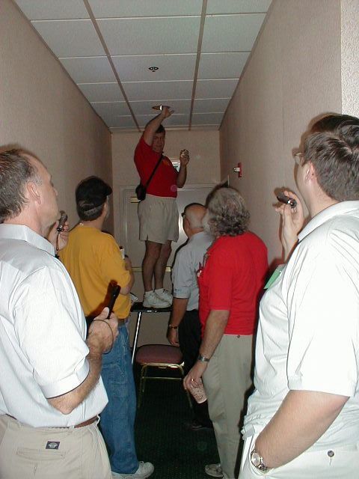
Why Use TRMs

Slide 24
TRM Advantages
Saves time and money while providing relative accuracy – calculate once for state, versus over and over again for each utility and each program (and project?), and perhaps doing that every year
  Allows evaluators to better allocate resources
Pre-vetted, pre-approved values – reduce regulatory risk and provide certainty for regulator, utility, implementer and (maybe) customer
Maintains state-wide consistency across utilities
  Planning and evaluation values will be calculated using the same methodology while allowing for utility specific inputs
  Evaluation findings (e.g., billing analysis, metering, survey data) inform TRM updates allowing utilities to pool evaluation resources

Slide 25
TRM and Deemed Savings Cautions
Can they be dangerous? Yes!
  Only as good as the data, analysis, and QC that goes into them (garbage in…..)
  Requires experienced oversight to ensure proper use
  Accurate on average (should be - can be even better than case by case M&V)
  Accurate for each project and customer (probably not…..)
Use care not to put the cart before the horse
  Need good baseline data (baseline data, performance data, saturations, load shapes)
  Need to build off evaluation and other field/lab results (empirical vs. theoretical)
  Carefully select data from other jurisdiction’s TRMs (see next slide)
Watch out for:
  Applying values where they are applicable!
  Systematic biases
  Interactive and stacking effects (multiple measures in same facility)
Need transparency and detailed documentation with a detailed guide on how to use the data and algorithms

Slide 26
TRM Comparison
Cadmus conducted a scoping study for regional TRMs for U.S. DOE and LBNL; the study included an assessment of savings values for 20 measures covering different fuels, sectors, end-uses in multiple TRMs
  See this website for the report and other resources: http://www1.eere.energy.gov/seeaction/evaluation.html
Findings:
  Savings estimates vary by order of magnitude across sources
  Main drivers of variances are:
    Differing baseline assumptions (e.g., hours of use, weather, prevailing codes)
    Source of savings calculations (building simulation versus engineering algorithm)
    Parameters included in algorithm (e.g., use of HVAC interaction factor for lighting)

Slide 27
Bottom Line
TRMs
  Create greater savings certainty and consistency for savings values, and perhaps more accuracy
  Are widely assumed to reduce a state’s EM&V costs
  Focus EM&V resources
  Statewide or regional TRMs are becoming essentially a standard practice
But
  As with any tool need to be used for the right use and with caution
  Require (a) agreement among stakeholders, (b) some startup research and costs, and (c) time to get going

Slide 28

TRM Examples

Slide 29
Quick History of TRMs
1990s – The first databases of savings
  Northwest Power & Conservation Council’s Regional Technical Forum (RTF) Unit Energy Savings (UES) Workbooks Database
  California Public Utility Commission (CPUC) Database for Energy Efficient Resources (DEER)
2000s – Continued work by the RTF and CPUC and new documents called Technical Reference Manuals
  The sophistication of the RTF’s UES Database and DEER laid the groundwork for more
  More states started to develop these resources for the use of all utilities within the state
Now
  More and more jurisdictions are adopting TRMs
  Movement to create regional if not national standardization of resources
  U.S. DOE supporting efforts at standardization
Notes:
Modified Cadmus slide

Slide 30
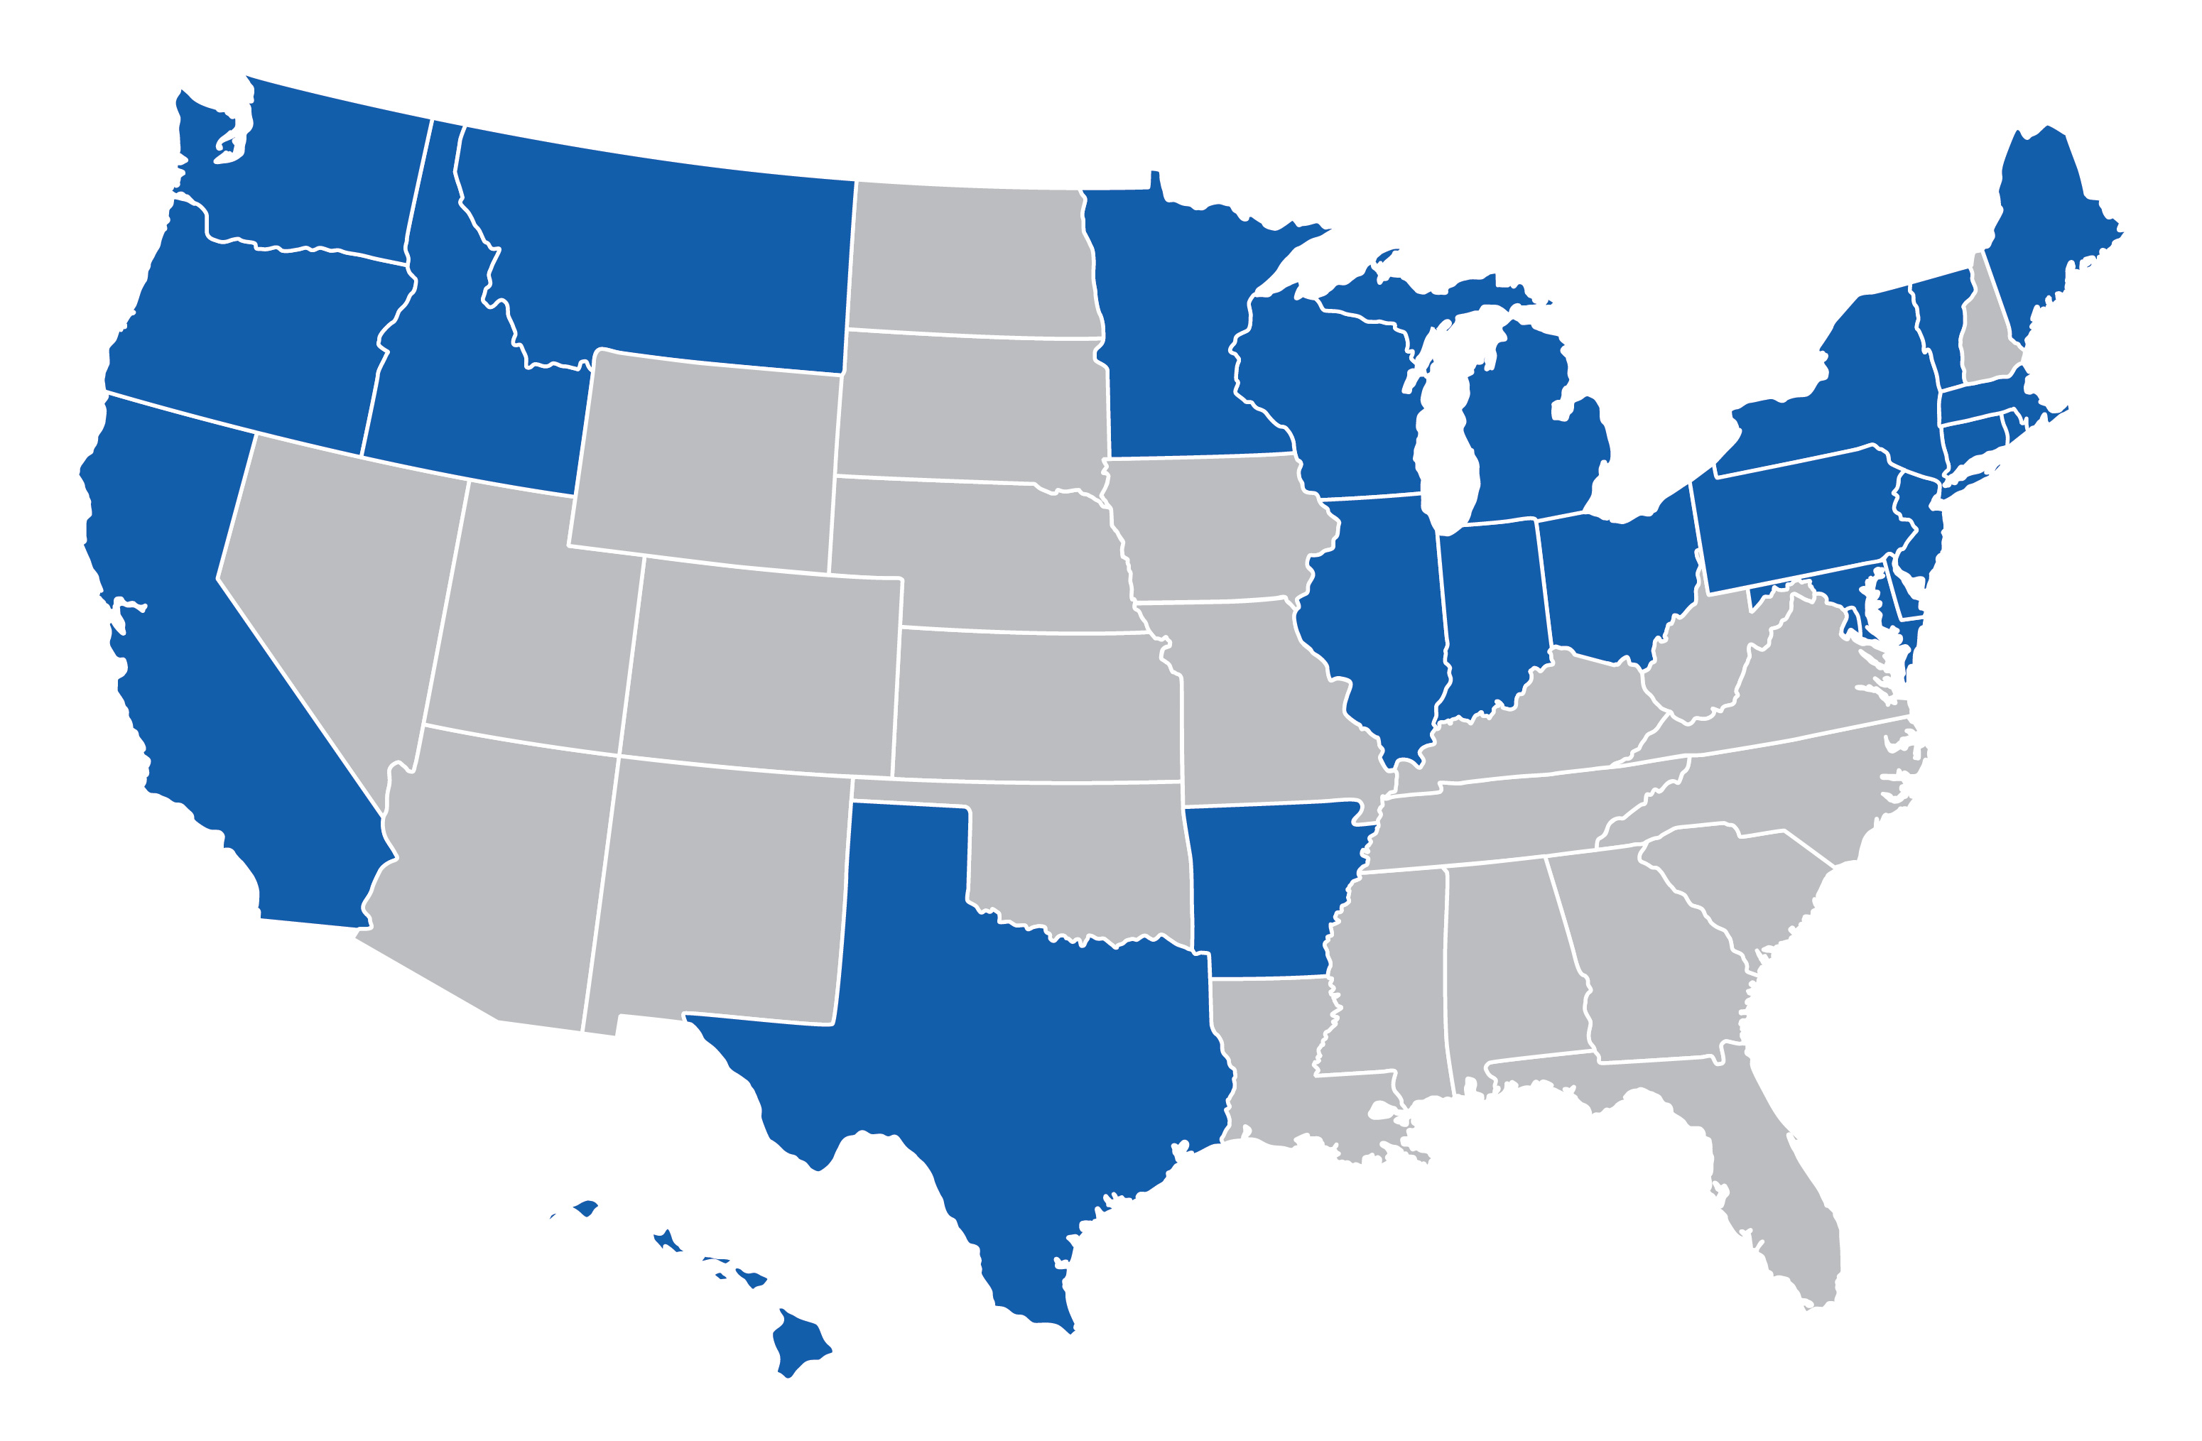
Today’s National Picture
23 states have TRM resources (from Cadmus study, see resources section)
And so does New Mexico..

Slide 31
Introduction to Two Regional TRMs
Mid-Atlantic TRM – slides from Elizabeth Titus of NEEP
Northwest Regional Technical Forum – slides from Tom Eckman of the RTF

Slide 32
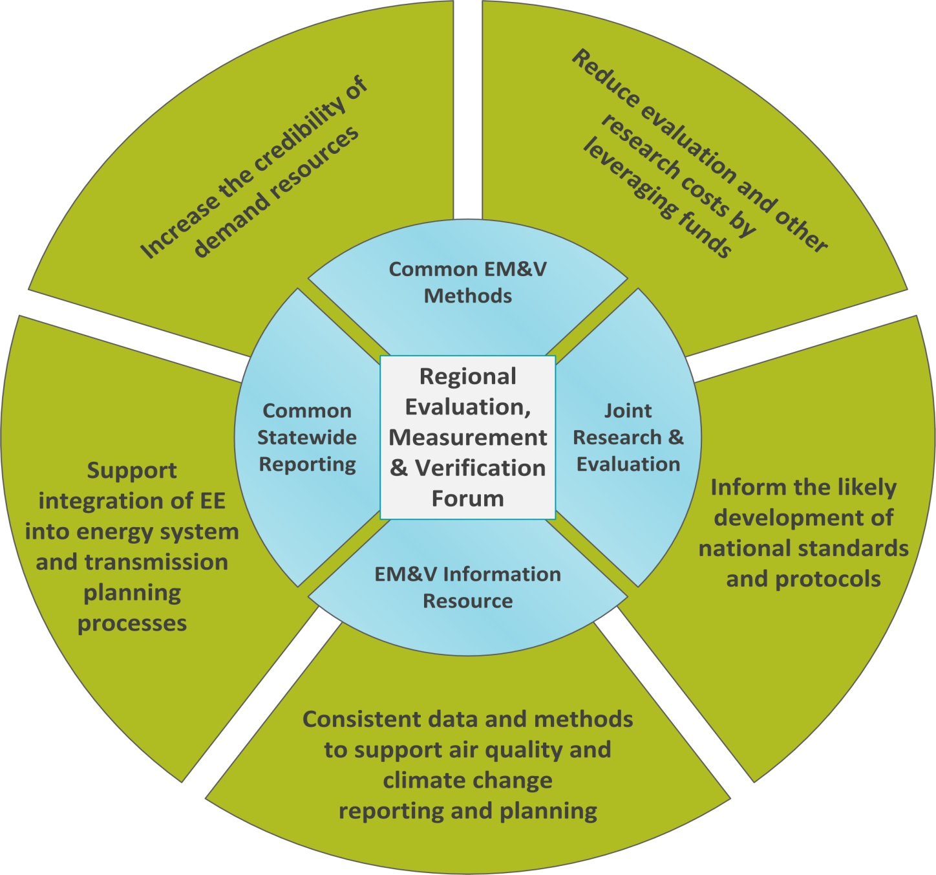
Regional (Northeast/Mid Atlantic) EM&V Forum
Launched in 2008, the Evaluation, Measurement, & Verification (EM&V) Forum is a project facilitated by NEEP, whose purpose is to support the development and use of consistent protocols to evaluate, measure, verify, and report the savings, costs, and emission impacts of energy efficiency and other demand-side resources.
Notes:
NEEP Slide from AESP webinar

Slide 33
Forum Participants and Multistate (Mid-Atlantic)TRM
Maryland, Delaware and District of Columbia stakeholders developed one Technical Reference Manual in 2009
Now developing the update process; informed by research on experience from 6 individual state TRMs (IL, ME, MA, NJ, PA, VT)
Who is Involved in Forum

Slide 34
Northwest Regional Technical Forum an advisory committee established in 1999 to develop standards to verify and evaluate conservation savings
Northwest Power and Conservation Council
Regional
Stakeholders
Regional Technical Forum (RTF)
Regional Technical Forum
Policy Advisory Committee
(RTF PAC)
RTF Subcommittees

Slide 35

RTF TRM
A decade of experience
  “Codified” decision-making process
  http://rtf.nwcouncil.org/subcommittees/Guidelines/RTF%20Guidelines%202013-04-16.pdf
Their process for information:
  Research
  Quantify
  Deliver
  Verify

Slide 36
Measure Category/Quality Standards
Peer reviewed by RTF for measures with regional applicability and reasonable expectation that data will be collected to bring measure through an RTF path in the future
Planning
Baseline use can be reliably estimated, efficient-case use can be only be reasonably approximated. RTF approves with conditions requiring the collection of data documenting efficient-case use to improve reliability of savings estimation.
Provisional
Statistical or calibrated engineering data are available and reliable to characterize both the baseline and efficient-case energy consumption for measure-affected end uses
Proven
Small Saver
RTF approves based on sound engineering analysis and applicability to the region and because cost to obtain quality data outweighs expected regional savings potential
Notes:
Small saver most likely to be UES
Custom/Standard/PIE all require local technical infrastructure; largely aimed at commercial and industrial. Most res measures are UES.
UES and Standard – RTF approves detailed estimation procedures
Custom/PIE – RTF provides general guidance
Intention is that each method will produce savings estimates of comparable reliability at the lowest reasonable cost
Guidelines define level of treatment for approved methods
Guidelines rely on impact evaluation to
Reliably estimate savings for all the other measures
Provide data for developing and improving UES and standard protocols
RTF provides peer review of research designs

Slide 37
Guidelines Measure Status
Active
Under Review
Errors need to be corrected
Out of Compliance
Lack of data sources identified that can bring the savings estimations into guideline compliance
Calculation updates with new identified data sources
Calculation updates with data to be developed or sought
1 year to bring research plan to RTF for review
De-activated
Inadequate data exists to bring into compliance with Guidelines
Federal/State codes require target efficiency level
Measure meets all requirements set forth in Guidelines
Notes:
Designates status with regards to guidelines compliance, not utility offering status

Slide 38
RTF - Getting to Unitized Savings (UES)
Statistical or meta-statistical data
  Quality judged by relative error of mean savings estimate
  Avoid when savings significantly interact with other measures due to large sample needs
Calibrated engineering models
  Adjusted to individual cases or to the average characteristics and consumption of groups
    Ex. SEEM heating loads calibrated to billing data from representative sample of SF homes
  Savings expected to be regionally applicable
  Significant interactions need to be dealt with

Slide 39

They Have No Secrets!
  RTF decisions, work papers and supporting data are all accessible via the web:
Work
  http://rtf.nwcouncil.org/

Slide 40
A Few State Examples
Energy Trust of Oregon
  Primarily fully deemed values in the database developed in conjunction with analysis completed by Regional Technical Forum; some calculators
  Used for programs, and made specific to Oregon IOU territory
  Updated as needed with EM&V results
Michigan Energy Measures Database
  Used by program planners and claimed savings
  Fully deemed values for most measures
  Allows for consistency of assumptions across state
  Updated annually
Pennsylvania TRM
  Primarily partially deemed algorithms with inputs based on look-up tables or customer-specific application data
  Used for program planners and claimed savings
  Updated annually
Notes:
Cadmus slide

Slide 41
Lets run through some examples…..

Slide 42

How To Set Up and Use TRMs and
Lessons Learned

Slide 43
Planning, Implementing, and Evaluating Efficiency Programs
A TRM Is Used in All Three Activities

Slide 44
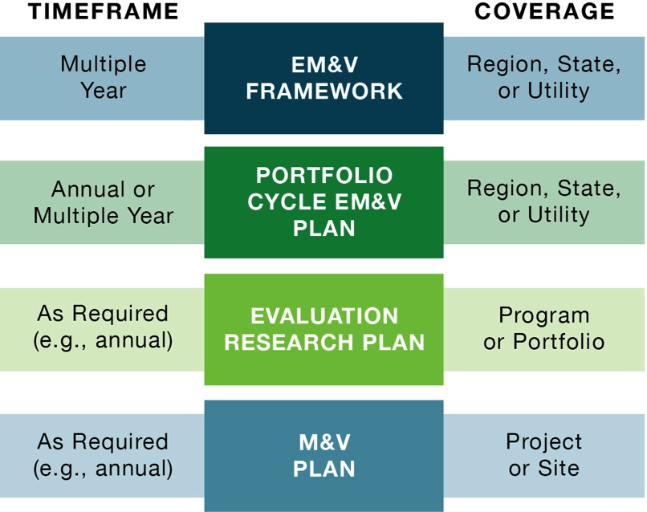
Structure for Defining Evaluation Activities – including TRMs
EM&V Framework – Primary document that lays out top level structure. This is perhaps the principle document that all stakeholders can focus on and provide high level input. When used -
  In some states it is standalone document, in other part of an overall “EE Rule”
  This is where the TRM concept gets defined
Portfolio (annual) Plans – Indicates major evaluation activities that will be conducted during the evaluation cycle
Evaluation Research Plans – Created for the major EM&V activities
Site Specific M&V Plans – For custom project sites that are analyzed and inspected

Slide 45
Timing: Portfolio Cycles and TRMs
Timing for a new TRM – based on typical timing, for example:
2014-2015- parties engaged to agree to support development of statewide TRM; Framework/Work Plan developed
Fall of 2015 – Technical consultant hired to prepare TRM
Summer of 2016 –TRM V 1.0 approved
  Time for technical consultant’s work – ~3 to 6 months
Program Year 2017 – first program year that uses TRM
TRM updated every year (not necessarily every measure – but measures can be dropped, added, or modified)
Could timeframe for first TRM be reduced? Maybe could have TRM by Summer 2015 if:
Stakeholders and commission agree to move forward and hire consultant by end of this year – and/or –
Commission decides to simply utilize existing TRM or join mid-Atlantic TRM process

Slide 46
How TRM Efforts Get Initiated
Most are "ordered" or just agreed to by a Commission or perhaps an advisory board if there is a third-party EE administrator.
With these TRMs operating in about half the states, sooner or later every Commission, stakeholder, administrator, and/or group of implementers says:
  Why are we recalculating or re-justifying the same savings values over and over again?
  Why does one of our utilities use “x” and another ”y” for the savings for the same measure?
  We need certainty – i.e. risk management
  We could save time and money
The barriers are usually money and process:
  Its almost certainly cheaper to do one for the state versus one per utility or implementer, but those costs are buried, versus a single larger line item
  Utilities and implementers would prefer that the Commission approves the TRM - to avoid second guessing, i.e. to provide certainty

Slide 47
Getting a TRM Process Started
Research (review 0ther states’ and regions TRM efforts)
Set Objectives:
  Used for planning, reporting and/or in place of ex-post savings determination?
Decide what information is needed:
  For example, gross and/or net savings values, cost data, effective useful life
  Deemed saving values only or also calculation tools? Include work papers for custom measures?
Answer some questions:
  Is it the commission’s or utilities’ database? How is it reviewed? How is it approved?
  Start from scratch or start with another state’s system and customize? Join a regional effort?
  Build large system (lots of EE measures) from beginning or start small (just high priority EE measures) and build up as data warrants?
  What format – on-line, spreadsheet, pdf, etc.
  Who develops, verifies, and maintains data?
  What are criteria for “good” data and how rigorously it is verified and applied appropriately. How are baselines defined?
Then set budgets and timeframes – and a framework and/or work plan

Slide 48
Typical Steps to Develop a TRM
Establish a process for addressing the previous slide’s points and questions, then prepare a framework document or work plan
Mostly likely next step is to hire a technical consultant to lead development of the TRM (with perhaps input from advisory committee)
  The framework document or work plan becomes the basis for work scope, time frame, and budgets in (or response to) RFP
Prepare TRM draft and final
  Work with stakeholders, particularly utilities, to decide what measures to include
  Review existing savings data resources, identify strengths and weaknesses
  Approve TRM for next program cycle
Have a clear update and review plan
  Some TRMs incorporate a sunset date for measures
  TRMs are often updated annually, though not all measures will be reviewed

Slide 49
Process for Evaluating Measures
Graphic from VEIC
Notes:
Dealing
Effectively with
TRM Development
Erin Carroll, Vermont Energy Investment Corporation
AESP online online conference 2013

Slide 50
One Issue: Who Does Evaluation (and TRMs)
“A National Survey Of State Policies and Practices For the Evaluation Of Ratepayer-Funded Energy Efficiency Programs” Martin Kushler, Seth Nowak, and Patti Witte February 2012 Report Number U122. www.aceee.org
Administration of the evaluation function:
    37% utility administration
    36% administration by the utility regulatory commission or a combination of the commission and utilities
    27% administration by some other government agency or third-party entity
Most states (79%) rely on independent consultants/contractors to conduct the actual evaluations with 21% using utility and/or government agency staff
Often the statewide evaluator is the consultant preparing a statewide TRM

Slide 51
Updating Process
Review and summarize other jurisdiction’s TRM update processes for comparison and guidance
Recommend an overarching strategy to update the TRM in a timely and appropriate manner, to best meet the needs of the organizations using it
Interview stakeholders to identify needs and schedules relevant to the update process, commonalities that are mutually supportive of a single process and schedule, as well as any unique needs or situations that necessitate extra attention.
Identify measures to be added or updated in the next round of TRM measure development
Notes:
----- Meeting Notes (9/29/14 11:28) -----
what other states are doing is probably what any state will have to do, directionally, at some time

Slide 52
Lessons Learned - Process
Establish definitions for metrics (gross, net, incremental savings, lifetime, etc.) and measures
Clearly define roles and responsibilities of different participants
Define process for input and approval of TRM and updates
  Strive for transparency, wide input and limited legal/regulatory hoops required to make changes
Decide whether values are to be “expected values” or “conservative values” (remember EE savings are estimates)
Provide some guidance on selection criteria for what measures go in the TRM
Process guidance should make it clear what assumptions are used and for which purposes – baselines!
Decide how values are used – “looking back” or “going forward”

Slide 53
Looking Back or Going Forward?
  For the affected measures the per unit energy savings are based on the values found in the TRM – but which version for what purposes and when?
      TRM values can and do change – mistakes found, better data, baselines change, etc.
  For example:
      TRM updated in November 2013 and November 2014 and November 2015
      Program plans submitted in August 2014 – used November 2013 TRM values
      Program approved in December 2014 - with November 2013 TRM values
      Program implemented in 2015 – which TRM version should be used for claimed savings?
      Program evaluation completed in 2016 - which TRM version used for evaluated savings?
      What’s fair to utility? What’s fair to the ratepayers? What’s right for system planners?
  Points out two issues:
    Should line up program planning, approvals with TRM updates – it would have been much better if the 2014 TRM update was done in summer of 2014 versus fall
    Should decide in framework whether utilities get credit for savings based on looking back or going forward TRM versions
      Common approach is using TRM values valid at time of program approval
Notes:
----- Meeting Notes (9/29/14 11:28) -----
changes driven by exogenous factors too

Slide 54
Lessons Learned - Updates
Define update cycle that matches planning cycles (or planning and reporting if retroactive application)
  Typically annual or every other year
  Be realistic on time required to do updates
Use savings verification and evaluation results to inform updates
Develop process where old measures are systematically reviewed through annual update process
Maintain a reference library to track:
  Changes
  Feedback
  Error corrections
  New information including new measure suggestions and references
Notes:
From Mid-Atlantic Technical Reference Manual (TRM)Updating Process Guidelines
September 5, 2012
Prepared for the NEEP Regional EM&V subcommittee by Bret Hamilton, Shelter Analytics
Sam Dent, Dent Energy
and Matt Socks, Optimal Energy
Under the direction and assistance of Elizabeth Titus, NEEP
Lessons learned, some examples and some recommendations
Clearly define roles and responsibilities
There should be an individual or governing group who is ultimately responsible for keeping the document up to date and determining who works on the analysis and adjustments during updates, as well as facilitating final approval of changes and updates.
The consultant team thinks NEEP currently fills this role well, working with the subcommittee and EM&V Forum Steering Committee in a consensus based process.
Limit the legal/regulatory hoops required to make changes
Some jurisdictions such as Pennsylvania require approval by the regulator and significant public consultation for any TRM adjustment - this can significantly hold up the process of updating or developing new measure characterization and can limit energy efficiency program offering
Others, as in Vermont, give the evaluator/regulator significant opportunity for input but the TRM does not need to be formally approved to be used. If significant disagreements remain they are addressed during the annual Technical Advisory Group meetings prior to the savings verification process.
The current consensus "approval" process appears to be meeting the needs of the stakeholders in the Mid-Atlantic, so no change is recommended here. It may be noted that adding complexity to the TRM approval process can limit the ability to add new measures and update existing ones at the pace necessitated by the rapid market transformation occurring in the energy efficiency industry.
Process guidance should make it clear what assumptions are used and for which purposes
Implementers need some level of consistency in measure savings assumptions to allow adequate planning and goal setting for subsequent program years. Massachusetts handles this by always having two active versions - "Planning" and "Report" TRMs. For the Mid-Atlantic, we think deciding when and whether assumptions should be used for planning purposes, ex post evaluations or goal setting is subject to preferences of the implementers and evaluators..As such we propose not to insert any language on this topic in the TRM but assume that either
Page |4
utilities or PSC staff will add this information either to the TRM or in some other forum or publications.
Set expectations about update cycle so jurisdictions can decide whether adjustments apply to current year or only future years
Vermont allows flexibility (case by case) as to how and when adjustments should apply. Characterizing measures to reflect existing implementation methodology, or to correct clerical errors identified during the annual review process can be performed retroactively. New measure developments and additions are performed proactively. Measure characterizations are submitted for DPS and 3rd party evaluator review through a portfolio update process.
Massachusetts applies changes and files a "Report TRM" ex-post (after evaluations are complete and results are included in annual performance reports).
The Pennsylvania process takes too long for retrospective corrections and is used only ex-ante, i.e. for planning.
We recommend recognizing the difference between correcting errors4 and updating parameter values based on new evaluations or research. Error corrections may be applied ex-post, updates stemming from new evaluations or codes and standards applied ex-ante. If ex-post adjustments occur, each jurisdiction may want to consider a process for adjusting or pro-rating implementation goals if impact is significant enough.
Need for regular contact among implementers, evaluators, TRM administrators
A TRM requires regular review and revision to remain useful and relevant. The EM&V subcommittee appears to be a good forum to discuss TRM changes and reach consensus.
The consensus process is valuable but can be time consuming. We recommend the stakeholders form subcommittees to address the major markets (residential, commercial, institutional, etc.) to address any concerns on an ongoing basis and keep track of the need for updates based on new programs, evaluations, research, etc. The members will be responsible for informing the regional coordinator about update requests, keeping track of program needs, and relevant new studies for future use in the TRM. The subcommittees should meet at least once per year to discuss update needs, with regular email communication in between. The central coordinator may play a role in organizing information, tracking requests, hosting and facilitating the subcommittee meetings.
4 A significant error is one that causes substantial change to reported savings. For example, if there is a minor calculation error that results in a 0.5% difference in savings, it is probably not worth the hassle of changing values ex-post. There are two factors that dictate that significance – level of savings impact and penetration. A 0.5% change to a measure that is 80% of program savings would be worth ex post update, while a 25% error to a measure that is only 0.01% of savings may not be. We think the thresholds at which action is required can be subjectively determined ad hoc. If the stakeholders find it necessary, a threshold dictating action can be agreed upon.
Page |5
Utilize savings verification and evaluation results to inform TRM updates
Stakeholders should plan to highlight good sources of specific data, recent studies and other relevant research during annual TRM update meetings and make sure that the update schedule and budget allow for proper review and incorporation of those results.
Develop process where old measures are systematically reviewed through annual update process
Vermont has made the commitment that no measure characterization in the TRM should be more than 3 years old. Existing measures older than 3 years are reviewed annually and updated with newest evaluation results and savings assumptions. We think this is a good practice and recommend it for the Mid Atlantic TRM. The Mid Atlantic TRM currently has "Effective Date" and "End Date" fields at the measure level, reflecting the last review date, and expected end date for the assumptions. We suggest adding a "Last Periodic Review" field in the TRM at the measure level. If either the elapsed time since the "Effective Date" or "Last Periodic Review" exceeds 3 years, a thorough review of all measure assumptions is triggered.
Maintain a reference library to track changes and legacy measures that allows transparency and consistency through time.
Measure histories could be archived into a single read-only document, multiple documents, or stored in a searchable database for easy reference in the future. We recommend using the completion date to identify each version, rather than version numbers (v1, v1.2, v2 etc) to make the archive easier and more intuitive to use and reference.
Develop a protocol and database to catalog pertinent feedback, error corrections, updates, new information, new measure suggestions and references
The Stakeholders will need a place and process to file, store, and retrieve all of the various types of communication regarding TRM content that develops between updates, and the action steps taken in addressing each item. We suggest use of an online resource that is accessible to the coordinators (read/write) and users (read only) to house the TRM update database. The NEEP EM&V portal web site would be an excellent location. An example can be seen at: http://www.ma-eeac.org/DPU.htm
This database will need gatekeepers5 to help reduce redundancy and keep the content concise, relevant and timely. We suggest regional coordinators in each jurisdiction act as gatekeepers to compile and submit new requests through the database.

Slide 55
So, How Much Does This Cost?
It Depends
It depends on:
  Timing – how quick you want it and how often updated
  Quality
  Scope
    How many EE measures
    Primary or secondary research in state – or just update to another
    Level of documentation
    Format
    Level of review
What format – Word documents (PDFs), spreadsheets, databases, fully integrated reporting systems, web based (or not) – all have pros and cons

Slide 56
Some Ballpark Cost Ranges (remember it depends….)
Development - $50,000 - $200,000
  Could it be less? …perhaps; could it be more? ….oh yes
Updates - $10,000 to $50,000 per year
  Mid-Atlantic TRM update is $75,000 per year, balance larger scope and review process with very efficient/experienced team (this is also about what it cost for modifying it for use in another state)
Often combined with the scope of a statewide EE evaluator
Could all be combined with tracking and reporting systems

Slide 57
Northwest RTF 2013 Budget

Slide 58
Suggestions for working group/advisory structures
Whatever the format of working group or advisors, the needs are:
  Consultants with technical expertise and independence
  Transparency through public, peer review
  Cooperative if not consensus approach to input
  Somebody in charge – provide input to an entity that makes final decision (usually the Commission)
Typically an entity (utility, non-profit, Commission) has a contract with consultants that prepare TRM and related documents
Advisory Committee provides feedback to that entity and consultants
  Members either appointed for technical expertise or constituency representation, or combination
  Members, with occasional exceptions, serve pro bono
  Working meetings and pre- and post-meeting review – active engagement required
  Preferably input is solely technical (sorry, no lawyers)
  May also provide input on selection process and selection of technical consultants

Slide 59

EM&V and TRM Resources
TRMs

Slide 60
EM&V Resources
DOE/EPA SEE Action EM&V Resources website: http://www1.eere.energy.gov/seeaction/emv_resource_portal.html
U.S. DOE Uniform Methods Project website: http://www1.eere.energy.gov/office_eere/de_ump.html

Slide 61
SEE Action Impact Evaluation Guide
Describes common terminology, structures, and approaches used for determining (evaluating):
  energy and demand savings
  avoided emissions
  other non-energy benefits
Does not recommend specific approaches - it provides:
  context
  planning guidance
  discussion of issues
http://www1.eere.energy.gov/seeaction/

Slide 62

M&V: IPMVP Options A-D
    The Retrofit Isolation Options: Options A or B
      Addresses only the retrofitted system -
      Ignores interactive effects beyond the boundary (although these may be independently addressed)
      Usually needs a new meter
    The Whole Facility Options: Options C or D
      Addresses all effects in the facility
      Retrofits AND other changes (intended and unintended)
      Often uses the utility meter
  www.evo-world.org

Slide 63
TRM Resources
List of TRMs and their websites (as of January 2013, see pages 4-6) - http://www.emvwebinar.org/Meeting%20Materials/2013/Energy%20Efficiency%20EMV%20Documents%20Resources%20January%202013.pdf
Two Regional TRMs:
  Mid-Atlantic TRM – http://www.neep.org/Assets/uploads/files/emv/emv-products/A5_Mid_Atlantic_TRM_V2_FINAL.pdf
  Northwest RTF - http://rtf.nwcouncil.org/measures/Default.asp
SEE Action – National TRM Scoping Study - http://www1.eere.energy.gov/seeaction/pdfs/emvscoping__databasefeasibility.pdf
Mid-Atlantic Technical Reference Manual (TRM)Updating Process Guidelines - https://neep.org/Assets/uploads/files/emv/emv-rfp/emv-products/Recommendations%20and%20draft%20update%20process%20for%20the%20Mid%20Atlantic%20TRM-FINAL.pdf
September 2012 webinar on TRM – www.emvwebinar.org - also AESP had webinar on TRMs as well (but fee based)
And… there are about 6-12 national engineering/EM&V consulting firms that would be happy to talk with you about their experience doing just this kind of work

Slide 64
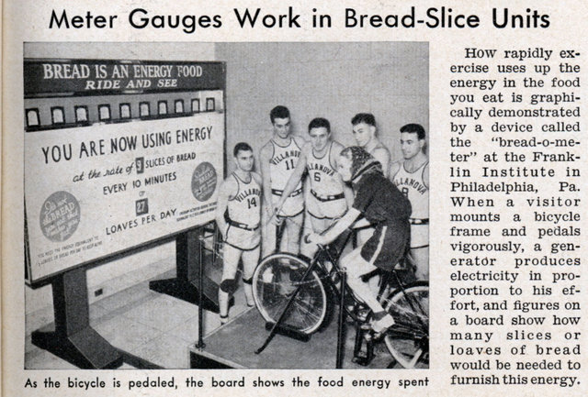
Thank You
From Albert Einstein:
“Everything should be as simple as it is, but not simpler”
“Everything that can be counted does not necessarily count; everything that counts cannot necessarily be counted”
Steve Schiller
steve@schiller.com

