Slide 1
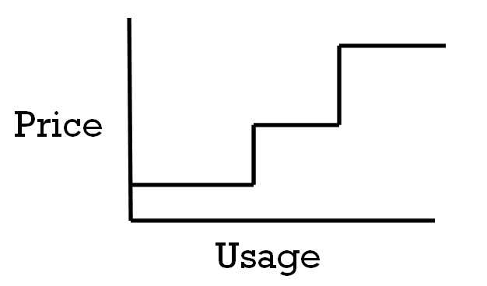
Rate Design:
Residential Electric Inclining Block Rates
Geoff Marke, Economist
Missouri Office of the Public Counsel

Slide 2
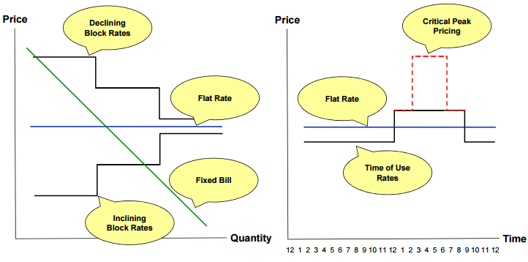
Pricing influences usage

Slide 3
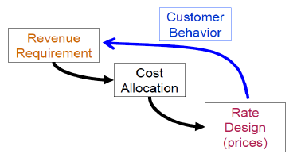
The Feedback Loop

Slide 4
Determine Rate Design Goals

Slide 5
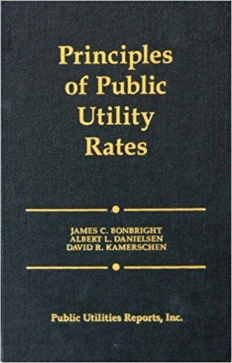
Bonbright Principles
Efficiency
Simplicity
Continuity
Equity
Stability

Slide 6
More art than science
Tradeoffs between principles
Different conditions between utilities
Different interpretations of the principles
Competing policy and/or mandates

Slide 7
Positive statements
are objective statements that can be tested, amended or rejected by referring to the available evidence.
Normative Statements
expresses a value judgment about whether a situation is desirable or undesirable. It looks at the world as it "should" be.

Slide 8
What is an Inclining Block Rate?

Slide 9
Inclining Block Rates
The more you use, the more expensive it gets
$$$
$$
$

Slide 10
What does the literature say?

Slide 11
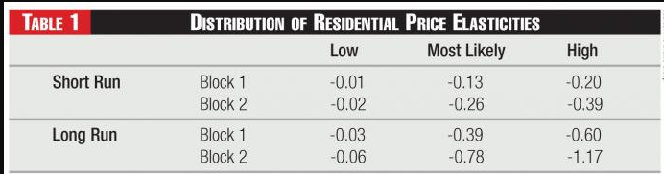
High usage = bigger price elasticity
As prices increase, less quantity is demanded
Farqui, A. (2008) Inclining Toward Efficiency. The Brattle Group https://www.fortnightly.com/fortnightly/2008/08/inclining-toward-efficiency

Slide 12
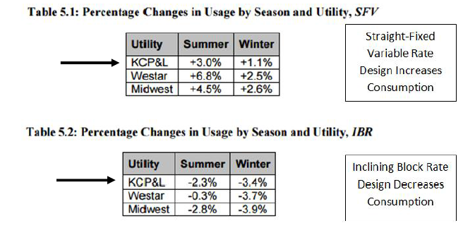
Kansas Corporation Commission Study
Hansen, D.G. and Michael O Sheasy (2012) Residential Rate Study for Kansas Corporation Commission Final Report. http://www.kcc.state.ks.us/electric/residential_rate_study_final_20120411.pdf

Slide 13
Policy Rationale Supporting
Inclining Block Rates

Slide 14
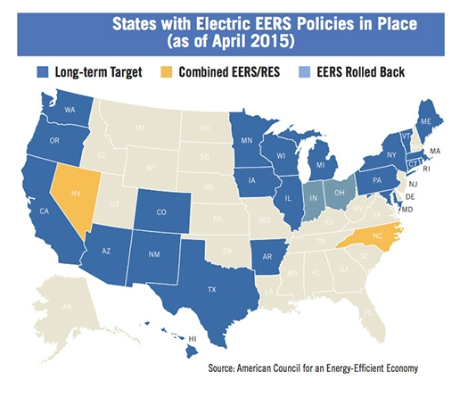
Promote conservation & meet mandates

Slide 15

Resource Crisis

Slide 16

Lifeline Rates

Slide 17
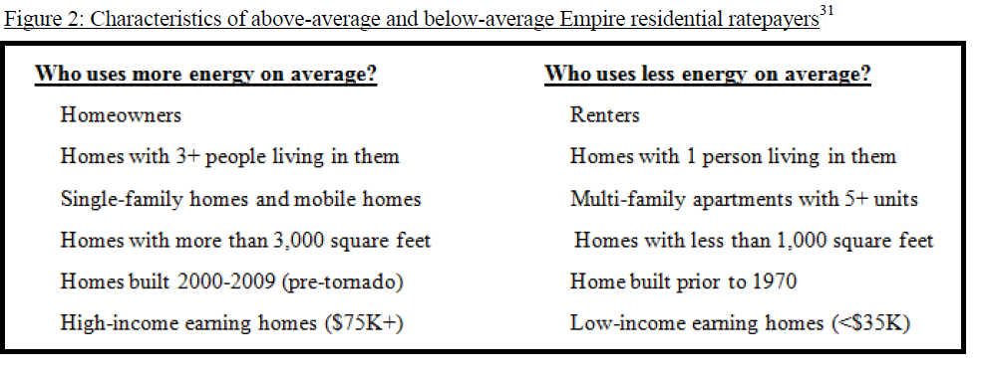
Lifeline Rates Cont…

Slide 18
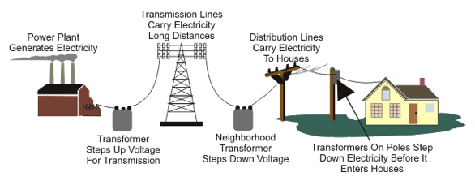
Long-run or social marginal costs
In the long run, all costs are variable

Slide 19
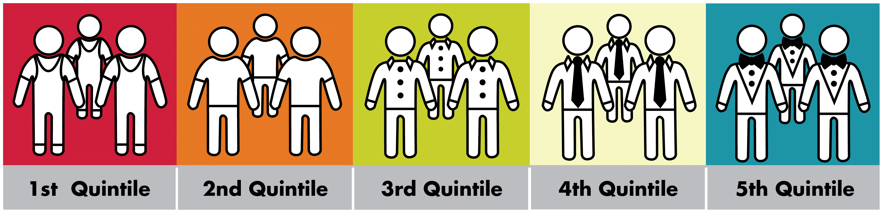
More “equitable” than energy efficiency?

Slide 20
Policy Rationale
Against
Inclining Block Rates

Slide 21

Revenue Instability
Natural Monopolies = large fixed costs

Slide 22
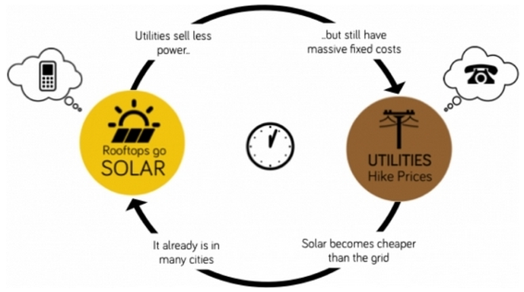
Grid Defection

Slide 23
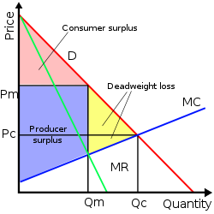
Deadweight Loss

Slide 24
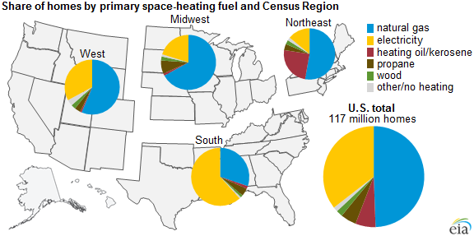
Space Heating

Slide 25

Special Rates

Slide 26

Special rates

Slide 27
Summary

Slide 28
Policy Arguments For:
Promote conservation and meet mandates
Resource crisis
Lifeline rates
  Low usage, low income
  Multi-family
Long-term or social marginal costs
More equitable than energy efficiency

Slide 29
Policy Arguments Against:
Revenue Instability
Deadweight loss
Grid Defection
Space Heating
Special rates
  (e.g., electric vehicles, medical baseline etc…)

Slide 30
Final Thoughts

Slide 31
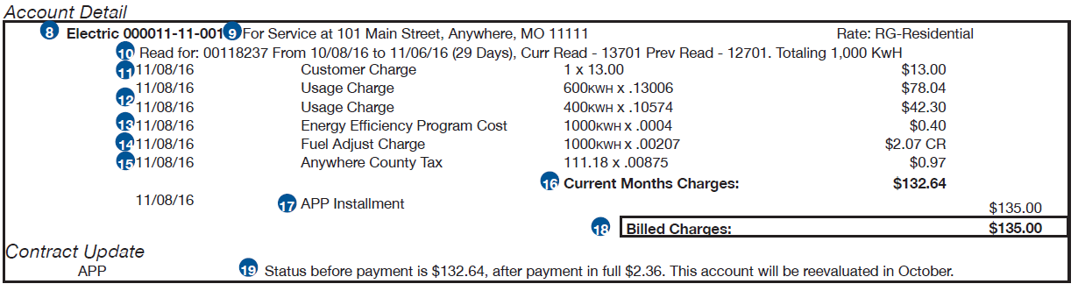
Do ratepayers understand this?

Slide 32
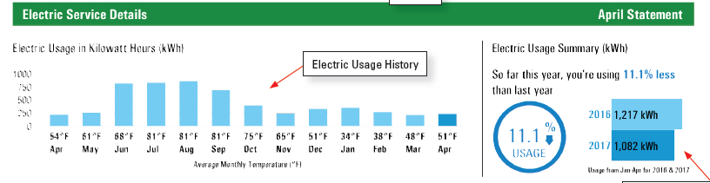
Do ratepayers understand this?

Slide 33
Research suggests that
“In reality, consumers make such decisions with limited information, attention and cognitive abilities.”
“It is quite clear from studies of cellphone pricing and marginal income taxes that consumer understanding of non-linear price schedules varies widely…

Slide 34
Such understanding seems amenable to education campaigns, though such approaches will still run up against attention and cognition constraints that are likely significant for the vast majority of consumers who don’t think like economists, and even for many who do.”
Borenstein, S. (2009) To what electricity price do consumers respond? Residential demand electricity under increasing-block pricing. Energy Institute at Haas. http://faculty.haas.berkeley.edu/borenste/download/NBER_SI_2009.pdf

Slide 35
And
“Given the information available to most residential electricity customers in my sample period, the information cost of understanding the marginal price of electricity is likely to be substantial.”
Ito, Koichiro (2012) Do Consumers Respond to Marginal or Average Price? Evidence from Nonlinear Electricity Pricing. Energy Institute at Haas. https://ei.haas.berkeley.edu/research/papers/WP210.pdf

Slide 36
Recommendations
Display the rate structure on the consumer’s bill in a way that conveys the cost (savings) from increased (decreased) usage.
Do not raise the (fixed) residential customer charge.

Slide 37

Questions
Geoff Marke, Economist
Missouri Office of the Public Counsel
Geoff.marke@ded.mo.gov
573-751-5563

