Slide 1
Non-Energy Benefits
Statewide Collaborative - MEEAC Meeting April 24, 2018

Slide 2
MEEIA Rules Update - NEBs
MEEIA rules were updated in Fall 2017
The update included the addition of language around Non-Energy Benefits (NEBs)

Slide 3
NEBs language in revised MEEIA rules
Non-Energy Benefits means—
1. Direct benefits to participants in utility demand side programs, including, but not limited to, increased property values, increased productivity, decreased water and sewer bills, reduced operations and maintenance costs, improved tenant satisfaction, and increases to the comfort, health, and safety of participants and their families;

Slide 4
NEBs language in revised MEEIA rules
Non-Energy Benefits means—
2. Direct benefits to utilities, including, but not limited to, reduced arrearage carrying costs, reduced customer collection calls/notices, reduced termination/reconnection costs, and reduced bad debt write-offs; or

Slide 5
NEBs language in revised MEEIA rules
Non-Energy Benefits means—
3. Indirect benefits to society at large, including, but not limited to, job creation, economic development, energy security, public safety, reduced emissions and emission related health care costs, and other environmental benefits;

Slide 6
NEBs language in revised MEEIA rules
Non-Energy Benefits means—
4. Non-Energy Benefits may be included in the total resource cost test (TRC) only if they result in avoided utility costs that may be calculated with a reasonable degree of confidence. Non-energy benefits may always be considered in the societal cost test.

Slide 7
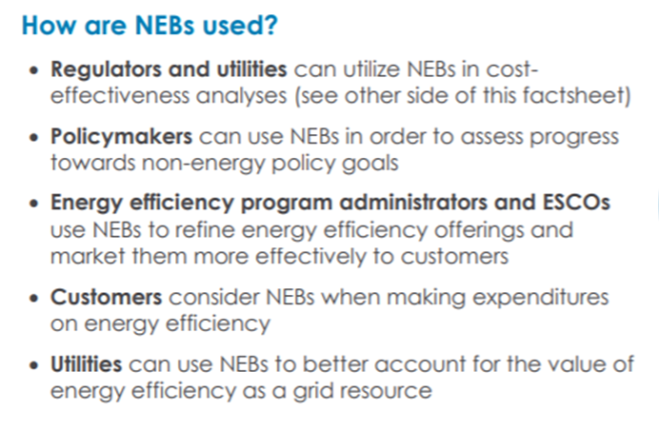


Slide 8
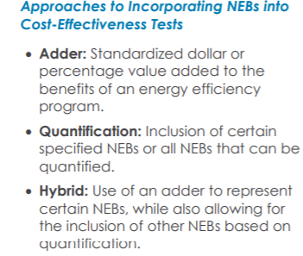
Source: Midwest Energy Efficiency Alliance

Slide 9
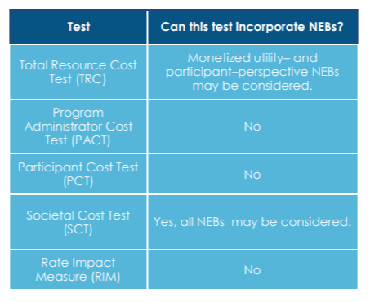
Cost-Effectiveness Tests & Their Incorporation of NEBs
Source: Midwest Energy Efficiency Alliance

Slide 10
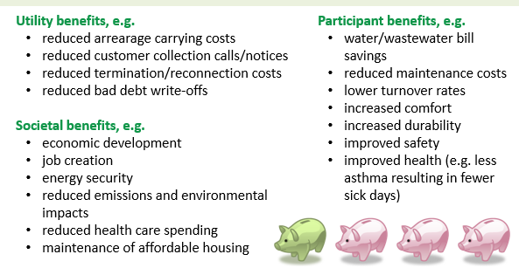
Examples of NEBs

Slide 11
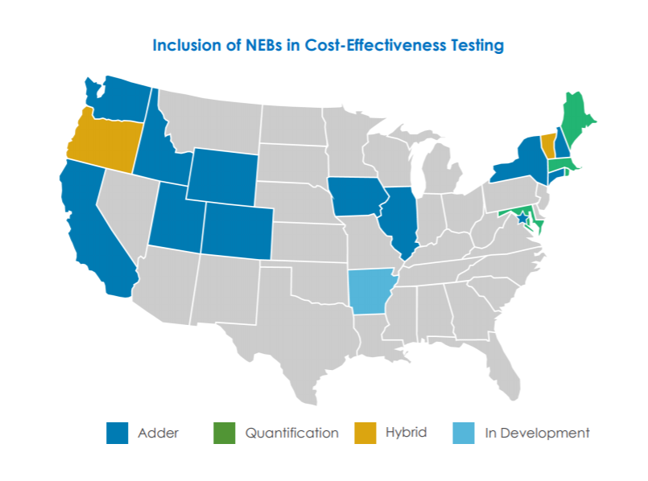
Source: Midwest Energy Efficiency Alliance

Slide 12
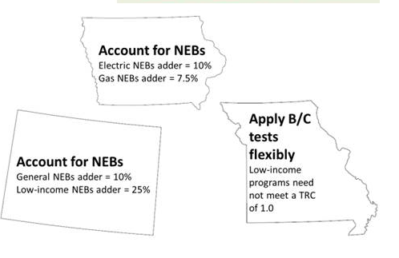
Examples of Incorporating NEBs:
Notes:
Colorado – 2008, Iowa - 1999, Missouri - 2009

Slide 13
An Example Process to Incorporate NEBs:
Vermont
  Adopted the societal cost-effectiveness test in 1990 with a 5% adder for the environmental externalities and a 10% adder to account for reduced risks from EE relative to generation.
  In 2009, a consensus of participants in a proceeding suggested NEBs should be incorporated in some way, but the best approach needed discussion.
  A large group of stakeholders was established to begin researching existing NEBs literature
  The literature was used to identify quantitative values for a range of key benefits associated with low income programs (especially related to financial and hardship benefits).
  The stakeholder group also promoted the research that was being conducted on the need to update C/E screening to incorporate NEBs.
  The case was ultimately made to incorporate NEBs – specifically a 15% adder for conservative value, to be revisited and amended with new research
Skumatz, L., Non-Energy Benefits / NEBs – Winning at Cost-Effectiveness Dominos State Progress and TRMs, 2016

Slide 14
The Status of NEBs in MO
Who has been engaged in conversations around NEBs?
Who is actively trying to incorporate NEBs into cost-effectiveness testing?

Slide 15
Small Groups Discussions
What are the barriers that utilities face in incorporating NEBs in MO?
What next steps would help begin to address some of those barriers?

Slide 16
Large Group Report Out
What are the barriers that utilities face in incorporating NEBs in MO?
What next steps would help begin to address some of those barriers?

Slide 17
Next Steps
Potential follow-up call on NEBs?
Cost-Effectiveness is a potential work group topic where NEBs could be discussed
Additional Next Steps?

Slide 18
Thank you!
Laura Goldberg, NRDC
  lgoldberg@nrdc.org

