Slide 1
Efficiency First for Missouri’s Energy Future
Becky Stanfield, NRDC
October 21, 2014
MPSC Statewide Collaborative Meeting

Slide 2
What is required, per draft rule?
Reduce carbon intensity of state’s power mix from 1963 lbs/mwh in 2012 to --
  1621 lbs/mwh on average between 2020 and 2029, and
  1544 lbs/mwh in 2030 and thereafter.
  21% reduction over the next 16 years

Slide 3
Building Blocks vs. Compliance Options
To determine the Missouri emission intensity target, EPA used four building blocks the combination of which they concluded represented the “Best System of Emission Reductions.”
EPA’s efficiency building block assumed that Missouri would do nothing until 2017, and then begin ramping up from 0.2% per year to level off at 1.5% per year and cumulative reduce demand by 10% by 2030.

Slide 4
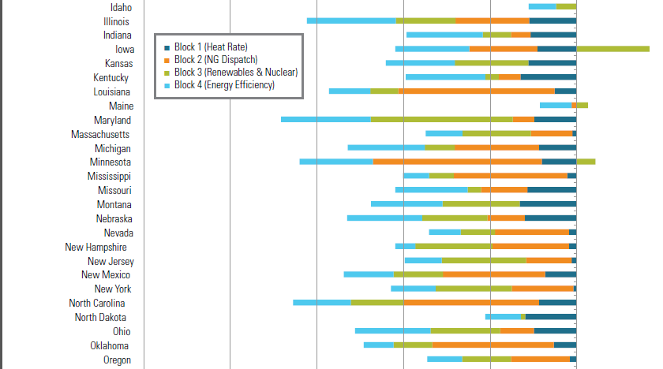
EPA building block application

Slide 5
Building blocks vs. Compliance options (continued)
Missouri does not have to follow the building blocks;
EPA did not count savings pursuant to programs already being offered today and every year before 2017 (but savings in the target years from measures installed post 2012 will count);
EPA did not take into consideration new non-utility policies and programs such as codes, standards, performance contracting, or CHP (but states can use these policies to comply).

Slide 6
ACEEE estimate of savings potential by state
By 2030 Missouri could reduce demand by 21 percent (17 million mwh/year, or double the amount of ee presumed by EPA in its BSER analysis) through a combination of
  EERs targets (14 million mwh/year),
  Building codes (2.5 million mwh/year of savings),
  CHP (180,000mwh/year savings) and
  Equipment standards (183,000 mwh/year savings).
“Change Is in the Air: How States Can Harness Energy Efficiency to Strengthen the Economy and Reduce Pollution, April 2014, Report E1401”

Slide 7
Utility Programs in Missouri
Still relatively immature and yet --
Exceeding goals, under budget
Producing net savings for customers
  Ameren’s first MEEIA programs exceeded budget by more than 50% and produced net savings of $140 million.

Slide 8
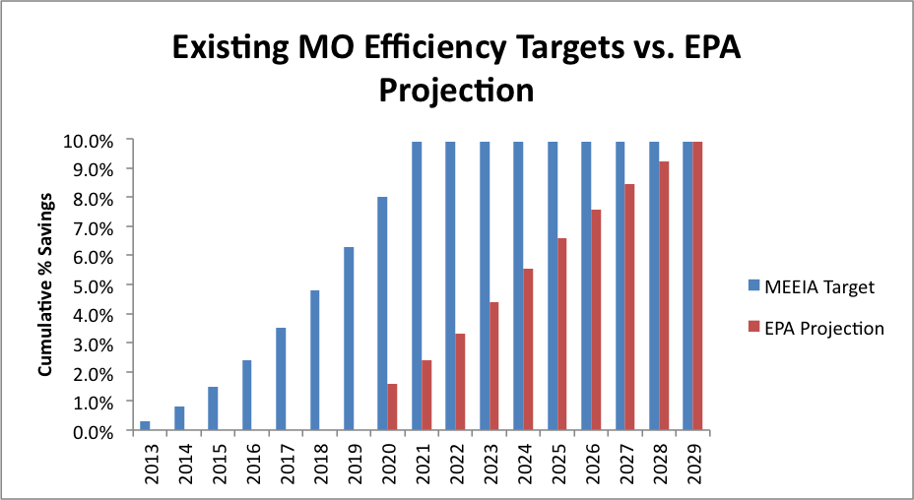
Missouri has already set a course to meet EPA’s projection thru utility programs

Slide 9
Cost of saved energy (current)
LBNL – current MW programs averaging 1.4 c/kwh;
ACEEE - looked at data from 20 states from 2009 to 2012 and concluded that the cost of energy savings for utility programs was between 1.3 and 5.6 cents per kwh, and averaged 2.8 cents nationwide. The Midwest had among the lowest costs for energy savings with Michigan, Iowa, and Wisconsin all reporting savings at under 2 cents per kwh.
Ameren Illinois for its 3-year plan: 2.7 c/kwh

Slide 10
Cost of saved energy, projected (Synapse and LBNL)

Slide 11
Ameren Illinois estimates 2.7 cents per kwh for its current 3-year plan

Slide 12
Non-utility options for Missouri
Yes. Ideally the utilities will partner, but that’s not always the case;
Codes, equipment standards and CHP as noted above;
Building labeling and transparency laws;
Competitive bidding for program implementation.
Adopt a market mechanism to regulate carbon (such as RGGI) and use proceeds to offer programs through a non-utility administrator.

Slide 13
More on RGGI
EPA’s draft give states broad flexibility to choose a compliance pathway, which could look like a portfolio of strengthened energy policies, could look like a mass-based emissions cap, or could take another form.
Regional Greenhouse Gas Initiative (RGGI) approach combines a carbon constraint with good state policies, and distributes proceeds from auctioning carbon allowances to fund programs that are regulated under state efficiency and renewables laws.
RGGI states have chosen to invest 65 percent of all auction proceeds to fund energy efficiency programs with enormous economic benefits in just 2.5 years including.
  $1.6 billion in net economic growth
  $1.1 billion in energy bill savings
  16,000 job years of employment

Slide 14
How do we know we can do more?
Potential studies show potential for >2% annual savings
    ComEd study says possible to ramp up to 2.4% by 2018
    DCEO study says 3% per year is possible
Potential studies are notoriously conservative.
    Among other limitations, they can’t assess emerging technologies
    Note: ComEd achieving more residential savings than “max achievable”
Other states are already achieving 2% or more on a sustained basis – MA, RI, VT
    …and most of these states already have more efficient buildings because they’ve been aggressively pursuing efficiency for decades.
There are major new efficiency opportunities that have only begun to be part of the Illinois portfolio.
    CHP, LEDs, heat pump dryers, building controls, smart meters, etc.
Other policies and programs, such as building codes are already capturing additional potential, which is measurable and can count toward 111d compliance.

Slide 15
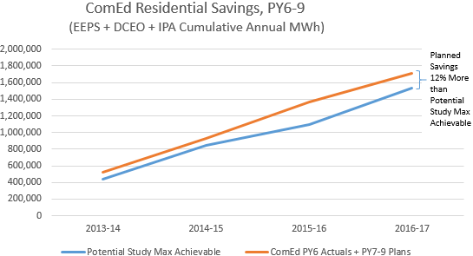
ComEd Exceeding Potential Study Estimate of “Max Achievable” (residential)
Note: potential study “max achievable” was savings of 2.1% of residential sales in 2016 (7.4% cumulative over 4 year period)

Slide 16
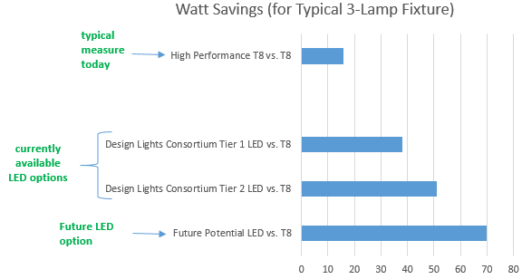
New Technology Increasing Efficiency Opportunities (example: LED alternatives to linear flourescents)

Slide 17
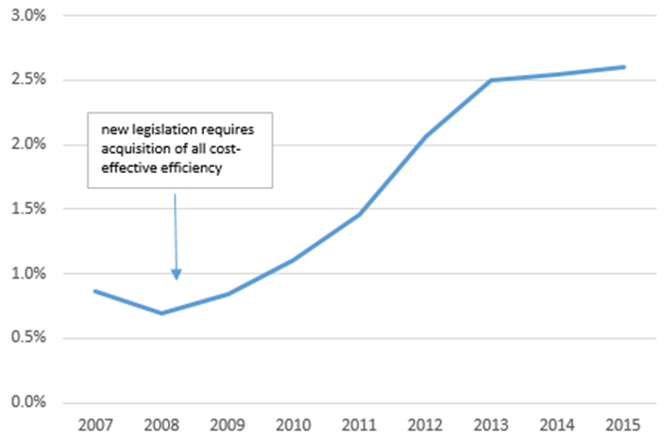
Getting to 2% is a Policy Choice
(not technically or economically constrained)
Massachusetts Electric Efficiency Savings as % of Sales

