Slide 1

Liberty Utilities
EW-2017-0245 MO Workshop
November 20th, 2017

Slide 2
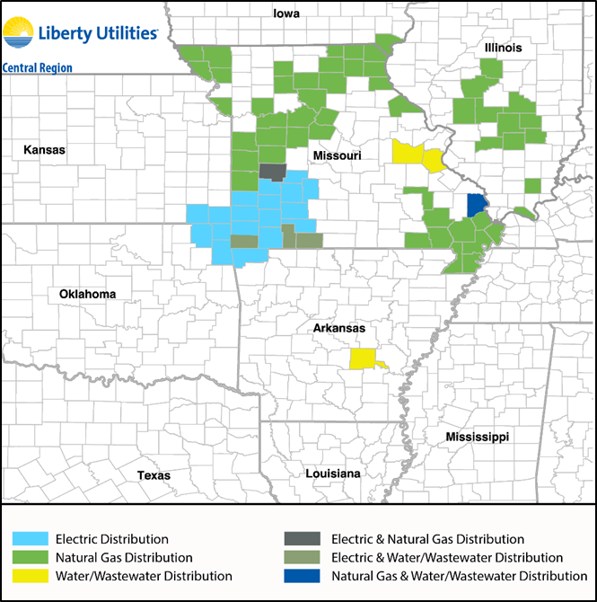
Liberty Utilities – Central Region
Tim Wilson
Regional Director of Electric Operations - Services
  Strategic Projects
  Environmental Compliance
  Electrical Procurement
Fast Facts
Electric, Natural Gas, Water and Wastewater Services
Approximately 330,000 Connections
Approximately 950 Employees

Slide 3
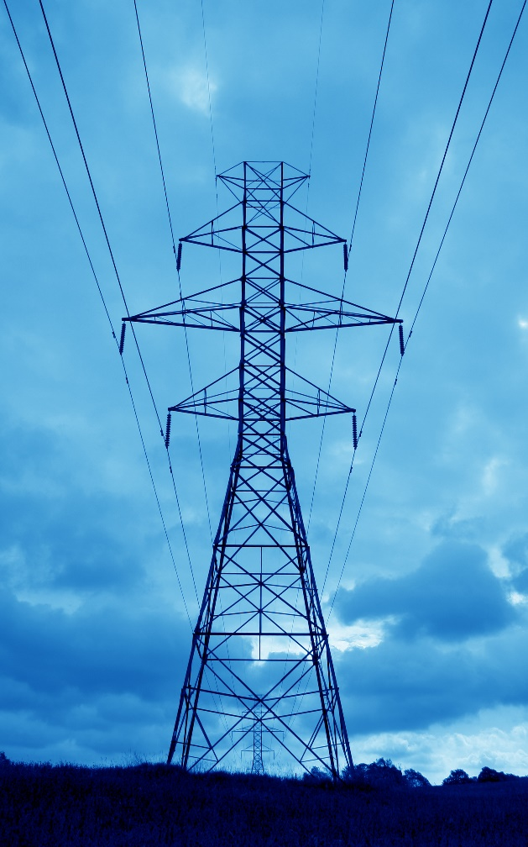
About Liberty Utilities
Liberty Utilities provides water, wastewater, natural gas and electric utility services in 12 states.
  Liberty’s parent, Algonquin Power & Utilities Corporation, is a $10 billion North American diversified generation, transmission and distribution utility.
The distribution business group provides regulated water, electricity and natural gas utility services to over 750,000 customers in the United States.
The generation business group owns wind, solar, hydroelectric and natural gas powered generating facilities representing more than 2,500 MW of installed capacity.
The transmission business group invests in regulated electric transmission and natural gas pipeline systems.

Slide 4

About Liberty Utilities
By The Numbers
2,200
EMPLOYEES
OPERATing IN 12 STATES
OVER 750,000
customers
state regulated 100% U.S.

Slide 5

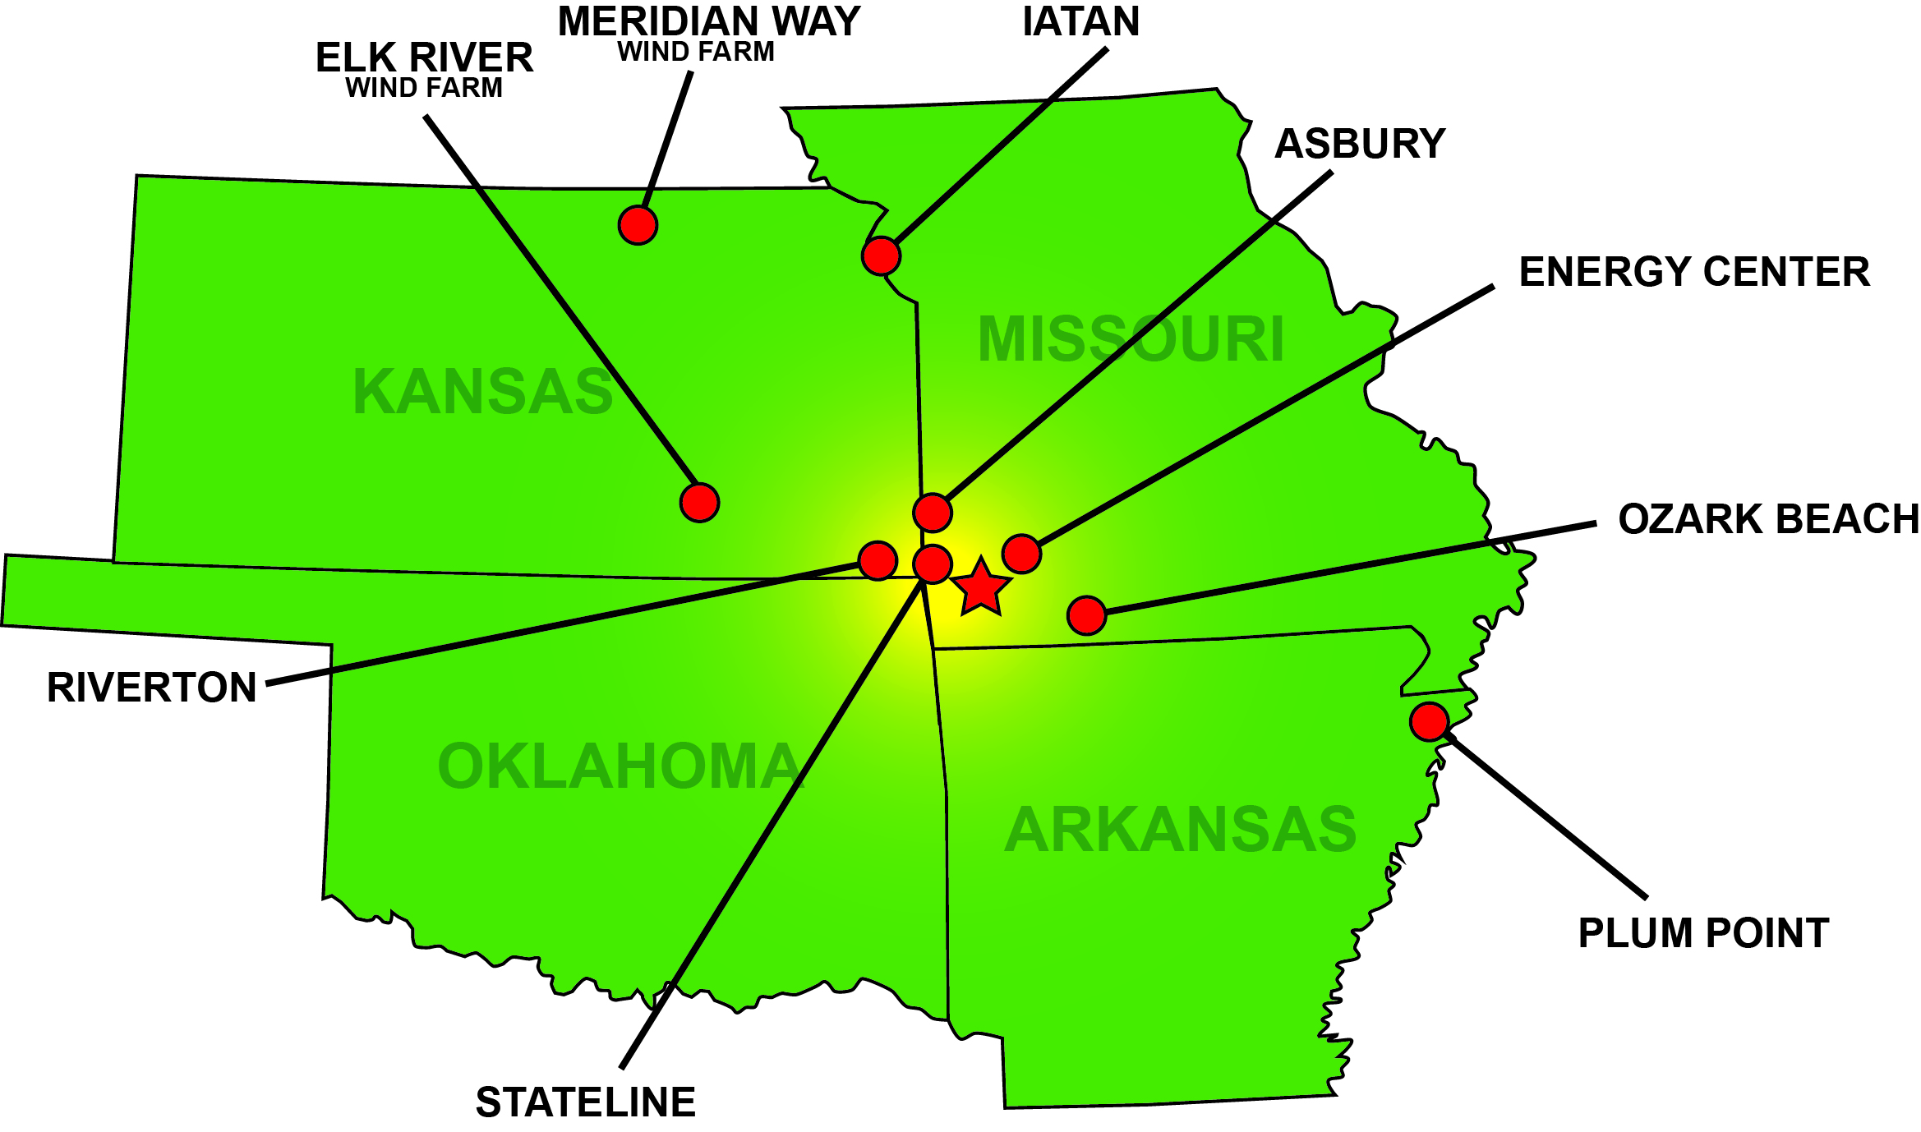
Generation Fleet
Company Owned & Operated
Asbury – 1970
Energy Center – 1980 & 2003
Ozark Beach – 1936
Riverton – 2016
Stateline – 2001
Co-Owned
Iatan I & II
Plum Point
Non-Owned
Elk River
Meridian Way

Slide 6
Customer Solar - Applied vs. Operational

Slide 7
Summary
Solar
Total rebates paid as of 10/31/2017:
$12,504,450 (1176 Customers paid)
Total rebates committed as of 10/31/2017:
$12,611,528
Total of received applications:
17,563,705 W (1342 Applicants)
Total Missouri PV online
16,177,585 W
34 applications received in October 2017
Wind
Nine customers in Missouri
Total of 100 kW

Slide 8
Projected EE savings
Annual Energy Savings Targets (kWh)
 | June 2017-May 2018 | June 2018-May 2019 | Total
Custom C&I Program | 5,600,000 | 5,600,000 | 11,200,000
Income-eligible Multi-Family Direct Install | 415,612 | 415,612 | 831,224
Multi-Family Direct Install | 415,612 | 415,612 | 831,224
Residential HVAC Program | 363,668 | 363,668 | 727,336
Total | 6,794,892 | 6,794,892 | 13,589,784

Slide 9

Questions?

