Slide 1
Statewide Collaborative – EW-2013-0519
Role of Energy Efficiency in Section 111(d) Compliance
October 21, 2014

Slide 2
EPA’s 2020-2029 Load Reduction Goals For Missouri vs. Ameren Missouri Maximum Achievable Potential (“MAP”)
Assume Ameren MO provides 50% of the electricity for MO. Ameren MO maximum achievable load reduction potential is 2,260,000 MWH or 51% of the EPA’s goal for Ameren Missouri, or 26 % of the EPA’s goal for Missouri
2.2 mil MWh

Slide 3
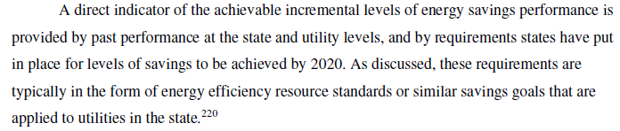
Building Block 4: EPA’s Foundational Assumption
Page 5-32
WHEN IT COMES TO ENERGY EFFICIENCY POTENTIAL, THE FUTURE DOES NOT RESEMBLE THE PAST.

Slide 4
1.5% Load Reduction Based In Part (1st of 2 Parts) On Performance of EER States

Slide 5
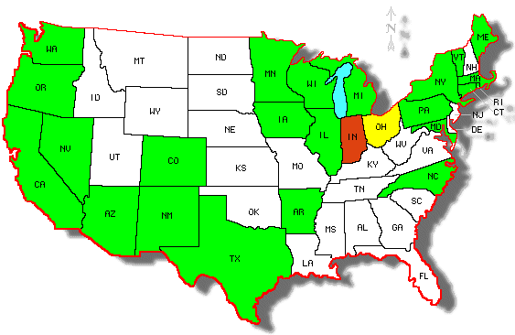
States with EERS Statutes (ACEEE Report)
Active EERS
Frozen EERS
Cancelled EERS

Slide 6
States with an EERS in place as of January 2014
Provisions within each state EERS that impacts performance assessment
 | Rate Caps | Use Gross Savings | Credit for Renewables | Credit for Combined Heat and Power | Credit for Utility Infrastructure Improvements | Credit for Codes and Standards | Credit for Earlier Years EE Load Reductions | Credit for Demand Response as EE | Credit for Self Directed Energy Savings | Non-TRC Cost Effectiveness Test | Fuel Neutrality
Arizona
Arkansas
California
Colorado
Connecticut
Hawaii
Illinois
Indiana†
Iowa
Maine
Maryland
Massachusetts
Michigan
Minnesota
Nevada
New Mexico
New York
North Carolina
Ohio††
Oregon
Pennsylvania
Rhode Island
Texas
Vermont
Washington
Wisconsin
† Indiana cancelled their EERS in 2014
†† Ohio has frozen their EERS for 2014-2015
Actual Load Reductions ≠ Reported Load Reductions

Slide 7
1.5% Load Reduction Based In Part (2nd of 2 Parts) On The Results of Ten DSM Potential Studies

Slide 8
EPA Basis for 1.5% Load Reduction
TABLE 1
Summary of Recent (2010-2014) Electric Energy Efficiency Potential Studies
State | Client | Analyst | Study Year | Study Period | End-year Projected Potential as % of Baseline Sales |  | Average Annual Projected Potential as % of Baseline Sales
 |  |  |  |  | Economic | Achievable | Economic | Achievable
Arizona | Salt River Project | Cadmus Group | 2010 | 2012-2020 | 29% | 20% | 3.2% | 2.2%
California | California Energy Commission | California Energy Commission | 2013 | 2014-2024 | Not reported | 9.6% | N/A | 0.9%
Colorado | Xcel Energy | Kema, Inc. | 2010 | 2010-2020 | 20% | 15% | 1.8% | 1.4%
Delaware | Delaware DNR/DEC | Optimal Energy, Inc. | 2013 | 2014-2025 | 26.3% | Not reported | 2.2% | N/A
Illinois | ComEd | ICF International | 2013 | 2013-2018 | 32% | 10% | 5.3% | 1.7%
Michigan | Michigan PSC | GDS Associates | 2013 | 2013-2023 | 33.8% | 15% | 3.1% | 1.4%
New Jersey | Rutgers University | EnerNOC Utility Solutions | 2012 | 2010-2016 | 12.8% | 5.90% | 1.8% | 0.8%
New Mexico | State of New Mexico | Global Energy Partners | 2011 | 2012-2025 | 14.7% | 11.1% | 1.1% | 0.8%
New York | ConEd | Global Energy Partners | 2010 | 2010-2018 | 26% | 15% | 2.9% | 1.7%
Pacific Northwest (Idaho, Montana, Oregon, Washington) | US Department of Energy | Lawrence Berkeley National Laboratory | 2014 | 2011-2021 | 11% | Not reported | 1.9% | Not reported
Pennsylvania | Pennsylvania PUC | GDS Associates and Nexant | 2012 | 2013-2018 | 27.2% | 17.3% | 4.5% | 2.9%
Tennessee | Tennessee Valley Authority | Global Energy Partners | 2011 | 2009-2030 | 24.8% | 19.8% | 1.1% | 0.9%
 |  |  | Range |  |  |  |  | 0.8% - 2.9% per year
 |  |  | Average |  |  |  |  | 1.5% Per year

Slide 9
EPA Basis for 1.5% Load Reduction
EPA Assumption 1
TABLE 1
Summary of Recent (2010-2014) Electric Energy Efficiency Potential Studies
State | Client | Analyst | Study Year | Study Period | End-year Projected Potential as % of Baseline Sales |  | Average Annual Projected Potential as % of Baseline Sales
 |  |  |  |  | Economic | Achievable | Economic | Achievable
Arizona | Salt River Project | Cadmus Group | 2010 | 2012-2020 | 29% | 20% | 3.2% | 2.2%
California | California Energy Commission | California Energy Commission | 2013 | 2014-2024 | Not reported | 9.6% | N/A | 0.9%
Colorado | Xcel Energy | Kema, Inc. | 2010 | 2010-2020 | 20% | 15% | 1.8% | 1.4%
Delaware | Delaware DNR/DEC | Optimal Energy, Inc. | 2013 | 2014-2025 | 26.3% | Not reported | 2.2% | N/A
Illinois | ComEd | ICF International | 2013 | 2013-2018 | 32% | 10% | 5.3% | 1.7%
Michigan | Michigan PSC | GDS Associates | 2013 | 2013-2023 | 33.8% | 15% | 3.1% | 1.4%
New Jersey | Rutgers University | EnerNOC Utility Solutions | 2012 | 2010-2016 | 12.8% | 5.90% | 1.8% | 0.8%
New Mexico | State of New Mexico | Global Energy Partners | 2011 | 2012-2025 | 14.7% | 11.1% | 1.1% | 0.8%
New York | ConEd | Global Energy Partners | 2010 | 2010-2018 | 26% | 15% | 2.9% | 1.7%
Pacific Northwest (Idaho, Montana, Oregon, Washington) | US Department of Energy | Lawrence Berkeley National Laboratory | 2014 | 2011-2021 | 11% | Not reported | 1.9% | Not reported
Pennsylvania | Pennsylvania PUC | GDS Associates and Nexant | 2012 | 2013-2018 | 27.2% | 17.3% | 4.5% | 2.9%
Tennessee | Tennessee Valley Authority | Global Energy Partners | 2011 | 2009-2030 | 24.8% | 19.8% | 1.1% | 0.9%
 |  |  | Range |  |  |  |  | 0.8% - 2.9% per year
 |  |  | Average |  |  |  |  | 1.5% Per year
Only 10 of the studies indicate Achievable Potential

Slide 10
EPA Basis for 1.5% Load Reduction
EPA Assumption 1
TABLE 1
Summary of Recent (2010-2014) Electric Energy Efficiency Potential Studies
State | Client | Analyst | Study Year | Study Period | End-year Projected Potential as % of Baseline Sales |  | Average Annual Projected Potential as % of Baseline Sales
 |  |  |  |  | Economic | Achievable | Economic | Achievable
Arizona | Salt River Project | Cadmus Group | 2010 | 2012-2020 | 29% | 20% | 3.2% | 2.2%
California | California Energy Commission | California Energy Commission | 2013 | 2014-2024 | Not reported | 9.6% | N/A | 0.9%
Colorado | Xcel Energy | Kema, Inc. | 2010 | 2010-2020 | 20% | 15% | 1.8% | 1.4%
Delaware | Delaware DNR/DEC | Optimal Energy, Inc. | 2013 | 2014-2025 | 26.3% | Not reported | 2.2% | N/A
Illinois | ComEd | ICF International | 2013 | 2013-2018 | 32% | 10% | 5.3% | 1.7%
Michigan | Michigan PSC | GDS Associates | 2013 | 2013-2023 | 33.8% | 15% | 3.1% | 1.4%
New Jersey | Rutgers University | EnerNOC Utility Solutions | 2012 | 2010-2016 | 12.8% | 5.90% | 1.8% | 0.8%
New Mexico | State of New Mexico | Global Energy Partners | 2011 | 2012-2025 | 14.7% | 11.1% | 1.1% | 0.8%
New York | ConEd | Global Energy Partners | 2010 | 2010-2018 | 26% | 15% | 2.9% | 1.7%
Pacific Northwest (Idaho, Montana, Oregon, Washington) | US Department of Energy | Lawrence Berkeley National Laboratory | 2014 | 2011-2021 | 11% | Not reported | 1.9% | Not reported
Pennsylvania | Pennsylvania PUC | GDS Associates and Nexant | 2012 | 2013-2018 | 27.2% | 17.3% | 4.5% | 2.9%
Tennessee | Tennessee Valley Authority | Global Energy Partners | 2011 | 2009-2030 | 24.8% | 19.8% | 1.1% | 0.9%
 |  |  | Range |  |  |  |  | 0.8% - 2.9% per year
 |  |  | Average |  |  |  |  | 1.5% Per year
Only 10 of the studies indicate Achievable Potential
And the EPA only used MAP from all 10 of these studies

Slide 11
EPA Basis for 1.5% Load Reduction
EPA Assumption 1
TABLE 1
Summary of Recent (2010-2014) Electric Energy Efficiency Potential Studies
State | Client | Analyst | Study Year | Study Period | End-year Projected Potential as % of Baseline Sales |  | Average Annual Projected Potential as % of Baseline Sales
 |  |  |  |  | Economic | Achievable | Economic | Achievable
Arizona | Salt River Project | Cadmus Group | 2010 | 2012-2020 | 29% | 20% | 3.2% | 2.2%
California | California Energy Commission | California Energy Commission | 2013 | 2014-2024 | Not reported | 9.6% | N/A | 0.9%
Colorado | Xcel Energy | Kema, Inc. | 2010 | 2010-2020 | 20% | 15% | 1.8% | 1.4%
Delaware | Delaware DNR/DEC | Optimal Energy, Inc. | 2013 | 2014-2025 | 26.3% | Not reported | 2.2% | N/A
Illinois | ComEd | ICF International | 2013 | 2013-2018 | 32% | 10% | 5.3% | 1.7%
Michigan | Michigan PSC | GDS Associates | 2013 | 2013-2023 | 33.8% | 15% | 3.1% | 1.4%
New Jersey | Rutgers University | EnerNOC Utility Solutions | 2012 | 2010-2016 | 12.8% | 5.90% | 1.8% | 0.8%
New Mexico | State of New Mexico | Global Energy Partners | 2011 | 2012-2025 | 14.7% | 11.1% | 1.1% | 0.8%
New York | ConEd | Global Energy Partners | 2010 | 2010-2018 | 26% | 15% | 2.9% | 1.7%
Pacific Northwest (Idaho, Montana, Oregon, Washington) | US Department of Energy | Lawrence Berkeley National Laboratory | 2014 | 2011-2021 | 11% | Not reported | 1.9% | Not reported
Pennsylvania | Pennsylvania PUC | GDS Associates and Nexant | 2012 | 2013-2018 | 27.2% | 17.3% | 4.5% | 2.9%
Tennessee | Tennessee Valley Authority | Global Energy Partners | 2011 | 2009-2030 | 24.8% | 19.8% | 1.1% | 0.9%
 |  |  | Range |  |  |  |  | 0.8% - 2.9% per year
 |  |  | Average |  |  |  |  | 1.5% Per year
Gross Potential is reported by 5 of the studies used by the EPA

Slide 12
EPA Basis for 1.5% Load Reduction
EPA Assumption 1
TABLE 1
Summary of Recent (2010-2014) Electric Energy Efficiency Potential Studies
State | Client | Analyst | Study Year | Study Period | End-year Projected Potential as % of Baseline Sales |  | Average Annual Projected Potential as % of Baseline Sales
 |  |  |  |  | Economic | Achievable | Economic | Achievable
Arizona | Salt River Project | Cadmus Group | 2010 | 2012-2020 | 29% | 20% | 3.2% | 2.2%
California | California Energy Commission | California Energy Commission | 2013 | 2014-2024 | Not reported | 9.6% | N/A | 0.9%
Colorado | Xcel Energy | Kema, Inc. | 2010 | 2010-2020 | 20% | 15% | 1.8% | 1.4%
Delaware | Delaware DNR/DEC | Optimal Energy, Inc. | 2013 | 2014-2025 | 26.3% | Not reported | 2.2% | N/A
Illinois | ComEd | ICF International | 2013 | 2013-2018 | 32% | 10% | 5.3% | 1.7%
Michigan | Michigan PSC | GDS Associates | 2013 | 2013-2023 | 33.8% | 15% | 3.1% | 1.4%
New Jersey | Rutgers University | EnerNOC Utility Solutions | 2012 | 2010-2016 | 12.8% | 5.90% | 1.8% | 0.8%
New Mexico | State of New Mexico | Global Energy Partners | 2011 | 2012-2025 | 14.7% | 11.1% | 1.1% | 0.8%
New York | ConEd | Global Energy Partners | 2010 | 2010-2018 | 26% | 15% | 2.9% | 1.7%
Pacific Northwest (Idaho, Montana, Oregon, Washington) | US Department of Energy | Lawrence Berkeley National Laboratory | 2014 | 2011-2021 | 11% | Not reported | 1.9% | Not reported
Pennsylvania | Pennsylvania PUC | GDS Associates and Nexant | 2012 | 2013-2018 | 27.2% | 17.3% | 4.5% | 2.9%
Tennessee | Tennessee Valley Authority | Global Energy Partners | 2011 | 2009-2030 | 24.8% | 19.8% | 1.1% | 0.9%
 |  |  | Range |  |  |  |  | 0.8% - 2.9% per year
 |  |  | Average |  |  |  |  | 1.5% Per year
Six studies referenced by the EPA reported measure level potential

Slide 13
EPA Basis for 1.5% Load Reduction
EPA Assumption 1
TABLE 1
Summary of Recent (2010-2014) Electric Energy Efficiency Potential Studies
State | Client | Analyst | Study Year | Study Period | End-year Projected Potential as % of Baseline Sales |  | Average Annual Projected Potential as % of Baseline Sales
 |  |  |  |  | Economic | Achievable | Economic | Achievable
Arizona | Salt River Project | Cadmus Group | 2010 | 2012-2020 | 29% | 20% | 3.2% | 2.2%
California | California Energy Commission | California Energy Commission | 2013 | 2014-2024 | Not reported | 9.6% | N/A | 0.9%
Colorado | Xcel Energy | Kema, Inc. | 2010 | 2010-2020 | 20% | 15% | 1.8% | 1.4%
Delaware | Delaware DNR/DEC | Optimal Energy, Inc. | 2013 | 2014-2025 | 26.3% | Not reported | 2.2% | N/A
Illinois | ComEd | ICF International | 2013 | 2013-2018 | 32% | 10% | 5.3% | 1.7%
Michigan | Michigan PSC | GDS Associates | 2013 | 2013-2023 | 33.8% | 15% | 3.1% | 1.4%
New Jersey | Rutgers University | EnerNOC Utility Solutions | 2012 | 2010-2016 | 12.8% | 5.90% | 1.8% | 0.8%
New Mexico | State of New Mexico | Global Energy Partners | 2011 | 2012-2025 | 14.7% | 11.1% | 1.1% | 0.8%
New York | ConEd | Global Energy Partners | 2010 | 2010-2018 | 26% | 15% | 2.9% | 1.7%
Pacific Northwest (Idaho, Montana, Oregon, Washington) | US Department of Energy | Lawrence Berkeley National Laboratory | 2014 | 2011-2021 | 11% | Not reported | 1.9% | Not reported
Pennsylvania | Pennsylvania PUC | GDS Associates and Nexant | 2012 | 2013-2018 | 27.2% | 17.3% | 4.5% | 2.9%
Tennessee | Tennessee Valley Authority | Global Energy Partners | 2011 | 2009-2030 | 24.8% | 19.8% | 1.1% | 0.9%
 |  |  | Range |  |  |  |  | 0.8% - 2.9% per year
 |  |  | Average |  |  |  |  | 1.5% Per year
Six studies referenced by the EPA have a study end of 2020 or prior

Slide 14
EPA Basis for 1.5% Load Reduction
EPA Assumption 1
TABLE 1
Summary of Recent (2010-2014) Electric Energy Efficiency Potential Studies
State | Client | Analyst | Study Year | Study Period | End-year Projected Potential as % of Baseline Sales |  | Average Annual Projected Potential as % of Baseline Sales
 |  |  |  |  | Economic | Achievable | Economic | Achievable
Arizona | Salt River Project | Cadmus Group | 2010 | 2012-2020 | 29% | 20% | 3.2% | 2.2%
California | California Energy Commission | California Energy Commission | 2013 | 2014-2024 | Not reported | 9.6% | N/A | 0.9%
Colorado | Xcel Energy | Kema, Inc. | 2010 | 2010-2020 | 20% | 15% | 1.8% | 1.4%
Delaware | Delaware DNR/DEC | Optimal Energy, Inc. | 2013 | 2014-2025 | 26.3% | Not reported | 2.2% | N/A
Illinois | ComEd | ICF International | 2013 | 2013-2018 | 32% | 10% | 5.3% | 1.7%
Michigan | Michigan PSC | GDS Associates | 2013 | 2013-2023 | 33.8% | 15% | 3.1% | 1.4%
New Jersey | Rutgers University | EnerNOC Utility Solutions | 2012 | 2010-2016 | 12.8% | 5.90% | 1.8% | 0.8%
New Mexico | State of New Mexico | Global Energy Partners | 2011 | 2012-2025 | 14.7% | 11.1% | 1.1% | 0.8%
New York | ConEd | Global Energy Partners | 2010 | 2010-2018 | 26% | 15% | 2.9% | 1.7%
Pacific Northwest (Idaho, Montana, Oregon, Washington) | US Department of Energy | Lawrence Berkeley National Laboratory | 2014 | 2011-2021 | 11% | Not reported | 1.9% | Not reported
Pennsylvania | Pennsylvania PUC | GDS Associates and Nexant | 2012 | 2013-2018 | 27.2% | 17.3% | 4.5% | 2.9%
Tennessee | Tennessee Valley Authority | Global Energy Partners | 2011 | 2009-2030 | 24.8% | 19.8% | 1.1% | 0.9%
 |  |  | Range |  |  |  |  | 0.8% - 2.9% per year
 |  |  | Average |  |  |  |  | 1.5% Per year
Three studies referenced by the EPA use data from secondary data sources, not primary

Slide 15
EPA Basis for 1.5% Load Reduction
EPA Assumption 1
TABLE 1
Summary of Recent (2010-2014) Electric Energy Efficiency Potential Studies
State | Client | Analyst | Study Year | Study Period | End-year Projected Potential as % of Baseline Sales |  | Average Annual Projected Potential as % of Baseline Sales
 |  |  |  |  | Economic | Achievable | Economic | Achievable
Arizona | Salt River Project | Cadmus Group | 2010 | 2012-2020 | 29% | 20% | 3.2% | 2.2%
California | California Energy Commission | California Energy Commission | 2013 | 2014-2024 | Not reported | 9.6% | N/A | 0.9%
Colorado | Xcel Energy | Kema, Inc. | 2010 | 2010-2020 | 20% | 15% | 1.8% | 1.4%
Delaware | Delaware DNR/DEC | Optimal Energy, Inc. | 2013 | 2014-2025 | 26.3% | Not reported | 2.2% | N/A
Illinois | ComEd | ICF International | 2013 | 2013-2018 | 32% | 10% | 5.3% | 1.7%
Michigan | Michigan PSC | GDS Associates | 2013 | 2013-2023 | 33.8% | 15% | 3.1% | 1.4%
New Jersey | Rutgers University | EnerNOC Utility Solutions | 2012 | 2010-2016 | 12.8% | 5.90% | 1.8% | 0.8%
New Mexico | State of New Mexico | Global Energy Partners | 2011 | 2012-2025 | 14.7% | 11.1% | 1.1% | 0.8%
New York | ConEd | Global Energy Partners | 2010 | 2010-2018 | 26% | 15% | 2.9% | 1.7%
Pacific Northwest (Idaho, Montana, Oregon, Washington) | US Department of Energy | Lawrence Berkeley National Laboratory | 2014 | 2011-2021 | 11% | Not reported | 1.9% | Not reported
Pennsylvania | Pennsylvania PUC | GDS Associates and Nexant | 2012 | 2013-2018 | 27.2% | 17.3% | 4.5% | 2.9%
Tennessee | Tennessee Valley Authority | Global Energy Partners | 2011 | 2009-2030 | 24.8% | 19.8% | 1.1% | 0.9%
 |  |  | Range |  |  |  |  | 0.8% - 2.9% per year
 |  |  | Average |  |  |  |  | 1.5% Per year
EPA reports Pennsylvania with highest average annual potential. However, EPA erroneously extracted real potential estimates from this study

Slide 16
Impacts On Customers If Maximum Achievable Potential (“MAP”) Load Reductions Are To Be Pursued

Slide 17

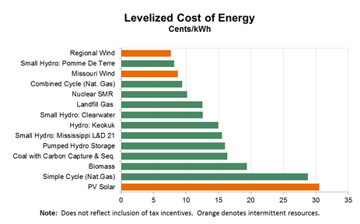
While the MAP portfolio may be cost effective on a total basis, the incremental cost of achieving MAP results is high
Highly Confidential
The levelized costs of incremental energy savings from MAP relative to RAP is $106/MWh or 10.6 cents per kWh
Higher levelized cost than the top supply side options, including wind, natural gas and nuclear

Slide 18
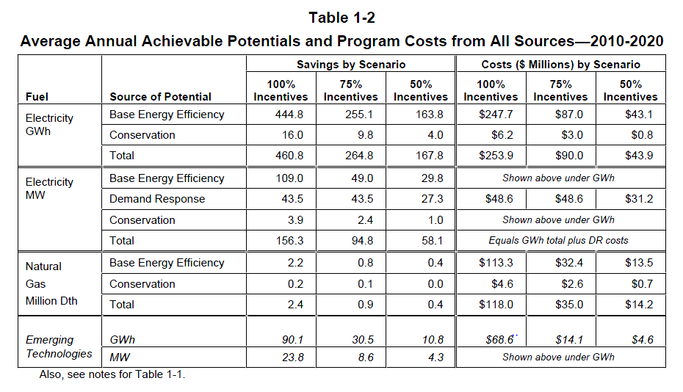
EPA REPORTS MAXIMUM ACHIEVABLE POTENTIAL OR “MAP”: REF. 2010 XCEL DSM POTENTIAL STUDY
MAP COSTS A MULTIPLE OF 6X RAP.

Slide 19
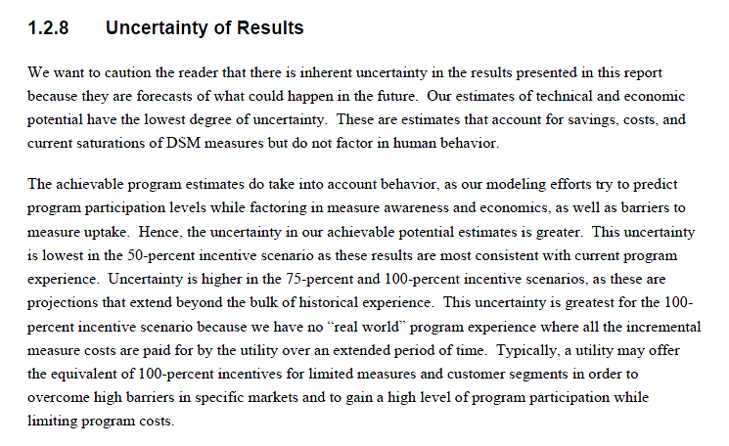
EPA REPORTS MAXIMUM ACHIEVABLE POTENTIAL OR “MAP”: REF: 2010 XCEL DSM POTENTIAL STUDY

Slide 20
Can Missouri Claim Credit For DSM Savings Achieved Prior To 2017?
EPA’s position is unclear, but…

Slide 21
DSM Savings Credit Prior to 2017
EPA’s position:
Excerpt from Step 4 of the EPA GHG Abatement Measures Document
  Any improvement in EE savings performance between 2012 and 2017 will benefit a state in meeting its state EE goals for the 2020-2029 interim compliance period.²²⁵
Corresponding excerpt from EPA Preamble (^{“225”} reference - above)
  … the EPA also requests comment on the following alternatives: The start date of the initial plan performance period, the date of promulgation of the emission guidelines, the end date of the base period for the EPA's BSER-based goals analysis (e.g., the beginning of 2013 for blocks 1-3 and beginning of 2017 for block 4, end-use energy efficiency), the end of 2005, or another date.
Excerpts from SNL article Sept 9, 5:08PM CT by Eric Wolff regarding U.S. House subcommittee hearing Sept. 9
  "EPA's Clean Power Plan is about moving forward," a spokeswoman said in an email.
  If states were to get credit for early action, it would likely take the form of moving the baseline year.
The EPA’s Scenario models – all of which exclude credit for any DSM savings prior to 2017

Slide 22
Final Thoughts
Utility program induced energy efficiency load reductions can be a cost effective source to reduce greenhouse gas emissions
Past utility program induced energy efficiency load reductions are not indicative of future load reductions
    Codes and Standards
    Actual EM&V results supplanting engineering models and savings
    Volatility of utility avoided costs used to quantify cost effectiveness
Incremental Customer costs of achieving overly aggressive energy efficiency load reduction targets are significant

