Slide 1
DER Workshop
November 20, 2017

Slide 2
Overview
Existing DERs
Future DERs
Implications for the grid of the future

Slide 3
Existing DERs – Customer Sited
Ameren Missouri Incented Energy Efficiency
MW MWH
2009-2012 (Pre-MEEIA) Not Available 581,629
2013-2015 (MEEIA 1) Not Available¹ 1,168,367
2016 (MEEIA 2) 57.8 162,279
MW levels were not tracked prior to MEEIA 2
Customer-Owned DER (9/30/2017)
MW MWH
Renewable (QF & Net Metering) ~57 ~78,000
Non-Renewable (CHP QF) - Retail ~24 unknown
Non-Renewable (CHP QF) - Whlsale ~30 unknown
Virtually all of this is solar. Estimated using PVWatts

Slide 4
Existing DERs – Company Owned
MW MWH
GOB Solar 0.1 91
Maryland Heights (Landfill) 15 58,481
O’Fallon (Solar) 4.5 7,488
2016 Data (from most recent RES Compliance Report)

Slide 5
2017 IRP EE Potential - % of Total Forecasted Sales
 | 2019 | 2020 | 2021 | 2022 | 2023 | 2024 | 2030 | 2036
Technical Potential | 28.9% | 31.0% | 32.4% | 34.1% | 35.7% | 36.8% | 42.1% | 44.0%
Economic Potential | 22.4% | 24.0% | 25.0% | 26.2% | 27.4% | 28.3% | 32.3% | 34.0%
MAP | 2.5% | 4.5% | 5.8% | 7.4% | 8.8% | 10.1% | 16.2% | 18.5%
RAP | 1.3% | 2.5% | 3.7% | 4.9% | 6.1% | 7.2% | 12.3% | 14.3%
Program MAP | 2.3% | 4.1% | 5.3% | 6.7% | 8.0% | 9.2% | 15.2% | 17.5%
Program RAP | 1.0% | 2.0% | 3.1% | 4.2% | 5.4% | 6.4% | 11.3% | 13.5%

Slide 6
Forecasted DER’s – Customer Solar PV
2017 IRP Load Forecast Assumptions for Solar DER: Current growth trajectory through early 2020’s then accelerating adoption in 3 scenarios:
 | Low Load Growth | Base Case | High Load Growth
MW Installed by 2037 | 930 | 622 | 114

Slide 7
2017 IRP Demand Response Potential

Slide 8
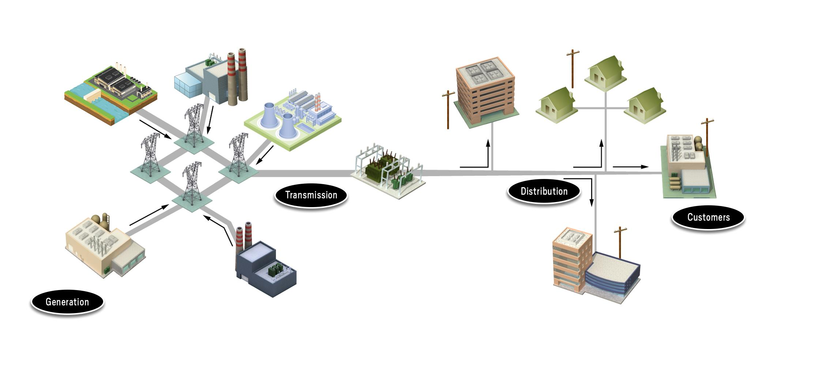
The Grid Today
Electric Power Research Institute

Slide 9
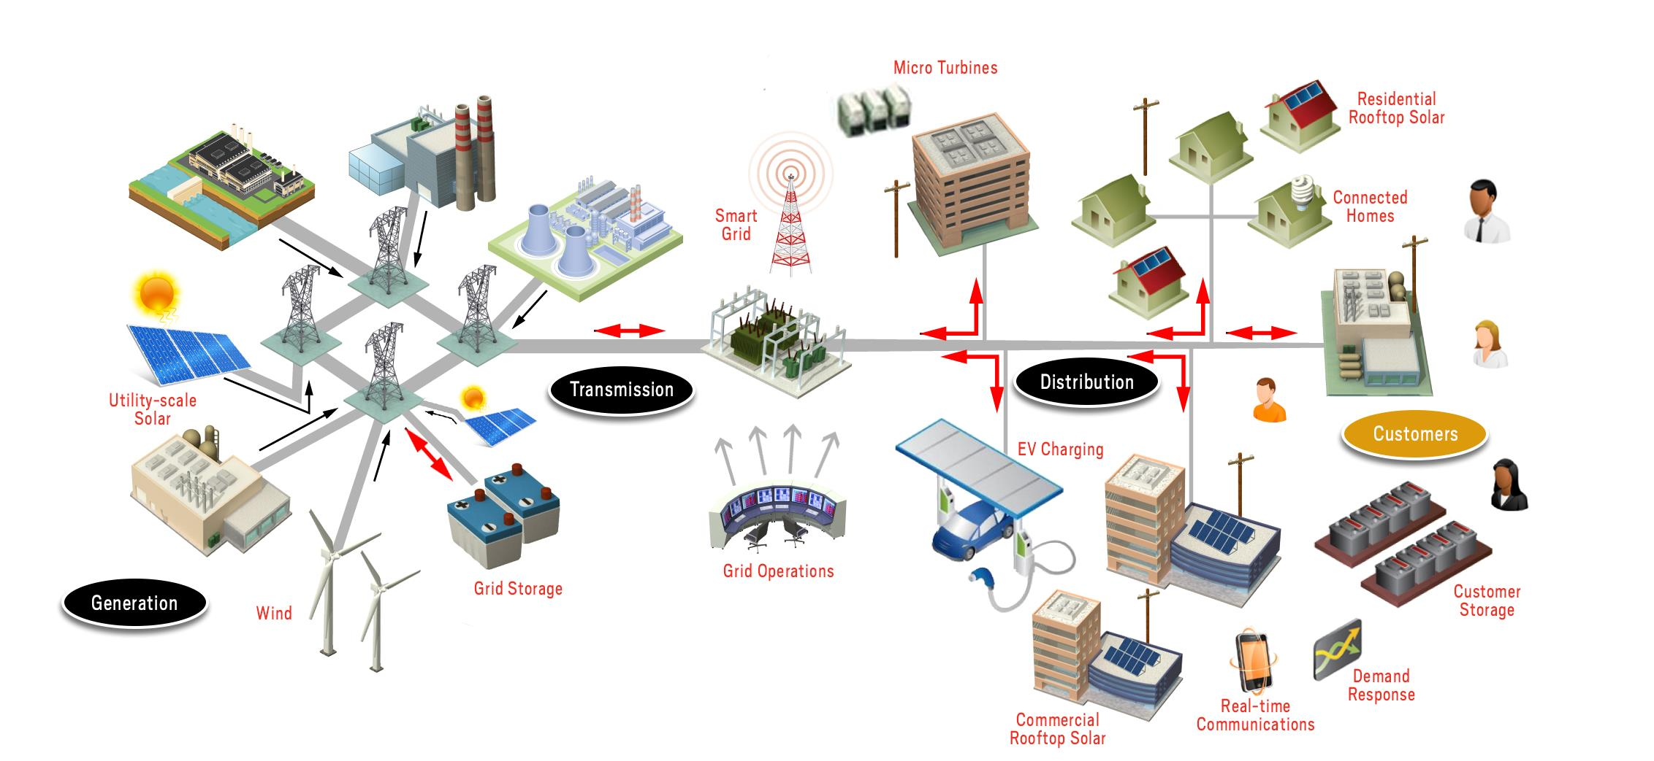
The Integrated Grid
Electric Power Research Institute

Slide 10
Utility Model of the Future
Grid will become more complex and resilient
  Significant penetration of DERs will need to be integrated
  Originally designed for one way power flow but will need to evolve to accommodate two way power flow
  Increasing automation
  Smart meters
  Digital communications
  Connected devices/homes
  More renewable generation
The grid will be a significant source of value creation giving customers greater reliability, choice, and control of energy usage and enabling higher penetrations of clean renewable resources
Achieving this vision requires a regulatory model that enables and encourages the investments necessary to continue to modernize the grid

