Slide 1

RENEW MISSOURI
ATTRIBUTION FOR ENERGY UPGRADE MEASURES
UNDERSTANDING MEEIA
For the PSC Demand Side Management – IRA Workshop
May 9th of 2023

Slide 2

Renew Missouri
Renew Missouri is a 501(c)(3) founded in 2006 and focused with a mission of advocating and championing for renewable energy and energy efficiency throughout the state. We advocate before the Public Service Commission on cases involving companies like Liberty-Empire, Ameren, and Evergy.
We also work with rural electric cooperatives and municipal utilities on energy related topics.
While we are limited by the amount of lobbying we can do by IRS rules, we do spend time in the Missouri Capitol talking to lawmakers and testifying before committees on legislative matters involving utilities, particularly issues that involve clean energy.

Slide 3

Presenter
James Owen – Executive Director
Attorney and Former Judge. Former Public Counsel, advocating for Missouri ratepayers before the Public Service Commission.
Served as Executive Director for Renew Missouri for the past four years. Born and raised on a dairy farm in Webster County Missouri.

Slide 4


PURPOSE
To explore how utilities can claim energy savings attribution for energy upgrade measures that they did not primarily fund and identify other attribution problems resulting from IRA funds, particularly for low-income residential buildings.

Slide 5
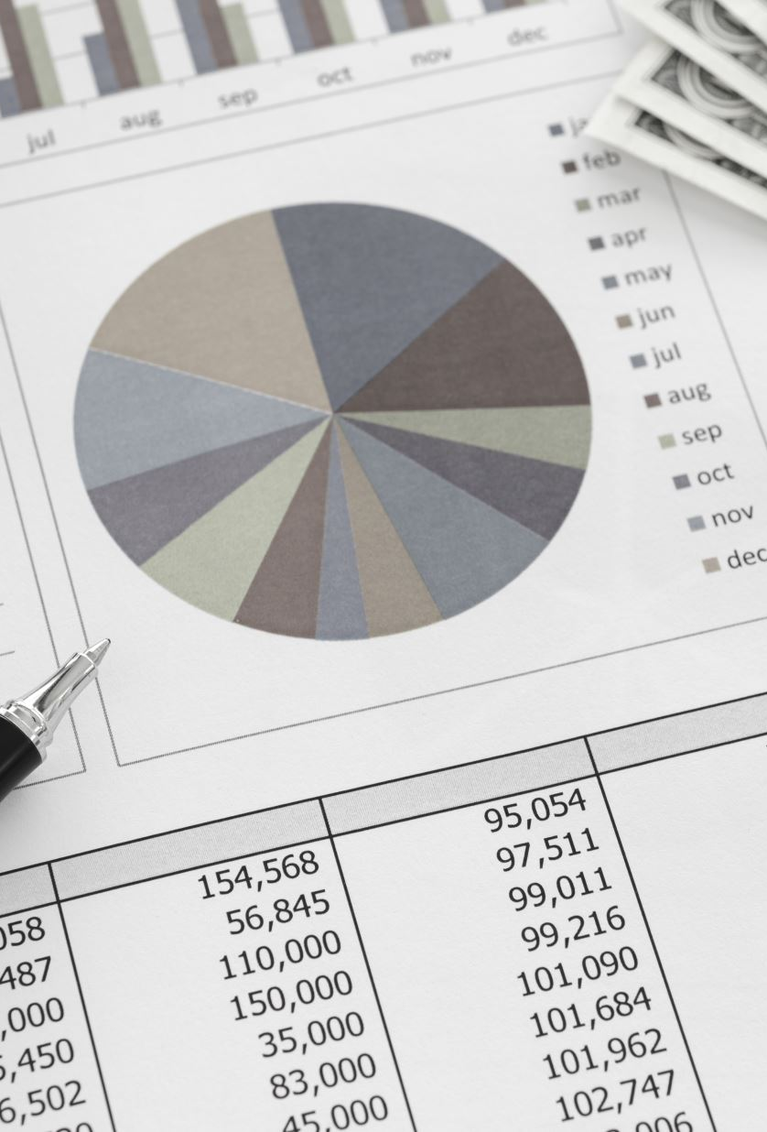
“It shall be the policy of the state to value demand-side investments equal to traditional investments in supply and delivery infrastructure and allow recovery of all reasonable and prudent costs of delivering cost-effective demand-side programs.”
EXCERPT FROM MEEIA

Slide 6

AN ANALOGY FOR ATTRIBUTION:
Attribution is the quantity of benefits delivered by the program or intervention. Attributable impacts are those that would not have otherwise been realized. For example, the sunrise is zero percent attributable to the rooster’s crow. It is 100% attributable to the earth’s rotation.

Slide 7

BACKGROUND
Attribution Definition:
Attribution in MEEIA filings refers to the ability of utilities to claim credit for energy savings resulting from their investments in energy efficiency measures.
Missouri Energy Efficiency Investment Act (MEEIA) Statute:
  MEEIA values demand side investments equally to traditional supply and delivery infrastructure.
  All reasonable and prudent costs associated with delivering effective demand side programs can be recovered.
  Total resource cost test is preferred for cost-effectiveness.
  Efficiency programs dedicated to low-income customers and customer education are exempt from cost-effectiveness requirement.

Slide 8

Three “legs of the stool” with MEEIA:
  Recovery of program costs
  Throughput disincentive
  Profit (performance incentive/earnings opportunity) valued same as traditional sources of generation
  Net to gross values:
  Utilities need to be able to claim savings resulting from their investments and exclude free riders. Spillover can offset free ridership to some extent. Attribution is important for the utility to prove that their actions caused the savings.
HOW MEEIA WORKS

Slide 9
IRA FUNDING
HUD's Green Resilience and Retrofit Program ($837.5M):
DOE's HOMES Rebate Program ($4.3B):
DOE's High Efficiency Electric Rebate Program ($4.5B):
DOE's Workforce Development in Clean Energy ($200 million):
EPA Greenhouse Gas Reduction Fund ($27B):
    Provides funds to improve energy or water efficiency, indoor air quality, low-carbon emission technologies, and climate resilience in HUD-subsidized project-based rental assistance properties.
    Offers rebates for whole house energy efficiency upgrades in LMI multifamily buildings.
    Offers rebates to cover the costs of electrification projects in LMI multifamily buildings.
    Provides home energy efficiency contractor training grants.
    Offers grants for financial and technical assistance to support eligible uses in low-income and disadvantaged communities.

Slide 10
MEEIA allows utilities to recover costs for energy savings achieved through demand-side programs.
Utilities can recover costs for program administration, incentives, and offset any sales reduction due to program participation.
BENEFITS TO UTILITIES AND CUSTOMERS
Utilities can raise rates to include program costs and profit from performance incentives.
Customers benefit from lower energy bills, improved indoor air quality, and greater comfort.
Low-income customers can benefit from special programs and federal funding for energy efficiency upgrades.

Slide 11
IMPORTANT POINTS FROM NRDC’s
LAURA GOLDBERG
Millions of dollars from IRA are soon to be available for energy improvements along with robust funding from Missouri utilities’ upcoming MEEIA filings, but utility involvement is dependent upon the utility receiving credit for the energy savings attribution.
For funds coming from a non-utility source, even if that funding constitutes a majority of the cost for the EE measure, the utility can claim attribution of the savings because without the utility’s engagement, the EE measure would not have been implemented.
The utility facilitates braiding resources, the implementation infrastructure with weaving of measures.
The utility can claim responsibility for the energy savings, even if they were not responsible for the majority of the energy savings.
Otherwise, you develop a lose-lose situation where the federal government and the utilities are competing with one another. Or where the utilities choose not to accept this funding and EE is not fully-valued as state statutes demand.

