Slide 1

Missouri ENERGY PROFILE
Where do we stand?
what are our challenges?

Slide 2
Why are we here?
Energy is Important to Missourians!!!
We like …
To drive cars
To flip on the light switch
To heat/cool our homes and businesses
A healthy life and environment
Affordability

Slide 3
What energy are we using?
Notes:
These are primary sources of energy only and do not include electricity or other secondary products/sources. Coal represents 46%, petroleum 38% and natural gas 16%. Most of these primary energy sources are imported to Missouri.
On the right you can see expenditures for each of these primary sources of energy: petroleum at nearly $17 billion, natural gas $2.2 billion and coal at a cost of $1.45 billion.

Slide 4
electricity
Over 80% of Missouri’s electricity is generated from coal, followed by nuclear and natural gas.
Missouri average residential electricity retail prices rank 26th in the nation as reported in June 2014.
Wind now closely trails hydroelectric power as a renewable energy source in Missouri’s electricity mix. Total renewable energy generation represents 2.1%.
Notes:
This was Missouri’s electricity mix in 2012. After coal at over 80%, nuclear is around 12%, natural gas at 5.6% and petroleum at 0.1%.
Missouri ranks 26th in average residential retail electricity prices at 12.44 cents/kwh as reported for June 2014. Note this is a monthly statewide average for residential and not an annualized number.
And renewable energy sources as reported by DOE/EIA include hydropower and other renewable sources (wind, solar, biomass) – at 2.1%.

Slide 5
What heats oUr homes?
53% Natural Gas
32% Electricity
10% Propane (LPG)
Notes:
These are our residential heating sources: natural gas at over 50%, electricity roughly 30% and propane at 10%. Fuel oil = 0.3%
Other = wood/pellet stoves and solar thermal for example.

Slide 6
Realities and Challenges
Energy should not be taken for granted. We need to plan for our future
  Maintain a diverse energy portfolio to sustain and adapt for the future
  Comply with federal air and water regulations
  Ensure that our energy infrastructure can meet our future needs
  Ensure a reliable energy supply safe from disruptions
  Keep energy prices affordable

Slide 7
  Missouri Governor Jeremiah W. (Jay) Nixon
  Executive Order 14-06
  “..develop a comprehensive State Energy Plan to chart a course toward a sustainable and prosperous energy future that will create jobs and improve Missourian’s quality of life”

Slide 8
Executive order 14-06
The Division of Energy shall. . . .
Solicit input from the public and energy stakeholders
Assess energy supply and demand
Examine policies, statutes and regulations
Guide development of energy infrastructure
Deliver State Energy Plan to the Governor by May 31, 2015

Slide 9
Missouri Energy Plan
A path to clean, affordable, abundant energy

Slide 10
OBJECTIVE
    The energy plan shall recommended how to:
    Meet Missouri’s short-term and long-term needs for clean, reliable, affordable, and abundant energy,
    Encourage efficient use of energy in all sectors of the economy,
    Foster the efficient allocation of capital among competing energy resources,
    Spur job creation and economic growth,
    Better align goals to promote development, security, and affordability of diverse energy sources essential to the future of Missouri’s economy, and
    Provide a framework to ensure stable and predictable energy prices.

Slide 11
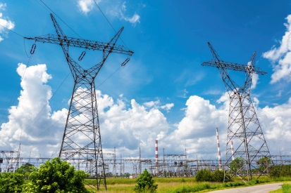
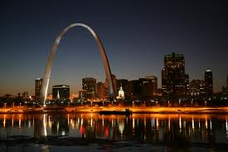


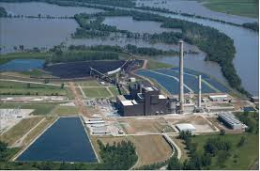
TOPICS ADDRESSED BY THE PLAN
  Electric Generation
  Fuels and Resource Extraction
  Energy Distribution
  Energy Usage
  Energy Storage
  Energy-related Land Use
  Energy/Water Nexus
  Energy Pricing and Rate-setting Processes
  Energy Security and Assurance
  Energy Resources in Emergencies

Slide 12
timeline
Working Group Input
Plan Completed
Executive Order 14-6
Public Meeting Input
Plan Development
06/18/14
10/01/14
10/30/11
11/15/14
02/01/15
05/31/15
Online Forum Input

Slide 13
PUBLIC OUTREACH MEETINGS
Oct. 1 – St. Louis
Washington University
Eric P. Newman Education Center Auditorium
1:30 p.m.
Oct. 9 – Fort Leonard Wood
Mahaffey Museum Complex
1:00 p.m.
Oct. 14 - Joplin
Missouri Southern State University
Billingsly Student Center
1:00 p.m.
Oct. 22 – Kansas City
Metropolitan Community College-Penn Valley Campus
Science & Technology Center
1:00 p.m.
Oct. 23 – Maryville
Northwest MO State University
The Ballroom
1:00 p.m.
Oct. 28 – Sikeston
Clinton Building Community Center
1:00 p.m.
Oct. 30 – Kirksville
Truman State University
Georgian Room B
1:00 p.m.

Slide 14
Steering committee
    60 individuals who represent a broad spectrum of interests
    Address big picture direction of the Plan
    Will attend public meetings and provide input and insight

Slide 15
All interested missourians
    If you have friends who are not able to attend one of the seven public meetings, please encourage them to contribute to the Plan by submitting their thoughts, comments, and suggestions through the On-Line Forum!
    http://energy.mo.gov/energy/about/comprehensive-state-energy-plan#committee

Slide 16
Missouri energy plan --- A path to clean, affordable and abundant energy
Learn more! Track progress!
Encourage others to provide input!
http://energy.mo.gov/energy/about/comprehensive-state-energy-plan
Email Address: energy@ded.mo.gov
Phone Number: 573-751-2254

