Slide 1

Does Better Information Lead to Better Choices? Evidence from Energy-Efficiency Labels
Lucas Davis & Gilbert Metcalf (2015)
Journal of the Association of Environmental and Resource Economists
http://ei.haas.berkeley.edu
Geoff Marke
Economist, Missouri Office of the Public Counsel
Nov. 21, 2016

Slide 2
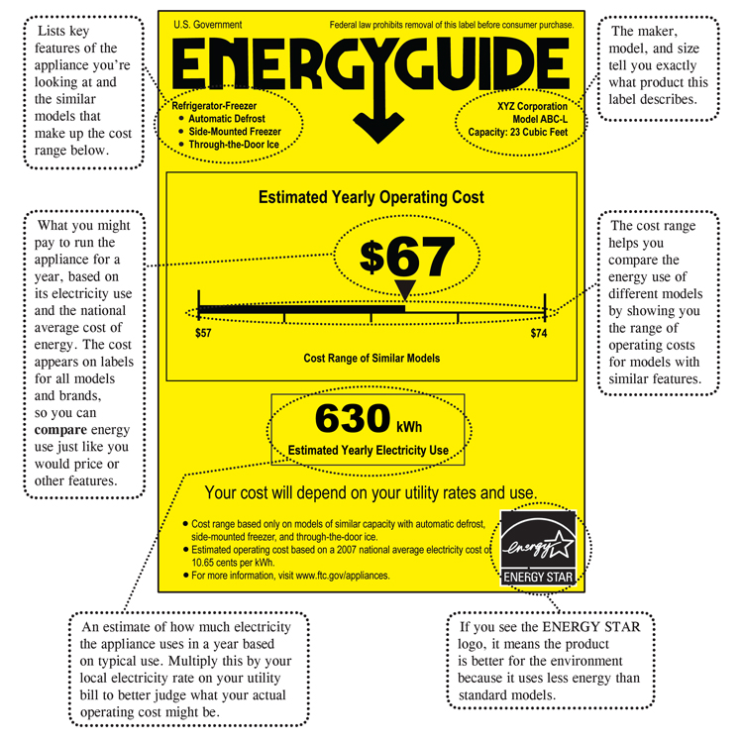

Slide 3
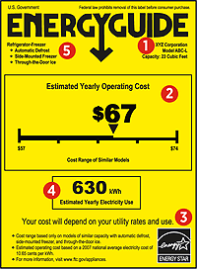
Government Mandated Labels
Collectively, EnergyGuide labels are applied to over 60% of all residential appliances
Accounting for 13% of total U.S. energy consumption
Values based on U.S. Average

Slide 4
Does it work?
Sort of…
Daniel Kahneman (2011) “What you see is all there is?”
  People take in the information without analyzing it carefully.
No additional effort taken to understand what that information means to them or to take into account local conditions.

Slide 5
But how big of a discrepancy is there in energy savings?
Highly dependent on where you live.
Within the lower 48 US states the annual cooling hours range by a 9:1 ratio.
  Annual HVAC costs Washington = $28.00
  Annual HVAC costs Florida = $316.00
All states see the same EnergyGuide label.

Slide 6
U.S. Breakdown

Slide 7
Air conditioner penetration in homes?

Slide 8
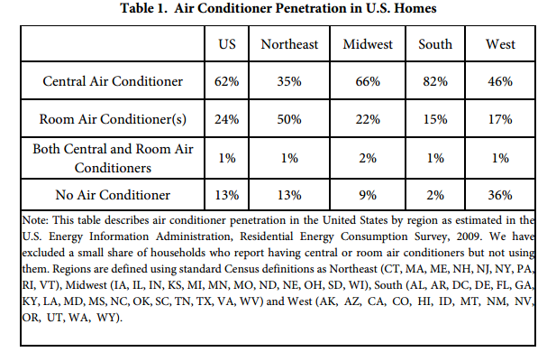

Slide 9
Annual Cooling Hours by state?

Slide 10
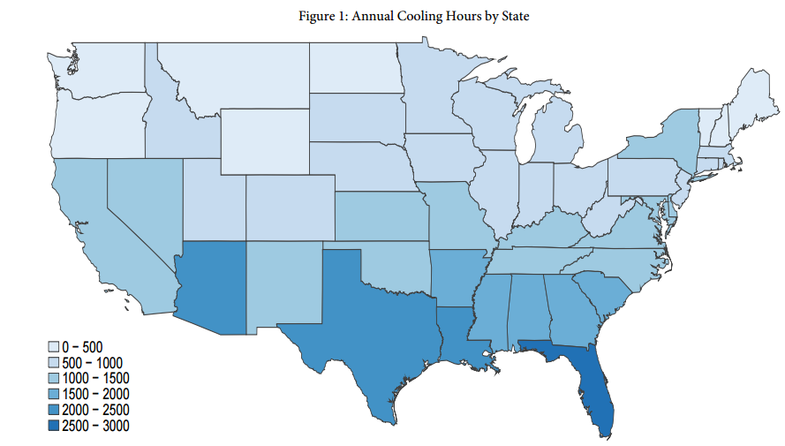

Slide 11
Residential electricity prices by state?

Slide 12
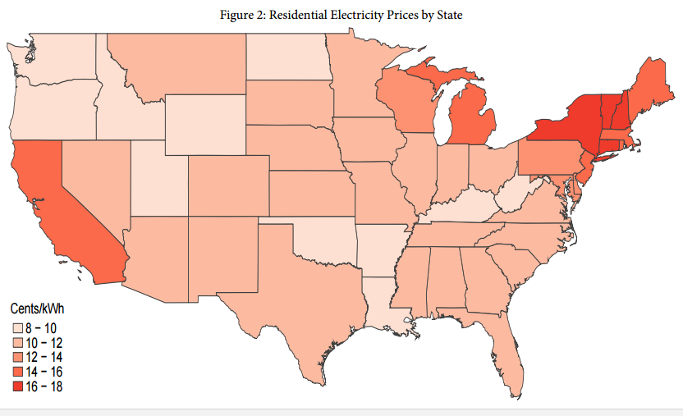

Slide 13
The cost of operating a medium-sized room air conditioner?

Slide 14
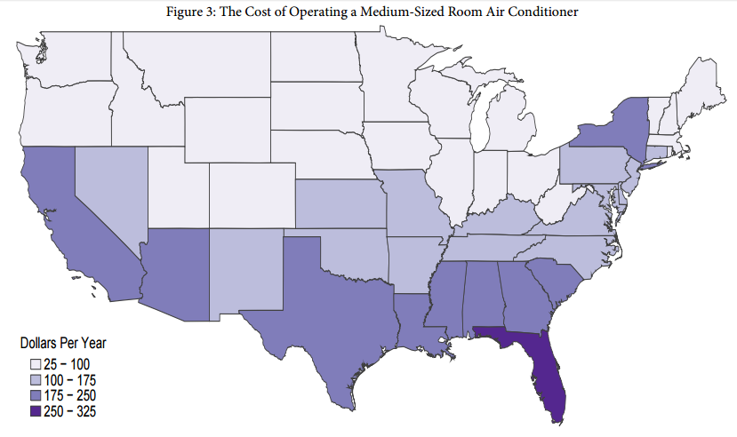

Slide 15
Share of energy star air conditioners sold in 2009?

Slide 16
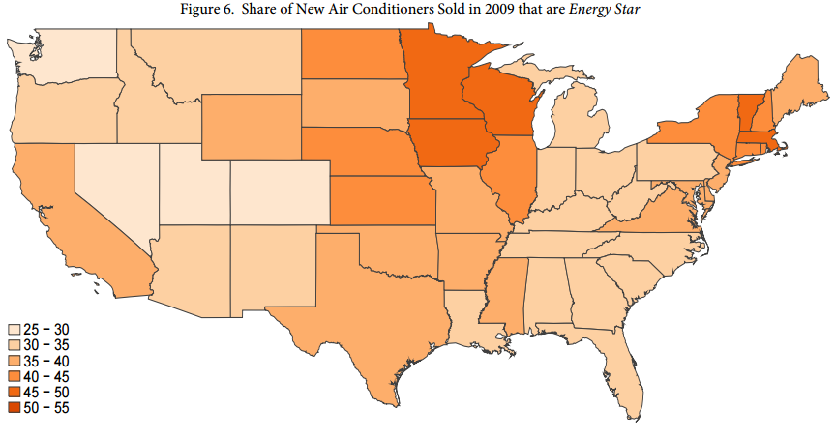

Slide 17
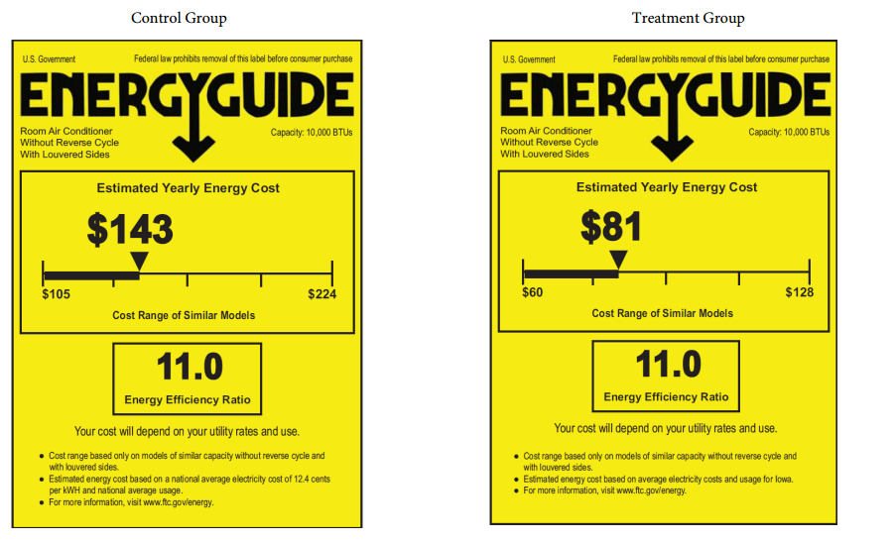
The experiment

Slide 19
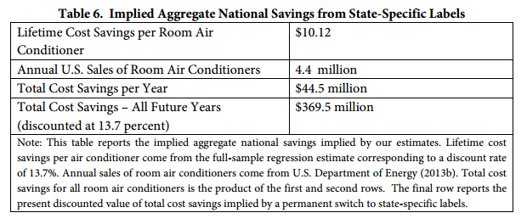
Financial Savings?

Slide 20
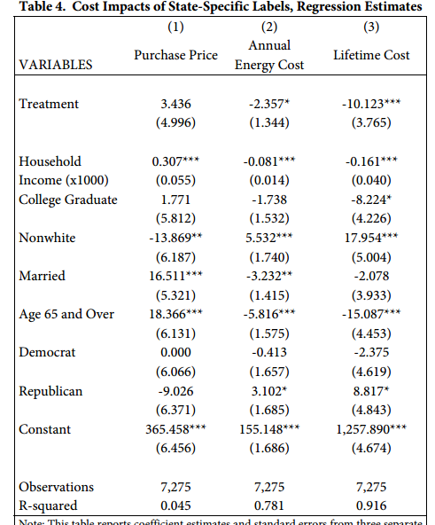
Variation in lifetime costs has more to do with cooling hours and electricity prices than with the energy efficiency of the appliance

Slide 21
Conclusions:
We find that better labels indeed lead to better choices.
The implied savings are larger than the estimated costs of implementing state-specific labels.
In general, providing better information leads energy consumption to decrease in high-cost states but increase in low-cost states.
  Florida savings increased and Maine savings decreased…

Slide 22
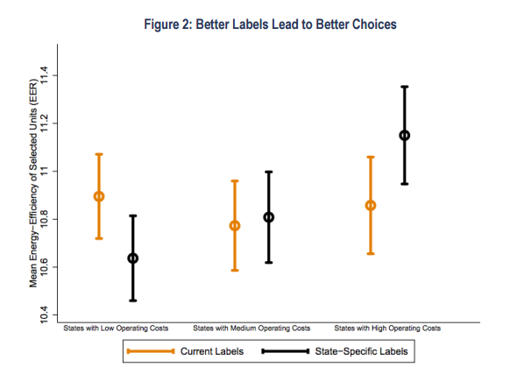

Slide 23
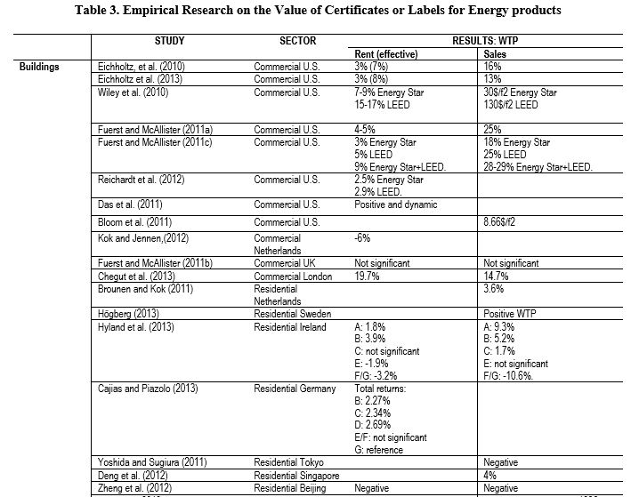

Slide 24
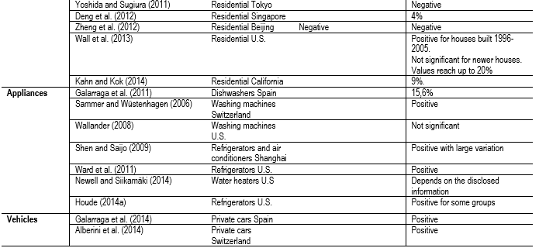

Slide 25

Questions?
Geoff Marke
Economist, Missouri Office of the Public Counsel
Nov. 21, 2016

