Slide 1
The Missouri Office of the Public Counsel’s Opening Statements
Case EO-2023-0277: In the Matter of the Eleventh Prudence Review of Costs Subject to the Commission-Approved Fuel Adjustment Clause of Evergy Missouri West, Inc. d/b/a Evergy Missouri West

Slide 2
Understanding the OPC’s Case
The Logic behind what the OPC is saying

Slide 3
The OPC’s Argument
A prudent electric utility will try to maintain enough generation to regularly meet or exceed the electric load required to serve its customers
This will mitigate exposure to energy market volatility

Slide 4
The Effect of Being in an RTO
An electric utility in an RTO will buy all the energy it requires to serve customers off the RTO energy market
But
The electric utility can also sell the electricity it generates into the RTO energy market to offset or “cover” the cost of the energy that it bought

Slide 5

A Helpful Analogy: Insurance

Slide 9
This is a Longstanding Problem
Evergy West has not been able to meet its customer’s load since before 2008
At that time, Evergy West only had enough generation resources to meet 74% of its customers needs
Evergy West now estimates it can only generate 62% of what was needed

Slide 10
In Millions of Dollars

Slide 11
Summary
Evergy West was imprudent because it did not seek to maintain enough generation to regularly meet or exceed the electric load required to serve its customers
This imprudence has exposed its customers to high market volatility resulting in high energy costs

Slide 12

Evergy West’s Witnesses Support the OPC’s Position

Slide 13
What Evergy West’s own Witnesses Say:
Energy prices in the wholesale market can be volatile and increase the risk of high costs for power purchases to meet load. For energy, these volatile periods are observed in extreme Winter cold periods and in heat waves in the Summer. The reduction in reliance on spot market purchases to meet customer needs increases value to customers through mitigating risk of higher costs.
– John Reed, Chairman and Chief Executive
Officer of Concentric Energy Advisors, Inc.
Direct Testimony, EA-2023-0291, pg. 7 lns. 19 – 23

Slide 14
What Evergy West’s own Witnesses Say:
[T]he forecasted reserve balance in the 2023 IRP is an indication of a current and ongoing energy need for EMW customers. . . . This need for energy can, and has, been met by the wholesale energy market, but this dependence on the energy market can create risk if it is covering a large portion of customer needs for the long-term.
– Kayla Messamore, Evergy Vice President of Strategy and Long-Term Planning
Direct Testimony, EA-2023-0291, pg. 11 ln. 16 – pg. 12 ln. 3

Slide 15
What Evergy West’s own Witnesses Say:
Market purchases can play an important role in a prudent resource mix, but on their own are not a plan but rather are akin to playing Lotto with customers energy supply.
– Darrin Ives, Evergy Vice President
of Regulatory Affairs
Direct Testimony, EO-2023-0277, pg. 14 lns. 14 – 16

Slide 16
There is no Hindsight to this Case
The OPC is relying only on what Evergy West knew long before the prudence period:
  That the Company couldn’t cover its load (known since 2008)
  That RTO energy markets can be volatile (known since markets were created)

Slide 17
Calculating Imprudence
The math behind the OPC’s disallowance

Slide 18
The Impact of this Case in Real Dollars
Net Base Energy Cost (what is included in general rates) = $306,660,121
Actual Net Energy Costs (what was actually incurred) = $510,291,308
Difference (what passes through the FAC) = $203,631,187
  After sharing mechanism and jurisdictional factors = $193,042,150

Slide 19
The Critical Questions
What would customers have needed to pay if Evergy West had acted differently?
This leads to the second question:
What should Evergy West have done differently?

Slide 20
Considering Evergy West’s IRP
Every IRP filed by Evergy West after it was acquired shows the same thing:
– Operating Evergy West and Evergy Metro as a “combined utility” is the plan with the lowest net present value revenue requirement
Is this how Evergy West actually operates?
– No

Slide 21
What the OPC did
The OPC modeled what Evergy West would have paid if it had been combined with Evergy Metro
  Evergy West customers would have paid $164 million less in decreased energy costs during the prudence period
  Evergy West customers would have paid $78 million more in increased capital costs during the prudence period
The OPC’s final recommended disallowance is the difference of these two: $86,376,294

Slide 23
The OPC’s Expert Witnesses
The people you will hear from today

Slide 24
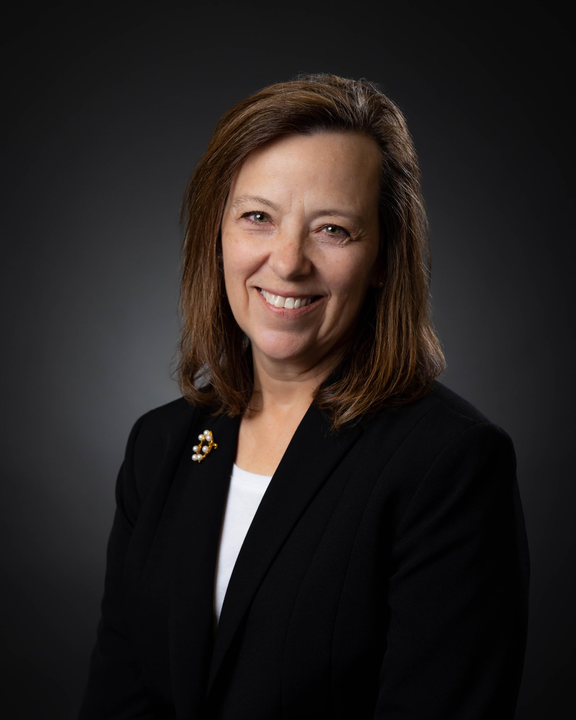
Lena Mantle, PE – Senior Analyst
Professional Engineer with over 40 years of experience working for both Commission Staff and OPC
Heavily involved in drafting the Commission’s rules regarding Electric Utility Resource Planning and author of a whitepaper on the subject
Instrumental in the developing the Commission’s FAC rules and author of a whitepaper on the subject

Slide 25

Dr. Geoff Marke – Chief Economist
15 years experience working in the private sector, the Missouri DOE, the Commission’s Staff, and the OPC
5-year instructor at Michigan State’s Institute of Public Utilities fundamentals course
Presented professional work and opinions at NARUC, NASUCA, MO Bar, Rocky Mountain Institute, ACEEE, Renewable Energy Wildlife Institute, MO SEMA, US AID, CCIF, FRI, NCAP, and Kansas CEBC

Slide 26
In Millions of Dollars

